Slide 1
Building Community
Through Book Clubs
Davina Morgan-Witts
BookBrowse Publisher

Slide 2
Building Community Through Book Clubs
      What those not in book clubs think of them
      Common attributes of happy book groups
      Tips for successful book selection
      Multiple book clubs, minimal involvement
      So much love for library book groups!

Slide 3

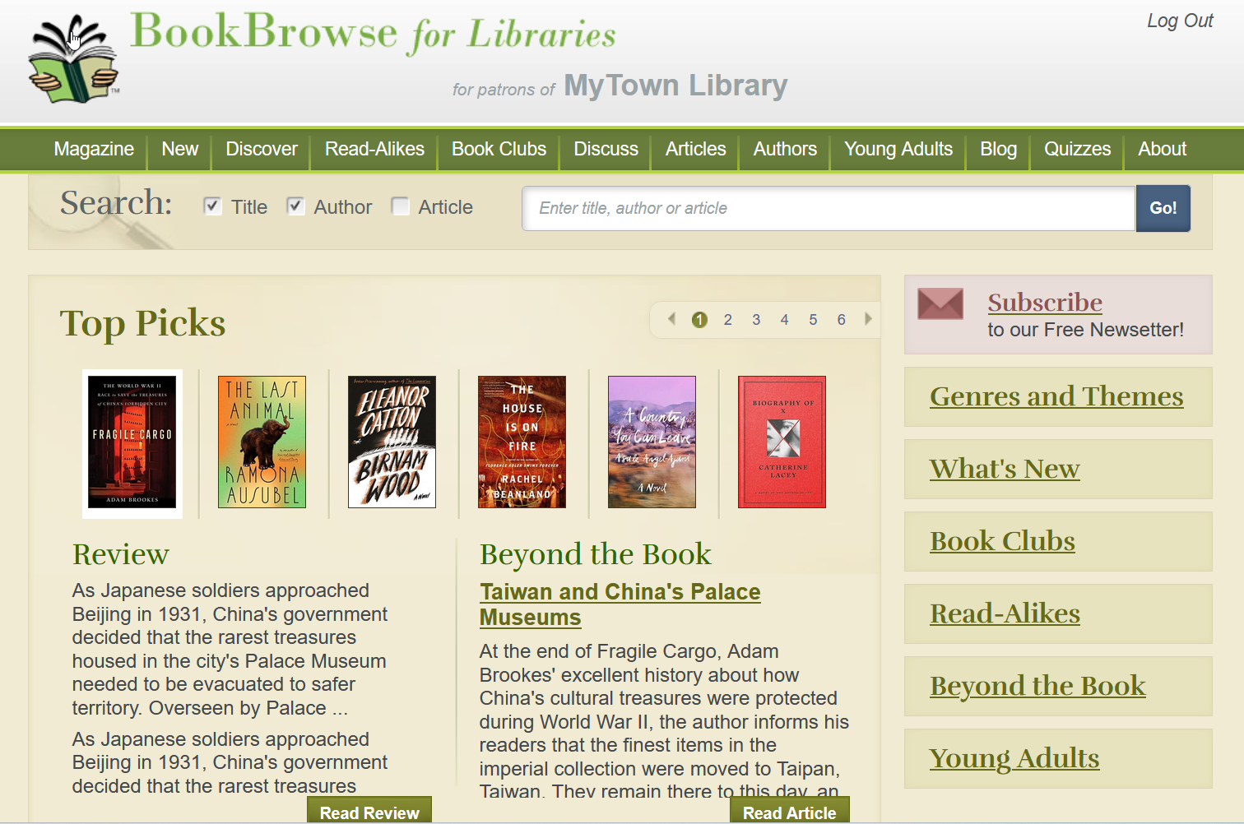
Notes:
Curated resource of contemporary fiction & nonfiction
For book clubbers and those who read to learn/expand their horizons
See bookbrowse.com/lib for features, quotes, free trials etc.

Slide 4
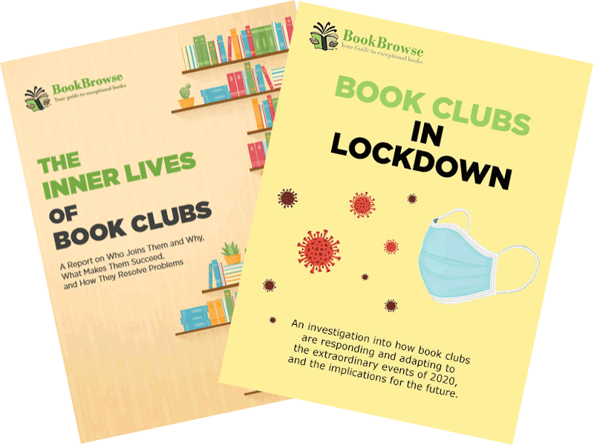
Understanding Book Groups
The Inner Lives of Book Clubs (2019 + updates)
  Two surveys totaling 5,000 book club members
  Plus 500 readers never in a group
Book Clubs in Lockdown (Fall 2020)
  Survey of 3,400 book club members
Ongoing Research over ~20 years
  ~3,000 surveyed annually, in-depth interviews etc.
More info about reports at bookbrowse.com/wp – including links to buy print copies of “Inner Lives,” a useful resource for your reference section.

Slide 5
  What People Think
  of Book Groups

Slide 6
Negative Perceptions
Among Readers Not in a Book Group
Always thought of them as somewhat cliquish women.
Groups of people who meet to socialize and may discuss a book while they're there.
?
They often read books that are not interesting or not challenging enough.
I would be forced to read something I'm not interested in.
You wind up wasting time reading something that’s not your taste, and then having to discuss it just to be with friends.
It seems a bit awkward to have a group where I don't know anyone - especially if the other people are likely to know each other
They read boring literary fiction and talk off-topic

Slide 7
What Those in Book Groups Say
“A vital part of my mental health—my favorite day of the month!”
“It’s a great place to meet people in the community and get to know them through discussions that would not take place in ordinary social gatherings.”
“I meet interesting people with wonderful life experiences and ideas. I read books I never would have picked. I love the mental stimulation.”
“Book club helps me to understand life and myself better. It is great to be with people.”
All members of public library book groups
Source: Inner Lives of Book Clubs

Slide 8
The Pandemic Focused People on
How Much They Love Their Book Club!
30%
“My book club experience is worse than last year”
48%
“My book club is more important to me”
Source: Book Clubs in Lockdown, Fall 2020 Survey
2500 respondents currently meeting with their book group
bookbrowse.com/wp

Slide 9
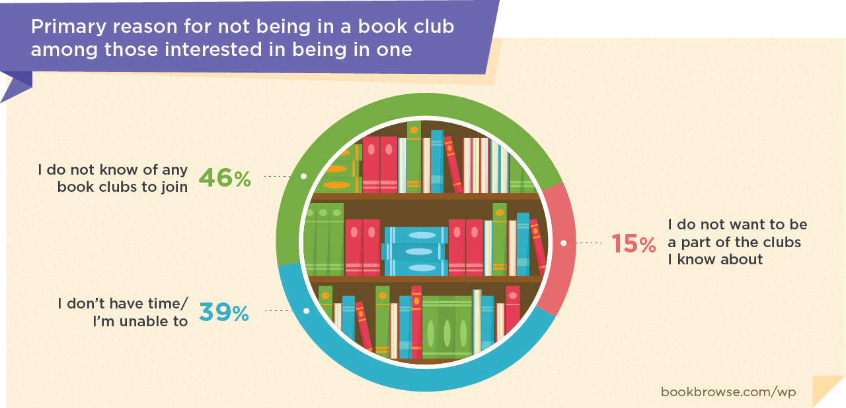
Positive Perception
So, Why Not in a Book Group?
Source: Inner Lives of Book Clubs
Sample 500 readers not in a book club
2019 survey, pre-pandemic

Slide 10
Where Did Your Group Meet in 2022?
Source: Book Club Survey Feb 2023
Sample: 1259 respondents

Slide 11
  Common Attributes of
  Happy Book Groups

Slide 12
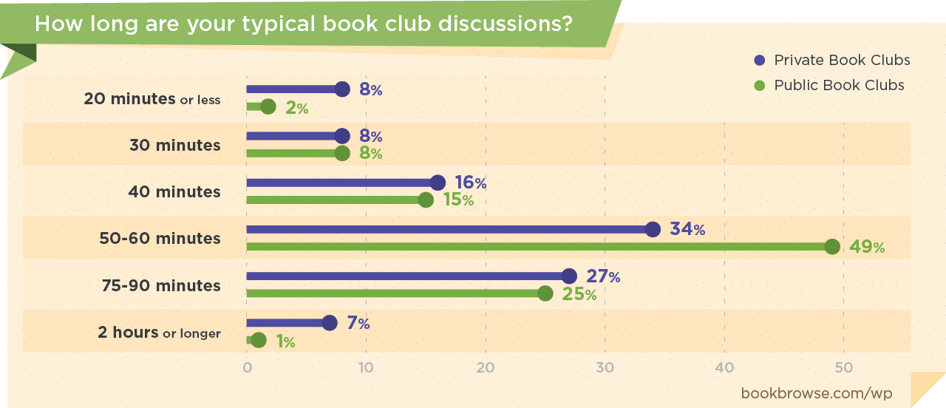
Book Groups Want to Discuss Books!
Source: Inner Lives of Book Clubs
Sample: 1434. bookbrowse.com/wp

Slide 13
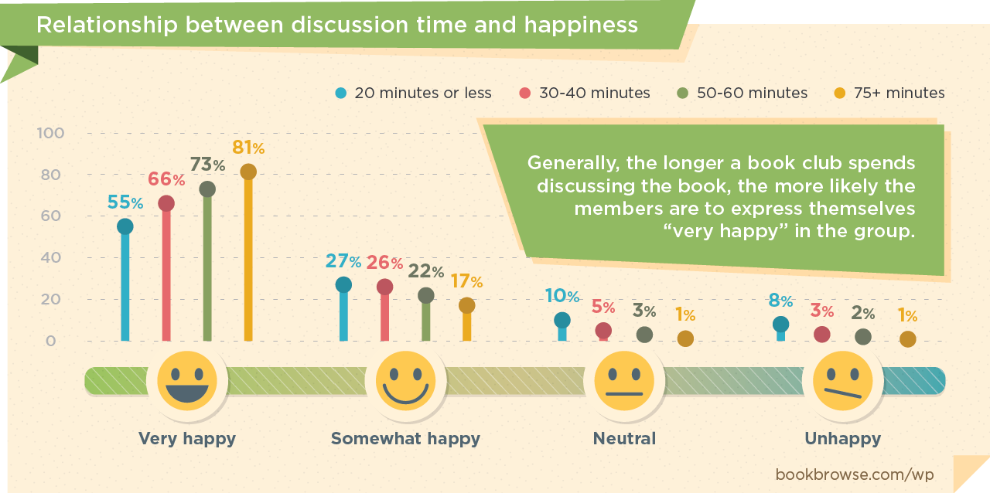
Longer Discussion = Happier Group
Blog post: bookbrowse.com/hbc
Source: Inner Lives of Book Clubs
Sample: 1434. bookbrowse.com/wp

Slide 14
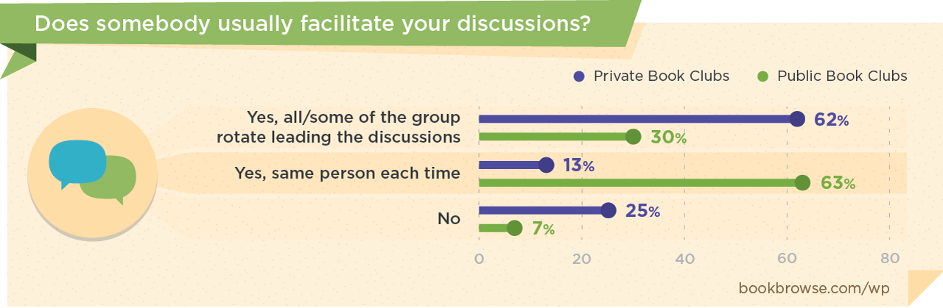
Most Groups Are Facilitated
Facilitated groups tend to be more focused
Source: Inner Lives of Book Clubs
Sample: 2,723. bookbrowse.com/wp

Slide 15
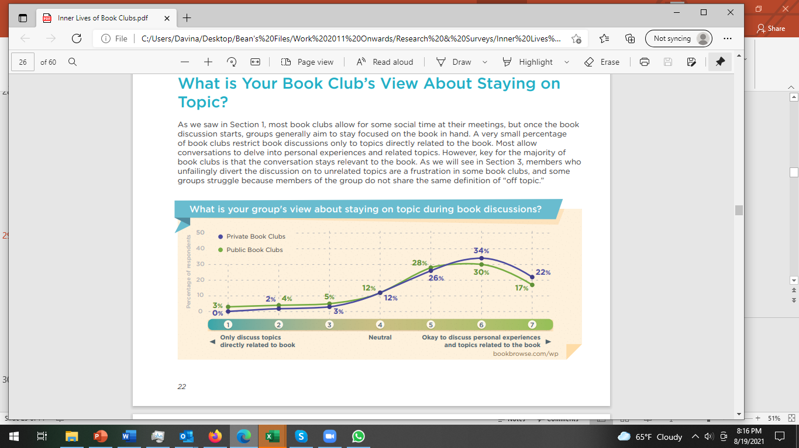
Most Want to Stay on Topic
But What Does “On Topic” Mean?
One-fifth of those who left a book group due to
dissatisfaction said off-topic discussions were a factor
Source: Inner Lives
of Book Clubs
Sample: 2,723
bookbrowse.com/wp

Slide 16


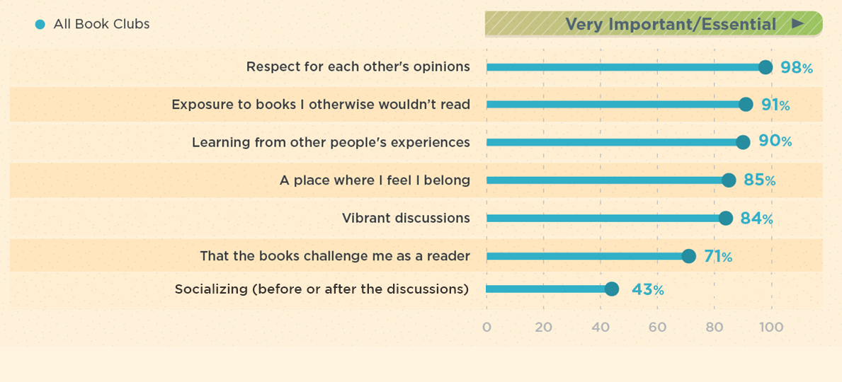
What People in Book Clubs Value
No difference between public and private book group members except for socializing: Important/essential to 43% of those in public groups and 71% of those in private groups
Source: Inner Lives
of Book Clubs

Slide 17
Common Attributes of Happy Book Groups
Allow ample book discussion time
Stay on topic (and agree what “on topic” means)
Respect each others’ opinions
Learn from the book and each other
Vibrant discussions of challenging books
Discussions are facilitated
Set expectations and discuss issues

Slide 18
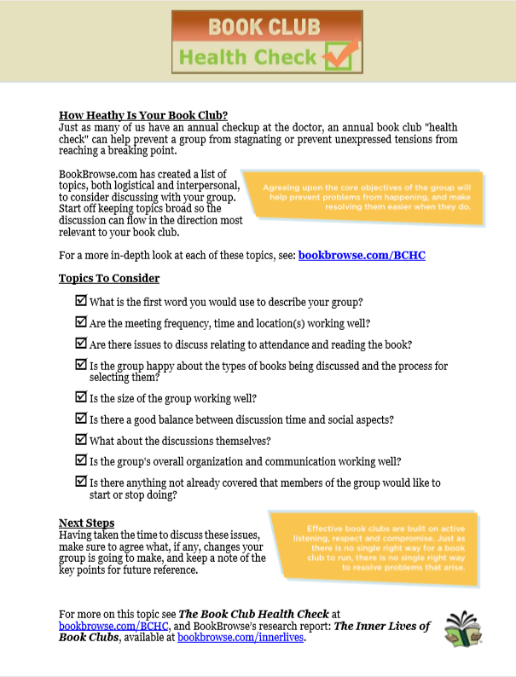
Of those who left a book club
due to dissatisfaction:
62% stayed at least a year.
37% stayed at least 3 years
bookbrowse.com/bchc

Slide 19
      Book Selection

Slide 20
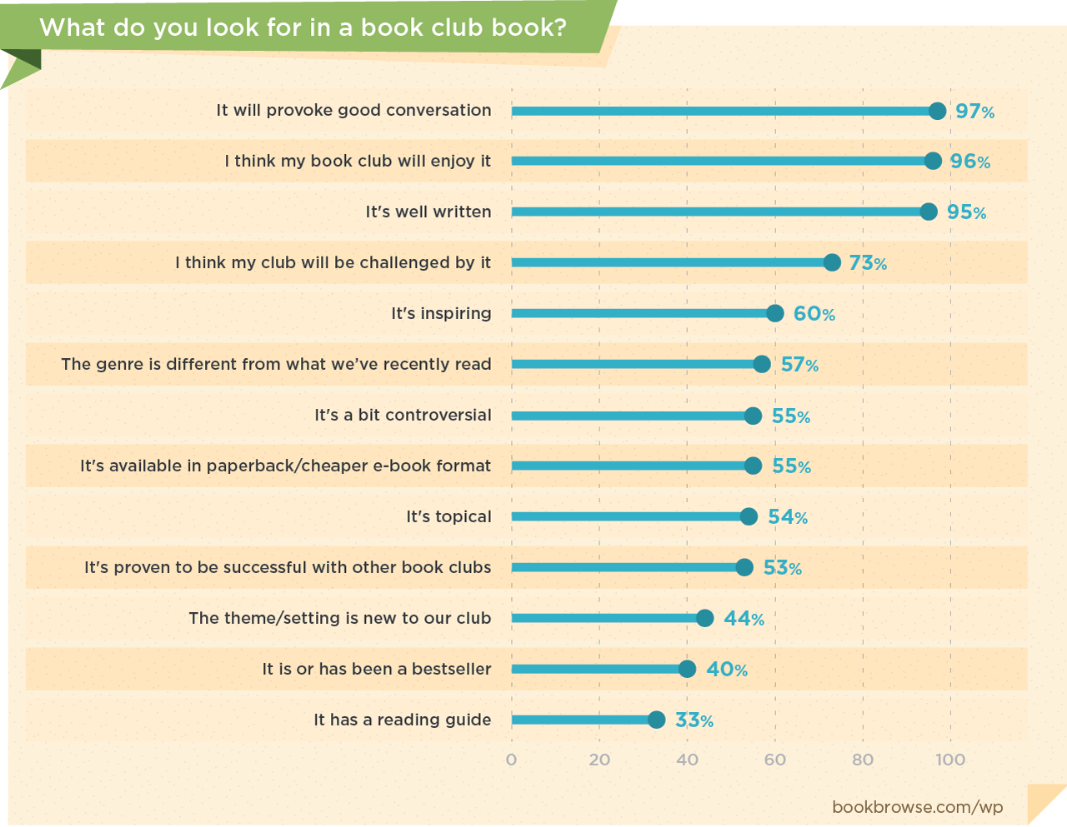

Book Selection
Factors Book Clubbers Consider
Source: Inner Lives of Book Clubs
Sample: 2,723
bookbrowse.com/wp

Slide 21
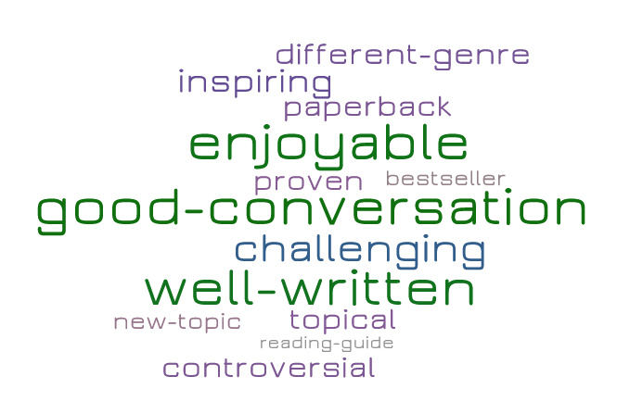
Book Selection
Guiding Book Selection
Consider these factors in your own choices
Provide reassurance/
reliable sources
Gently push comfort zone
bookbrowse.com/pick

Slide 22
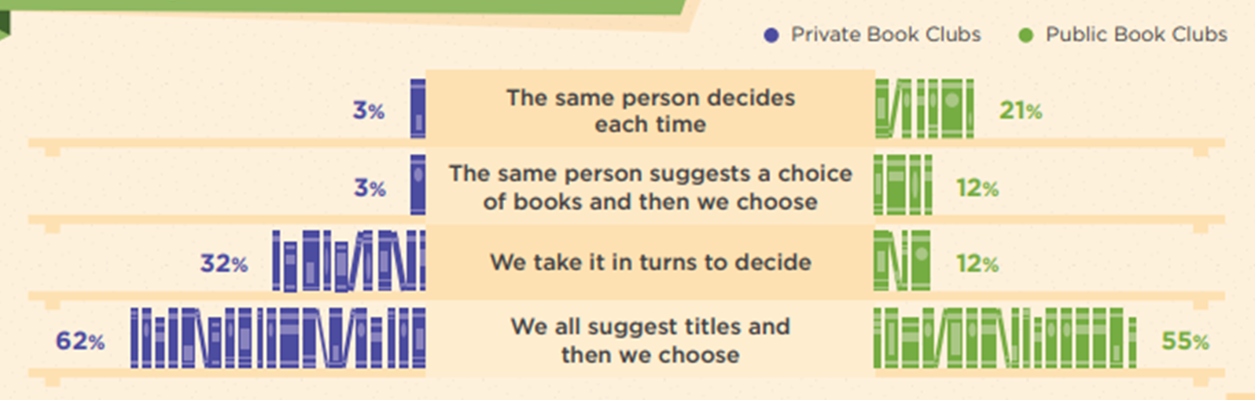
11668 | Everybody who has ever read a book will benefit from the way Keith Houston explores the most powerful object of our time. And everybody who has read ... https://www.bookbrowse.com/bb_briefs/detail/index.cfm/ezine_preview_number/11668 Keith Houston
11667 | Seven Skeletons The Evolution of the World's Most Famous Human Fossils An irresistible journey of discovery, science, history, and myth making, told through the lives and afterlives of seven famous human ancestors.... https://www.bookbrowse.com/bb_briefs/detail/index.cfm/ezine_preview_number/11667 Lydia Pyne
11645 | And Soon I Heard a Roaring Wind A Natural History of Moving Air A thrilling exploration of the science and history of wind from the bestselling author of <i>Cold.</i>... https://www.bookbrowse.com/bb_briefs/detail/index.cfm/ezine_preview_number/11645 Bill Streever
11629 | Grunt The Curious Science of Humans at War Best-selling author Mary Roach explores the science of keeping human beings intact, awake, sane, uninfected, and uninfested in the bizarre and extreme... https://www.bookbrowse.com/bb_briefs/detail/index.cfm/ezine_preview_number/11629 Mary Roach
11619 | Tong Wars The Untold Story of Vice, Money, and Murder in New York's Chinatown A mesmerizing true story of money, murder, gambling, prostitution, and opium: the Chinese gang wars that engulfed New York's Chinatown from the 1890s ... https://www.bookbrowse.com/bb_briefs/detail/index.cfm/ezine_preview_number/11619 Scott D. Seligman
11594 | The Universe in Your Hand A Journey Through Space, Time, and Beyond Utterly captivating and entirely unique, <i>The Universe in Your Hand</i> will find its place among other classics in the field.... https://www.bookbrowse.com/bb_briefs/detail/index.cfm/ezine_preview_number/11594 Christophe Galfard
11591 | The Perfect Horse The Daring U.S. Mission to Rescue the Priceless Stallions Kidnapped by the Nazis The remarkable story of the heroic rescue of priceless horses in the closing days of World War II.... https://www.bookbrowse.com/bb_briefs/detail/index.cfm/ezine_preview_number/11591 Elizabeth Letts
11577 | Les Parisiennes How the Women of Paris Lived, Loved, and Died Under Nazi Occupation New York Times bestselling author Anne Sebba explores a devastating period in Paris's history and tells the stories of how women survived - or didn't ... https://www.bookbrowse.com/bb_briefs/detail/index.cfm/ezine_preview_number/11577 Anne Sebba
11574 | The Glamour of Strangeness Artists and the Last Age of the Exotic Drawing on his own career as a travel writer and years of archival research uncovering previously unpublished letters and journals, James creates a pe... https://www.bookbrowse.com/bb_briefs/detail/index.cfm/ezine_preview_number/11574 Jamie James
11573 | Now I Sit Me Down From Klismos to Plastic Chair: A Natural History Have you ever wondered where rocking chairs came from, or why cheap plastic chairs are suddenly everywhere?... https://www.bookbrowse.com/bb_briefs/detail/index.cfm/ezine_preview_number/11573 Witold Rybczynski
11562 | White Trash The 400-Year Untold History of Class in America In her groundbreaking history of the class system in America, extending from colonial times to the present, Nancy Isenberg takes on our comforting myt... https://www.bookbrowse.com/bb_briefs/detail/index.cfm/ezine_preview_number/11562 Nancy Isenberg
11560 | The Lynching The Epic Courtroom Battle That Brought Down the Klan The powerful and spellbinding true story of a brutal race-based killing in 1981 and subsequent trials that undid one of the most pernicious organizati... https://www.bookbrowse.com/bb_briefs/detail/index.cfm/ezine_preview_number/11560 Laurence Leamer
11543 | Secondhand Time The Last of the Soviets The magnum opus and latest work from Svetlana Alexievich, the 2015 winner of the Nobel Prize in Literature - a symphonic oral history about the disint... https://www.bookbrowse.com/bb_briefs/detail/index.cfm/ezine_preview_number/11543 Svetlana Alexievich (Author), Bela Shayevich (Translator)
11531 | Black Flags The Rise of ISIS In a thrilling dramatic narrative, Pulitzer Prize-winning reporter Joby Warrick traces how the strain of militant Islam behind ISIS first arose in a r... https://www.bookbrowse.com/bb_briefs/detail/index.cfm/ezine_preview_number/11531 Joby Warrick
11513 | But What If We're Wrong? Thinking About the Present As If It Were the Past Built on interviews with leading creative thinkers Chuck Klosterman examines today's certainties with the assumption they will be proven wrong in the ... https://www.bookbrowse.com/bb_briefs/detail/index.cfm/ezine_preview_number/11513 Chuck Klosterman
11463 | The Morning They Came For Us Dispatches from Syria Once in a decade comes an account of war that promises to be a classic.... https://www.bookbrowse.com/bb_briefs/detail/index.cfm/ezine_preview_number/11463 Janine di Giovanni
11454 | Oneida From Free Love Utopia to the Well-Set Table A fascinating and unusual chapter in American history about a religious community that held radical notions of equality, sex, and religion - only to t... https://www.bookbrowse.com/bb_briefs/detail/index.cfm/ezine_preview_number/11454 Ellen Wayland-Smith
11446 | The Gene An Intimate History From the Pulitzer Prize-winning, bestselling author of <i>The Emperor of All Maladies</i> - a magnificent history of the gene and a response to the de... https://www.bookbrowse.com/bb_briefs/detail/index.cfm/ezine_preview_number/11446 Siddhartha Mukherjee
11444 | Dreamland The True Tale of America's Opiate Epidemic In 1929, in the blue-collar city of Portsmouth, Ohio, a company built a swimming pool the size of a football field; named Dreamland, it became the vit... https://www.bookbrowse.com/bb_briefs/detail/index.cfm/ezine_preview_number/11444 Sam Quinones
11424 | The Winter Fortress The Epic Mission to Sabotage Hitler's Atomic Bomb From the internationally acclaimed, best-selling author of <I>Hunting Eichmann</I> and <I>The Perfect Mile</I>, an epic adventure and spy story about ... https://www.bookbrowse.com/bb_briefs/detail/index.cfm/ezine_preview_number/11424 Neal Bascomb
11422 | The Secret War Spies, Ciphers, and Guerrillas, 1939-1945 Examining the espionage and intelligence stories of World War II, on a global basis, bringing together the British, American, German, Russian and Japa... https://www.bookbrowse.com/bb_briefs/detail/index.cfm/ezine_preview_number/11422 Max Hastings
11419 | The Edge of the Empire A Journey to Britannia: From the Heart of Rome to Hadrian's Wall An epic narrative journey from Rome to Hadrian's Wall - in the empire's northwestern frontier - brings vividly to life the colors, smells, sounds, and... https://www.bookbrowse.com/bb_briefs/detail/index.cfm/ezine_preview_number/11419 Bronwen Riley
11413 | Elizabeth The Forgotten Years A groundbreaking reconsideration of our favorite Tudor queen, <i>Elizabeth</i> is an intimate and surprising biography that shows her at the height of... https://www.bookbrowse.com/bb_briefs/detail/index.cfm/ezine_preview_number/11413 John Guy
11411 | Chain of Title How Three Ordinary Americans Uncovered Wall Street's Great Foreclosure Fraud In the depths of the Great Recession, a cancer nurse, a car dealership worker, and an insurance fraud specialist helped uncover the largest consumer c... https://www.bookbrowse.com/bb_briefs/detail/index.cfm/ezine_preview_number/11411 David Dayen
11405 | The Last Goodnight A World War II Story of Espionage, Adventure, and Betrayal The New York Times bestselling author of the acclaimed <i>Dark Invasion</i>, channels Erik Larson and Ben Macintyre in this riveting biography of Bett... https://www.bookbrowse.com/bb_briefs/detail/index.cfm/ezine_preview_number/11405 Howard Blum
11404 | The Gunning of America Business and the Making of American Gun Culture In this provocative and deeply-researched work of narrative history, Haag fundamentally revises the history of arms in America, and in so doing explod... https://www.bookbrowse.com/bb_briefs/detail/index.cfm/ezine_preview_number/11404 Pamela Haag
11403 | SPQR A History of Ancient Rome A sweeping, revisionist history of the Roman Empire from one of our foremost classicists.... https://www.bookbrowse.com/bb_briefs/detail/index.cfm/ezine_preview_number/11403 Mary Beard
11397 | Here Comes Exterminator! The Longshot Horse, the Great War, and the Making of an American Hero The father of the Kentucky Derby called him the greatest all-around Thoroughbred in American racing history." Sportswriter Grantland Rice simply call...
11862 | In Wartime Stories from Ukraine From one of the finest journalists of our time comes a definitive, boots-on-the-ground dispatch from the front lines of the conflict in Ukraine.... https://www.bookbrowse.com/bb_briefs/detail/index.cfm/ezine_preview_number/11862 Tim Judah
11840 | Bolshoi Confidential Secrets of the Russian Ballet from the Rule of the Tsars to Today An enthralling, definitive new history of the Bolshoi Ballet, where visionary performances onstage compete with political machinations backstage.... https://www.bookbrowse.com/bb_briefs/detail/index.cfm/ezine_preview_number/11840 Simon Morrison
11815 | Blood & Sand Suez, Hungary, and Sixteen Days of Crisis That Changed the World Essential to our understanding of the modern Middle East, <i>Blood and Sand </i> resonates powerfully with the problems of oil control, religious fund... https://www.bookbrowse.com/bb_briefs/detail/index.cfm/ezine_preview_number/11815 Alex Von Tunzelmann
11807 | Human Evolution Our Brains and Behavior The story of human evolution has fascinated us like no other: we seem to have an insatiable curiosity about who we are and where we have come from. Ye... https://www.bookbrowse.com/bb_briefs/detail/index.cfm/ezine_preview_number/11807 Robin Dunbar
11805 | Uprooted The Japanese American Experience During World War II On the 75th anniversary of the bombing of Pearl Harbor comes a harrowing and enlightening look at the internment of Japanese Americans during World Wa... https://www.bookbrowse.com/bb_briefs/detail/index.cfm/ezine_preview_number/11805 Albert Marrin
11804 | The Word Detective Searching for the Meaning of It All at the Oxford English Dictionary A brilliant expedition through the world of words, <i>The Word Detective </i>will delight, inspire, and educate any lover of language.... https://www.bookbrowse.com/bb_briefs/detail/index.cfm/ezine_preview_number/11804 John Simpson
11776 | Truevine Two Brothers, a Kidnapping, and a Mother's Quest: A True Story of the Jim Crow South The true story of two African-American brothers who were kidnapped and displayed as circus freaks, and whose mother endured a 28-year struggle to get ... https://www.bookbrowse.com/bb_briefs/detail/index.cfm/ezine_preview_number/11776 Beth Macy
11753 | The Fall of Heaven The Pahlavis and the Final Days of Imperial Iran An immersive, gripping account of the rise and fall of Iran's glamorous Pahlavi dynasty, written with the cooperation of the late Shah's widow, Empres... https://www.bookbrowse.com/bb_briefs/detail/index.cfm/ezine_preview_number/11753 Andrew Scott Cooper
11751 | Tastes Like Chicken A History of America's Favorite Bird From the domestication of the bird nearly ten thousand years ago to its current status as our go-to meat, the history of this seemingly commonplace bi... https://www.bookbrowse.com/bb_briefs/detail/index.cfm/ezine_preview_number/11751 Emelyn Rude
11743 | Company Confessions Secrets, Memoirs, and the CIA A fascinating, readable work." - Robert Wallace, coauthor of<i> Spycraft</i> and <i>The Official CIA Manual of Trickery and Deception</i>...
Book Selection
How Book Clubs Choose Books
Book selection was a factor for 26% of those who
left a book club due to dissatisfaction.
Source: Inner Lives of Book Clubs
Sample: 2,723.
bookbrowse.com/wp

Slide 23
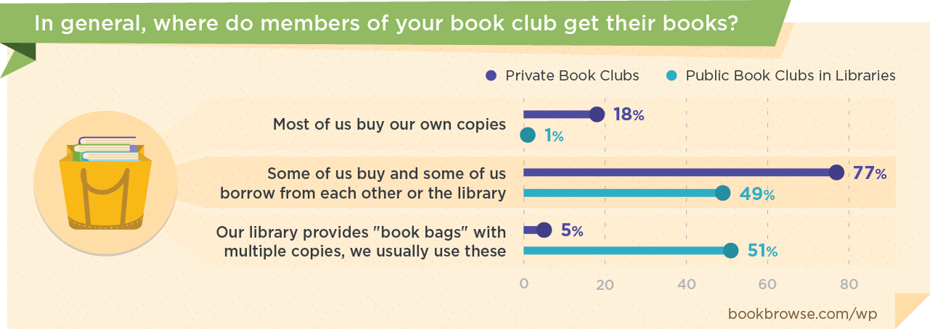
Utilizing Book Club Kits
Private Books Clubs vs Public Groups
Source: Inner Lives of Book Clubs
Sample: 2,723. bookbrowse.com/wp

Slide 24
Supporting Multiple Book Clubs
with lots of—or minimal—involvement

Slide 25
Running Multiple Groups With Lots of Involvement!
Darien Library, CT (23k population)
Works with local groups (e.g. YMCA, museum) to get them established.
Books in a bag, only available to registered book groups (approx. 100).
“Book talking” – meetings with individual groups seasonally to pick books.
Author events + Periodic workshops, e.g. “how to lead a better book discussion.”
Monthly newsletter and dedicated webpage.
Approx. 30 hours/week split between two staff; plus team events
Darien Library, CT (23k population)
bookbrowse.com/dbc
Works with local groups (e.g. YMCA, museum) to get them established.
Books in a bag, only available to registered book groups (approx. 100).
“Book talking” – meetings with individual groups seasonally to pick books.
Author events + Periodic workshops, e.g. “how to lead a better book discussion.”
Monthly newsletter and dedicated webpage.
Approx. 30 hours/week split between two staff; plus team events.
bookbrowse.com/dbc

Slide 26
Running Multiple Groups With Minimal Involvement
Delegate – book selection and moderation usually by others (not staff).
Collaborate – co-sponsor with local groups, support individuals with ideas.
Multi-locate – bookstore, café, bar, community center etc.
Promote – website, newsletter, in-store; compelling descriptions.
Experiment – try new themes, don’t get attached.
Thanks to sweet pea Flaherty of King’s Books, Tacoma, Washington
who runs 12 book clubs with just one permanent employee—himself!

Slide 27
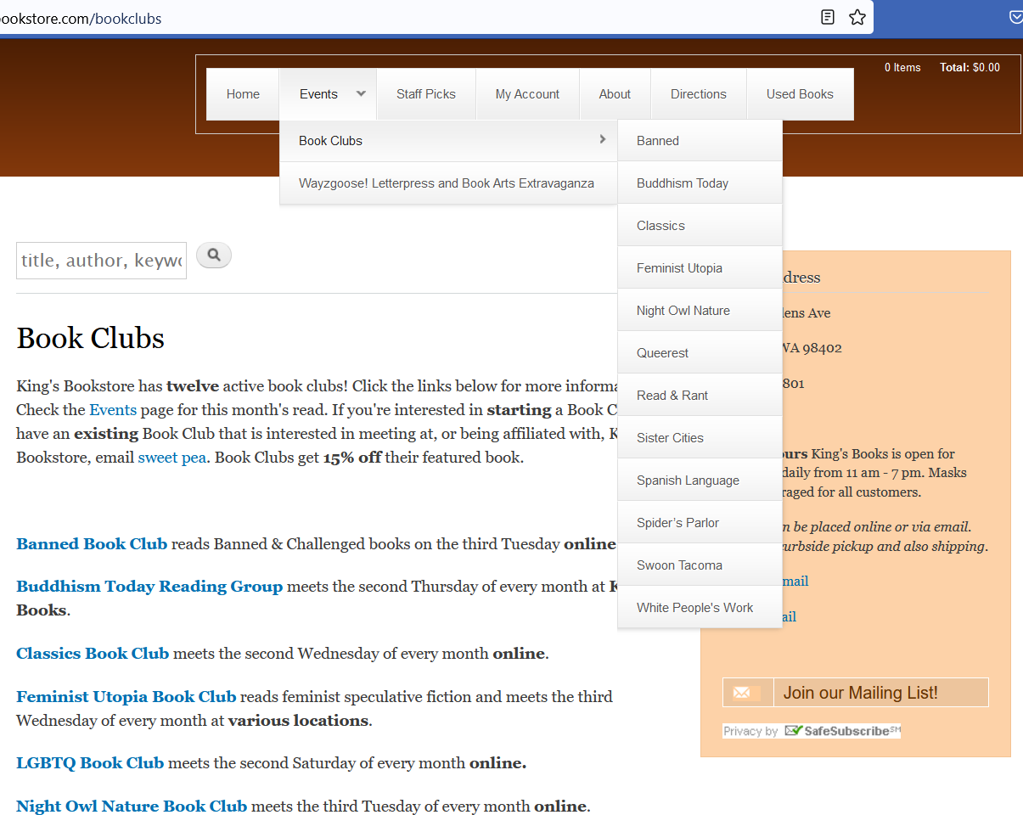

kingsbookstore.com

Slide 28
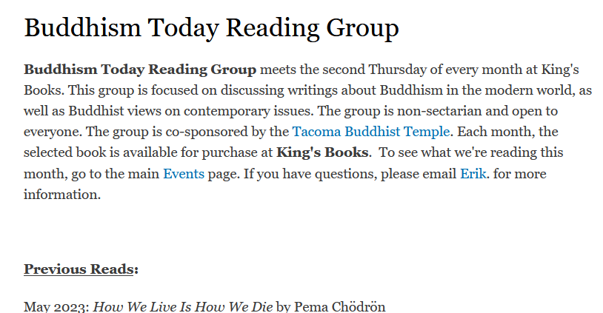
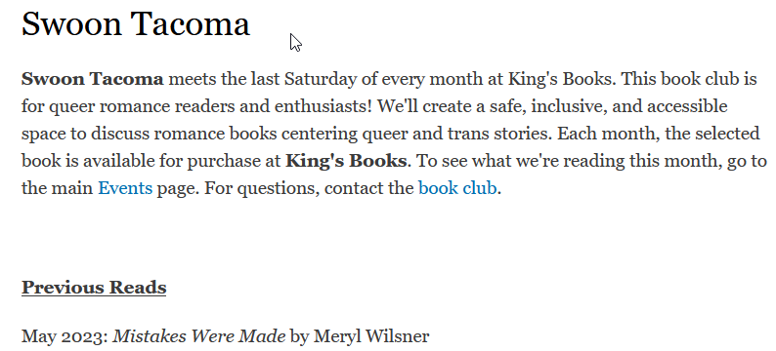
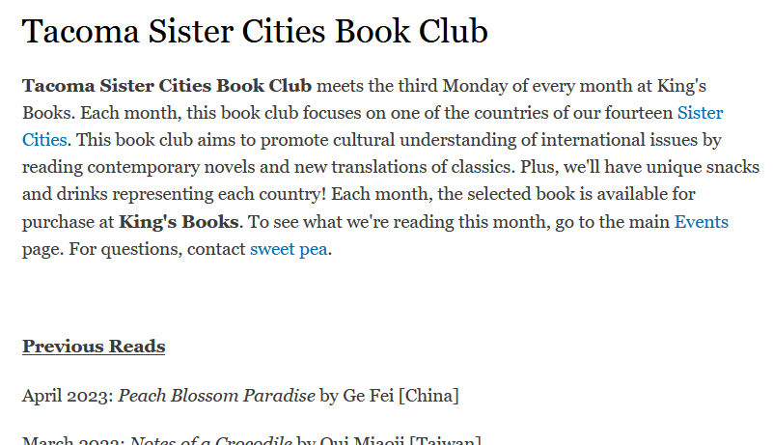
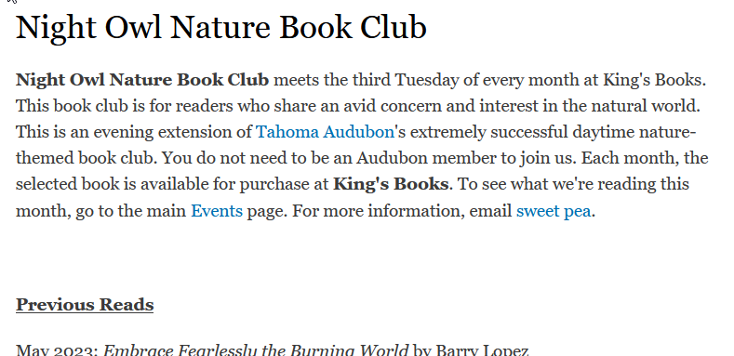
Currently Dormant: Self-Help, Comics and Pizza (now run by comic store), Sword & Laser, Cult Classics, Food Justice, Graphic Novel, Literary Medicine, Poetry, Reading for Writers, Shakespeare, Vegan etc.

Slide 29
      So Much Love for Library Book Clubs!

Slide 30
Public Book Groups Are Preferred!
Sample: People not currently in a book club who would like to be in one
Where: 50% prefer public location (café or library)
(30% private, 20% online*)
How Many: 8 – 12 people
Participants: Diverse
Discussion vs Social: Discussion!
Food & Drink: Low Key
*Pre-pandemic, so most who responded “online” probably had in mind a discussion forum
Source: Inner Lives of Book Clubs
Sample: 2,723. bookbrowse.com/wp

Slide 31
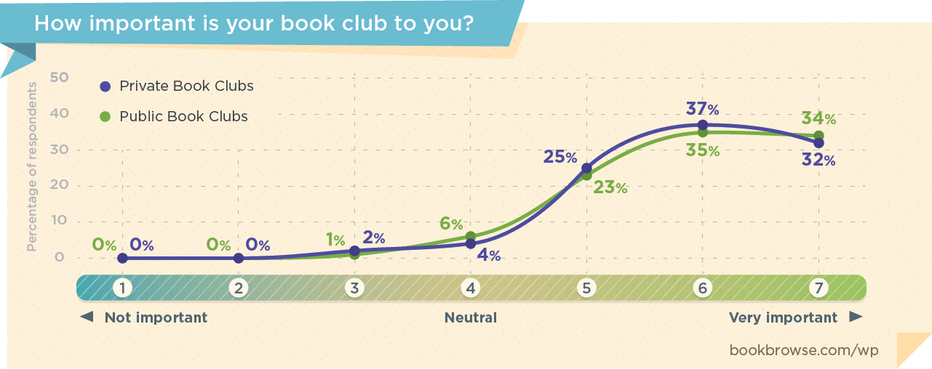
Public Library Book Groups Are Important!
5+ Years in Book Club
71% in private groups
58% in public groups

Slide 32
      Extra Charts Added After the Webinar, so as to Provide Information on Topics Discussed During the Q&A

Slide 33
Discussing Tough Topics
“Guide to Respectful Conversations” (Repair the World)
“How to Have a Respectful Conversation About Racial Justice” (AARP)
“Facilitating Difficult Race Discussions” (Wiley)
Summarized from Race Talk and the Company of Silence by Derald Wing Sue, PhD
Acknowledge that you/others might have discomfort
Establish ground rules
Use “I” statements
Be respectful of introverts – and of silence
Provide space for everyone to have a voice
Avoid “right” and “wrong”
Take a breath before responding
Be intentional with language
Keep power dynamics in mind
We all make mistakes
Use facts graciously, not to shut down
If you’re offended, consider some options
Blog post: bookbrowse.com/race

Slide 34
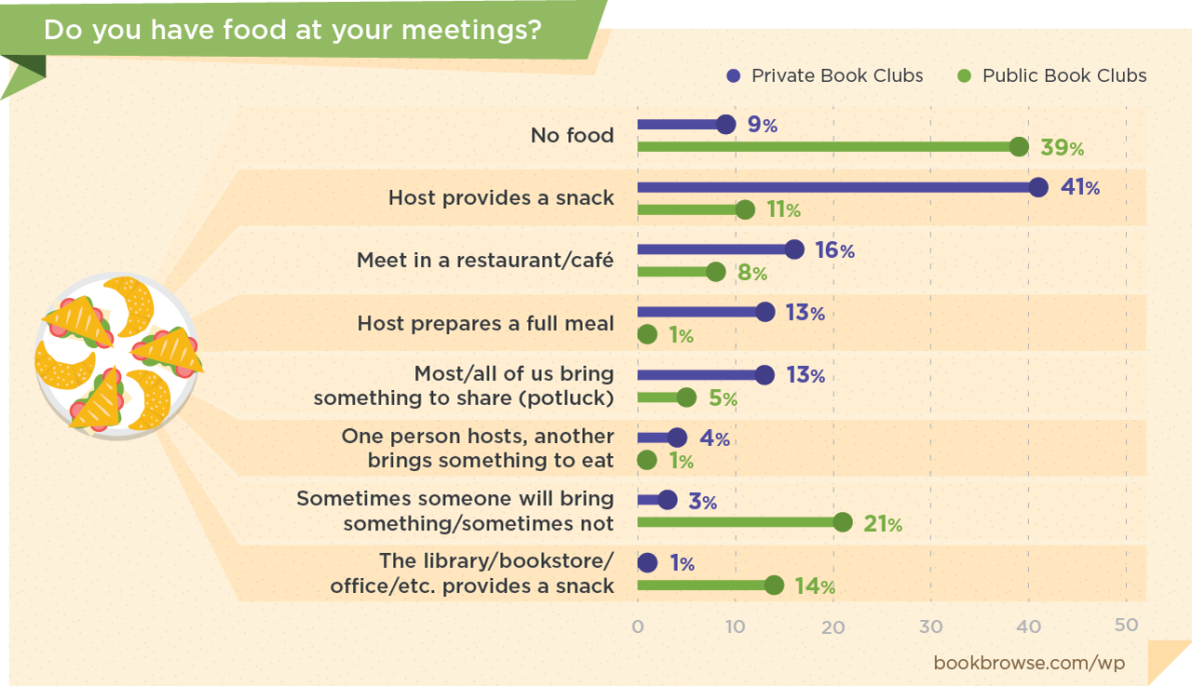
Most Prefer Food (and Hosting) to be Low-key
Two posts on food (one linked from the other): bookbrowse.com/food

Slide 35
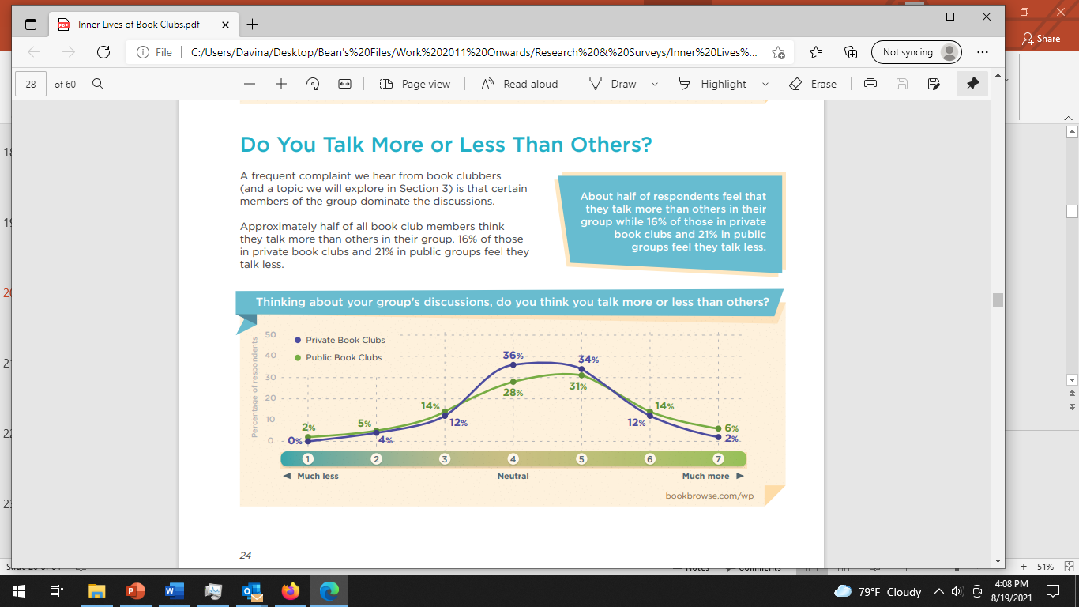
  Overly Dominant Personalities
ODPs were a factor for 38% who left because they were unhappy.
Tips:
Take turns choosing books
Designate a facilitator
Time keeping device
Talk to the ODP(s)
Recognize trait in yourself
Blog post: bookbrowse.com/ODP
2019 Survey: 4,240 of which 2,723 currently in one or more book groups and 1,581 had been in a book group in the past.

Slide 36
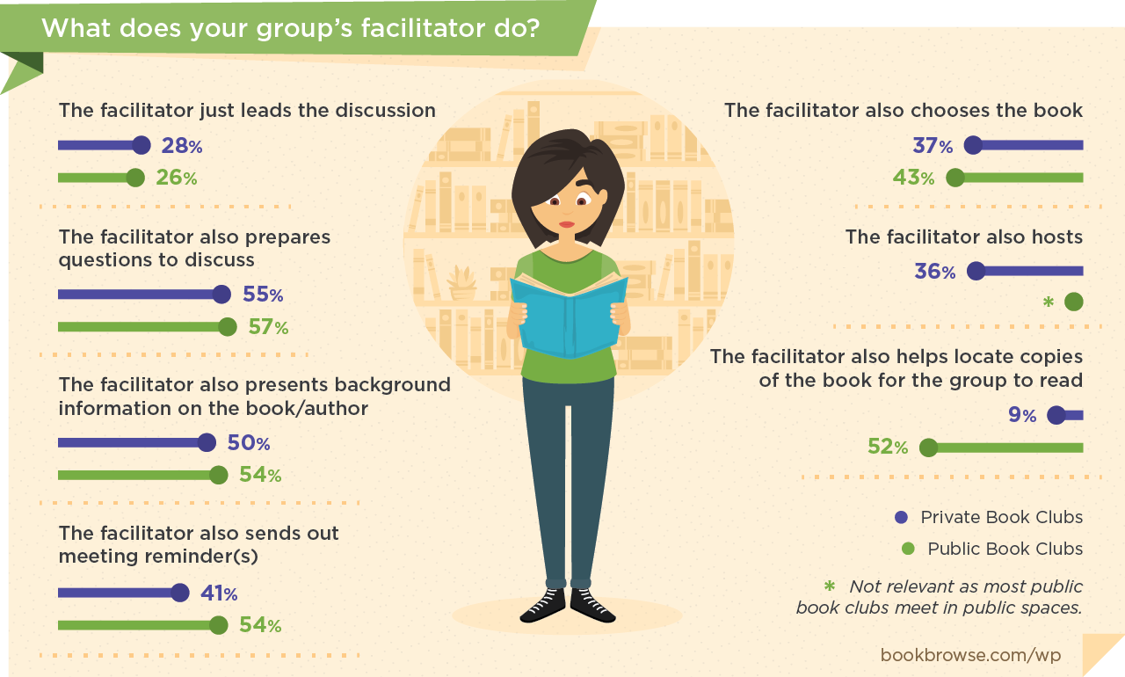
Facilitators Wear Many Hats!
Blog post: bookbrowse.com/facil
Also, see links at the bottom of this post to info on Zoom meetings

Slide 37
Tips for Facilitating a Meeting
Facilitate, don’t dominate
Quiet the loud and call on the quiet
Discourage side discussions
Refocus off-topic tangents
Move the topic on if necessary
Have some topics prepared, but be flexible
Note (some) key pages as you read
Wrap up

Slide 38
Discussions
Tips for Facilitating Virtual Discussions
Get comfortable with Zoom (Google: “Zoom live training webinars”)
Open meeting a few minutes early, run through meeting protocols
(muting/background noise, camera position, one at a time, indicating wish to talk)
Facilitate somewhat more actively
Embrace Zoom’s strengths
  Fewer side discussions, more focus.
  Can be easier for quieter members
  Interruptions – pets and children – can enrich the experience
  Inviting authors
See the links at the bottom of bookbrowse.com/facil
to Pros and Cons of Zoom Book Clubs Parts 1 & 2

Slide 39
BookBrowse for Libraries
bookbrowse.com/niche—for info, quotes, free trial
Reader-focused, easy to use, from anywhere, any device
Automatic one-click login to any page for remote patrons
(start browsing immediately, log-in fully later without losing place)
Apps for library site (e.g. read-alikes), free print materials etc.
Dynamic links to relevant search result in library OPAC
Sample rates (including 10% Niche Academy discount, until 7/1/23)
      9k service population = $405/yr
      49k service population = $963/yr
      174k service population = $1935/yr
A sample of current subscribers: Greenville County, SC | Jefferson County, CO
Prince William County, VA | Onondaga County, NY | Alameda, CA | Calcasieu, LA | Leon County, FL

Slide 40
Thank You!
Davina Morgan-Witts, Publisher
davina.witts@bookbrowse.com
direct: 408-867 6500
About BookBrowse for Libraries & 10% Saving
bookbrowse.com/niche
mention Niche Academy, offer ends July 1, 2023

