Slide 1
Cultivating and Sustaining the Relationship-Driven Library
February 14, 2024
Welcome Day-Spring 2020
Noah Lenstra
Associate Professor of Library & Information Science
University of North Carolina at Greensboro
lenstra@uncg.edu
Design courtesy Tammy Gruer

Slide 2
Our goals for today
Understand and communicate why relationships matter
Learn how to work w/ others
Advocate for the time you need to do this work effectively
Welcome Day-Spring 2020
LetsMoveInLibraries.org

Slide 3
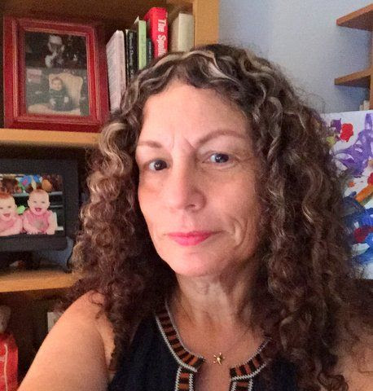
Some quick acknowledgments …
http://shell.cas.usf.edu/mccook/alaet/
“The central focus of this website is to identify new tables at which librarians might take a place.”
LetsMoveInLibraries.org

Slide 4
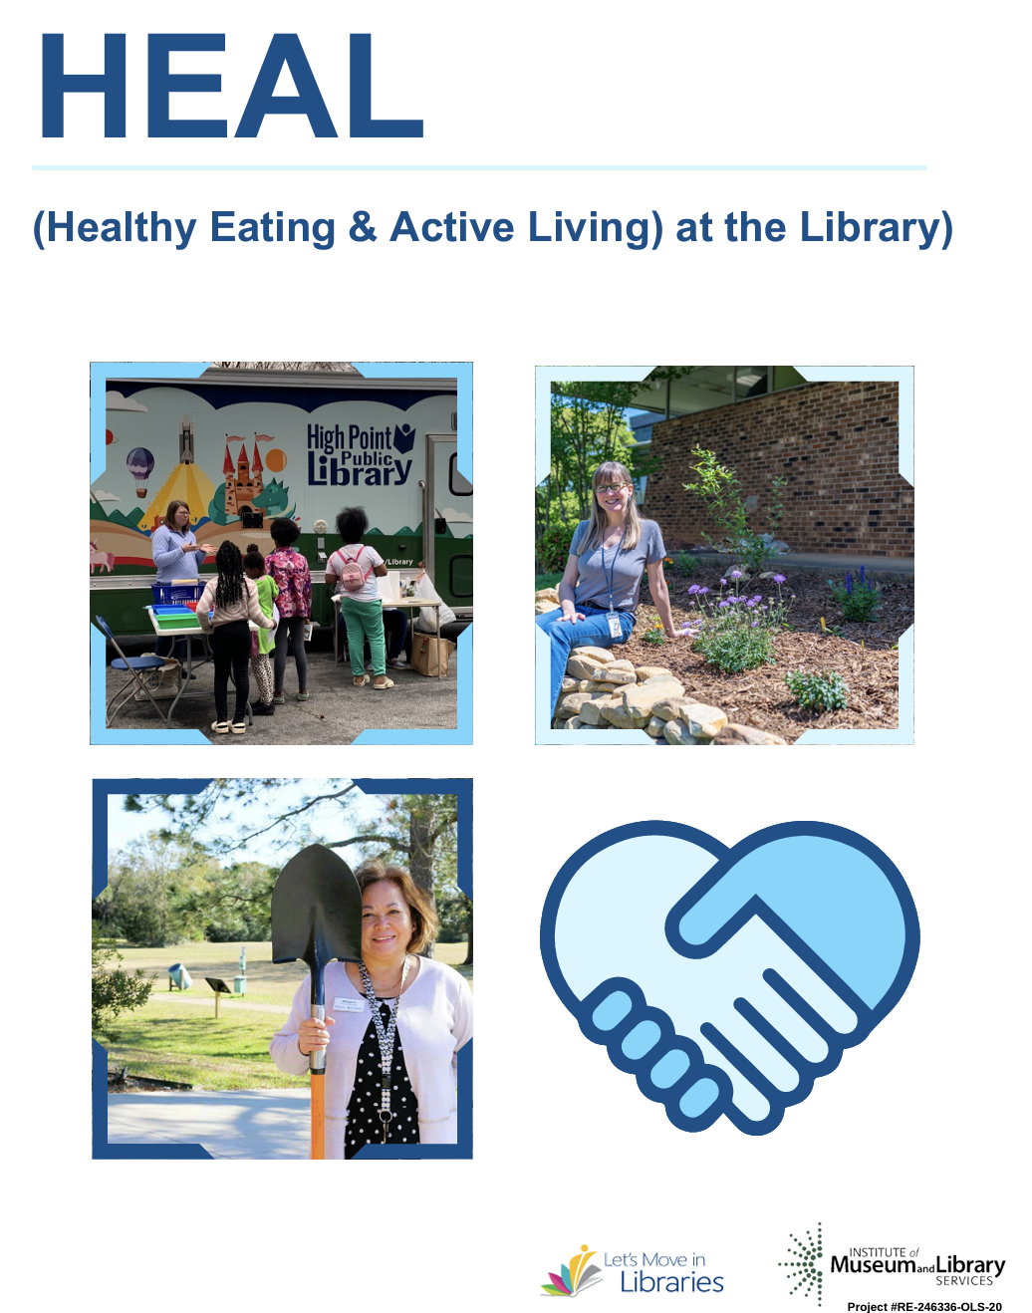
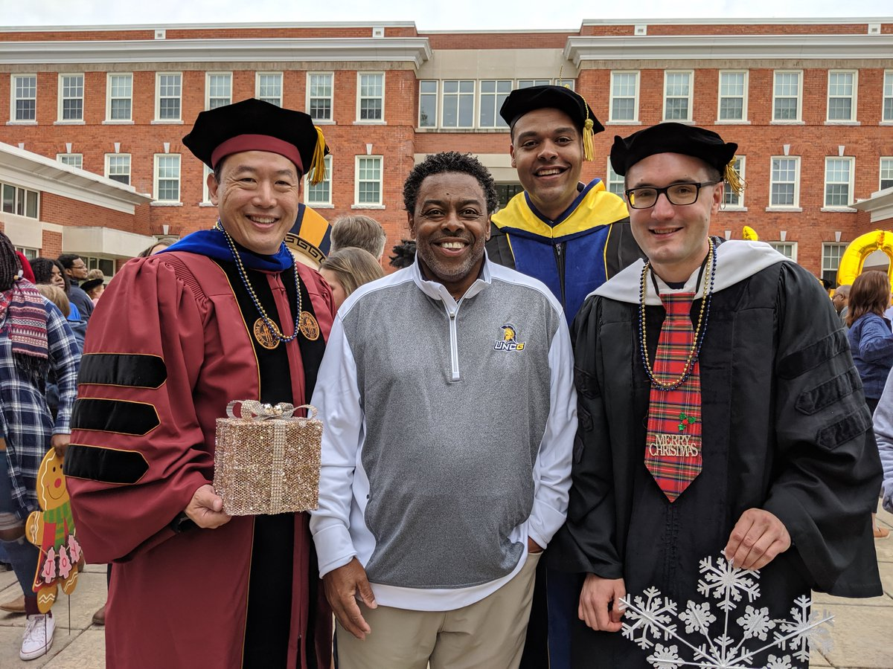
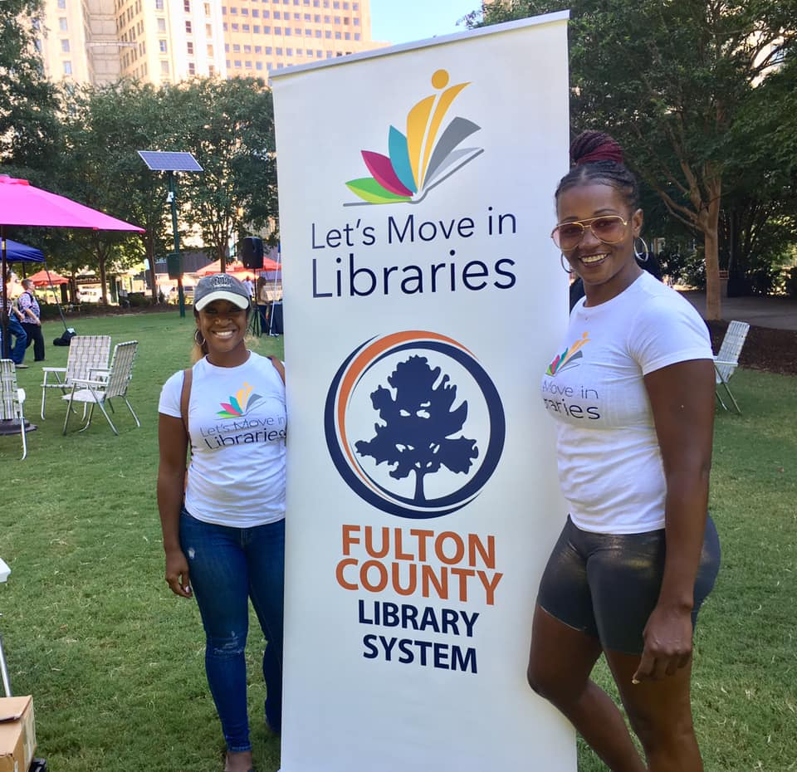
A little about me
Welcome Day-Spring 2020

Slide 5
Who are you?
Name, title, and anything you’d like to share about what brings you here today in the chat.
Welcome Day-Spring 2020
LetsMoveInLibraries.org

Slide 6
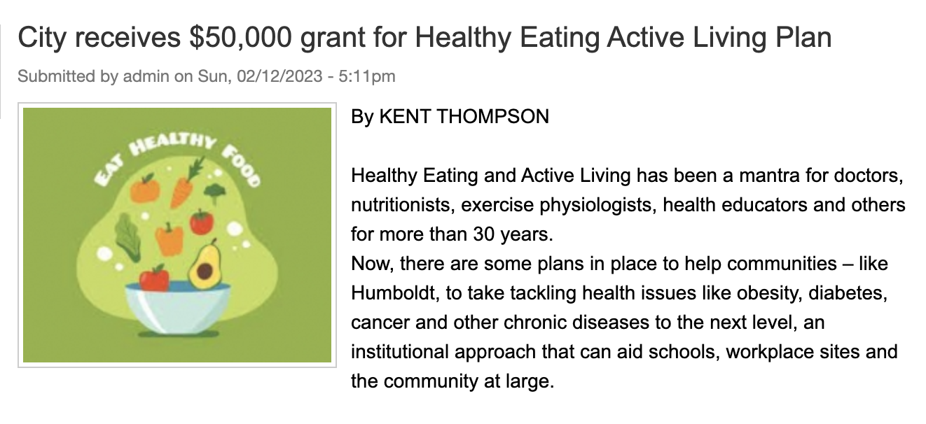
What does success look like?

Slide 7
Implementation committee members are
Director of Public Health at Humboldt County Memorial Hospital
Recreation Director Paxton Pedersen
Humboldt Public Library Director Julie Larsen
Humboldt County Economic Development Association Executive Director
Humboldt Community Schools Counselor
Humboldt Community School Superintendent
Upper Des Moines Opportunity Regional Director

Slide 8
What doesn’t success look like?
LetsMoveInLibraries.org

Slide 9
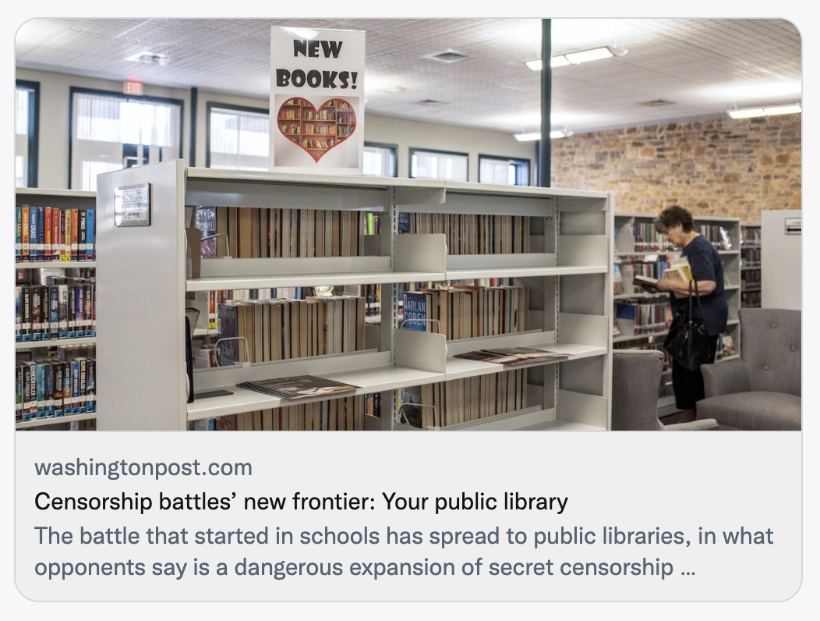
Where are we at as a profession?
Dudak, L. T., Comito, L., & Zabriskie, C. (2022). “You Can’t Self-Care Your Way Out of a Broken System”: The 2022 Urban Libraries Trauma Forum. Public Library Quarterly, 1–15. https://doi.org/10.1080/01616846.2022.2148826

Slide 10
Where it feels like we should be heading?

Slide 11
Where we actually should be heading?
LetsMoveInLibraries.org

Slide 12
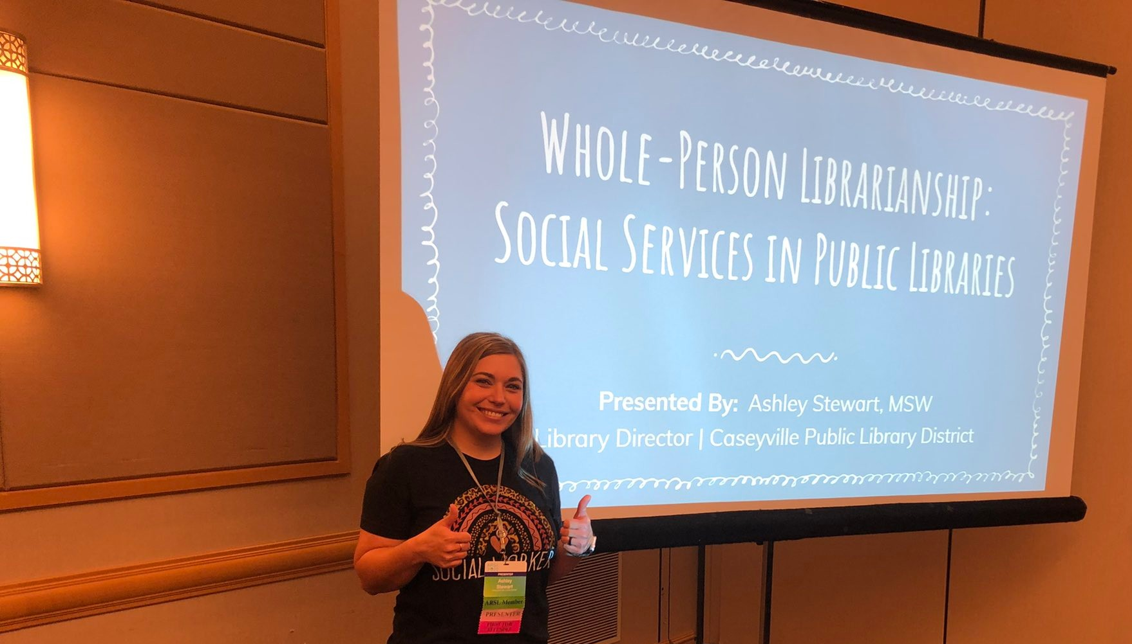
Don’t take my word for it …
Talked about how her library first in Southern Illinois to offer drag queen storytime –
By working as a critical community partner the library established a firewall against power of attacks
LetsMoveInLibraries.org

Slide 13
How do we cultivate and sustain the relationship-driven library?
Welcome Day-Spring 2020
LetsMoveInLibraries.org

Slide 14
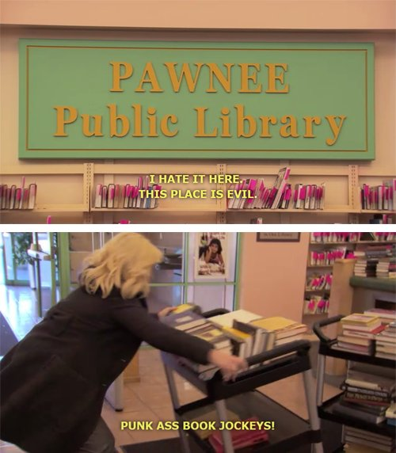
In a word: COMMUNICATIONS
Unless you are already working with other organizations in a sector,
they do NOT think of YOU
Welcome Day-Spring 2020
LetsMoveInLibraries.org

Slide 15
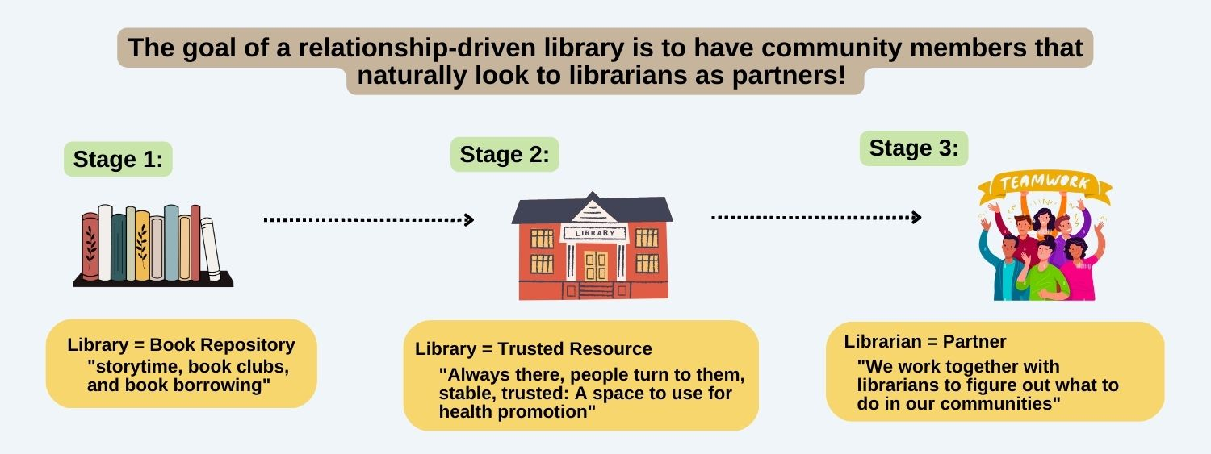
What we found in a national study of this topic
LetsMoveInLibraries.org

Slide 16
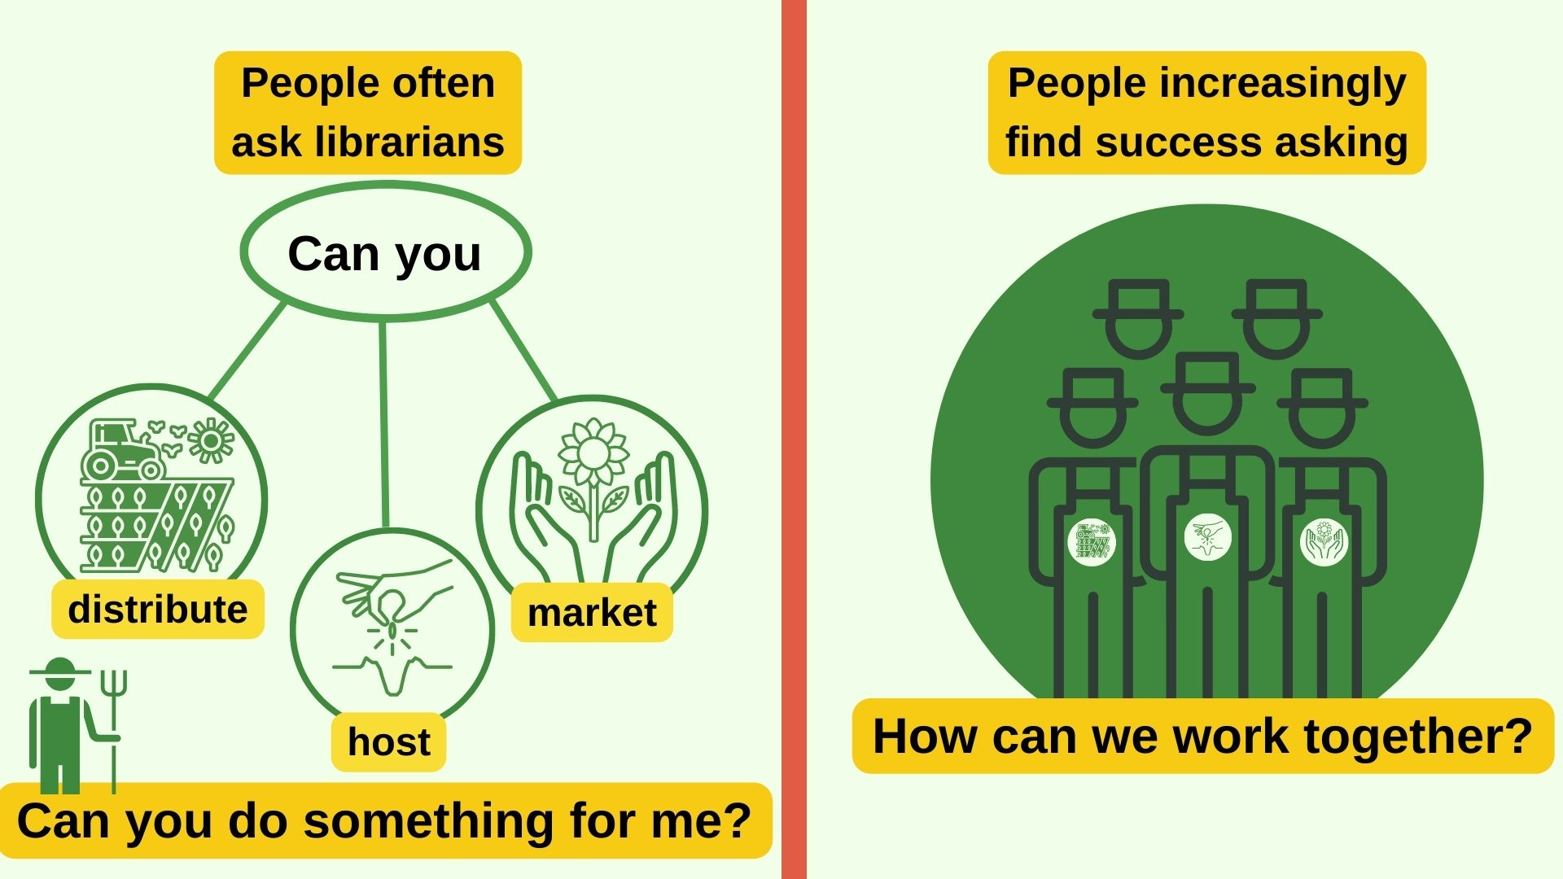

Slide 17
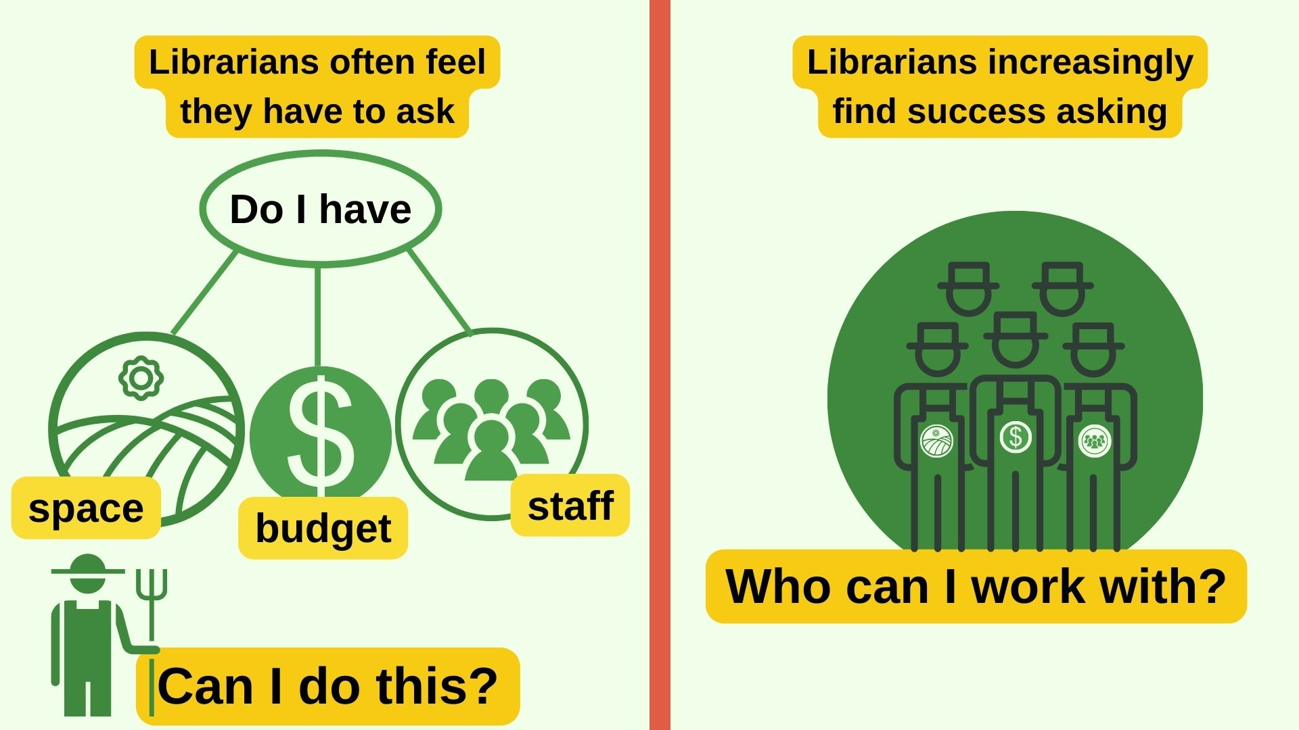
The branch manager told me “almost the whole first year [I participated in the health coalition], when we met I was asked to explain why the library was there. ‘What are you doing here? Like you're not a member of the community care team?’ Those were not the words. It was that sort of questioning. To which I said, ‘Oh, uh, we are.’”
Welcome Day-Spring 2020

Slide 18
Welcome Day-Spring 2020
So … what are we going to do?
LetsMoveInLibraries.org

Slide 19
Welcome Day-Spring 2020
LetsMoveInLibraries.org

Slide 20
Gardens | Recipes
One or more people working in an uncontrolled environment | One person working in a controlled environment
No guarantees of success – always depends on externalities | If you have EVERYTHING, comes out the same each time
There is a time and a place for different seeds to flourish | You can follow the same recipe any time or any place
Cyclical – time for rest, reflection, and harvesting | You can make a recipe any time if you have the supplies
LetsMoveInLibraries.org

Slide 21
How Milagros Tanega did it
At Harris County Public Library
Talk up the idea
Met with those interested in idea
Worked with them to develop idea
Made a plan and divide the work
Started small: Herb garden
Kept building: Vegetable garden
Kept growing: Fruit forest, storywalk, lending garden supplies, collaboration with adjacent middle school – it just keeps going!

Slide 22
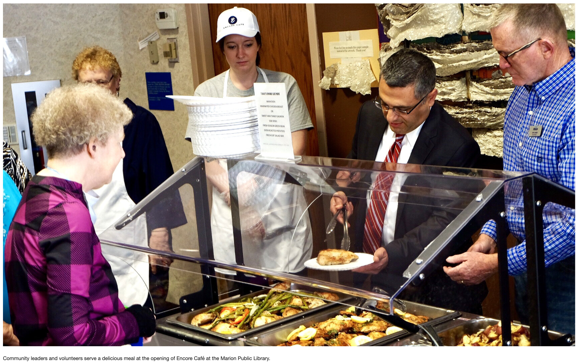
Welcome Day-Spring 2020
And sometimes seeds land in your lap. Are you ready?

Slide 23
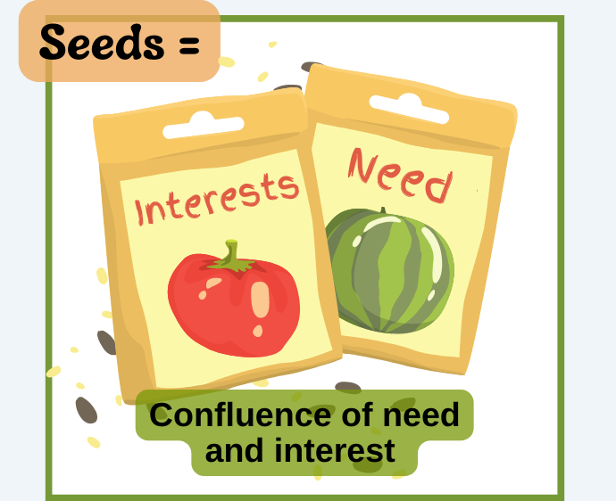
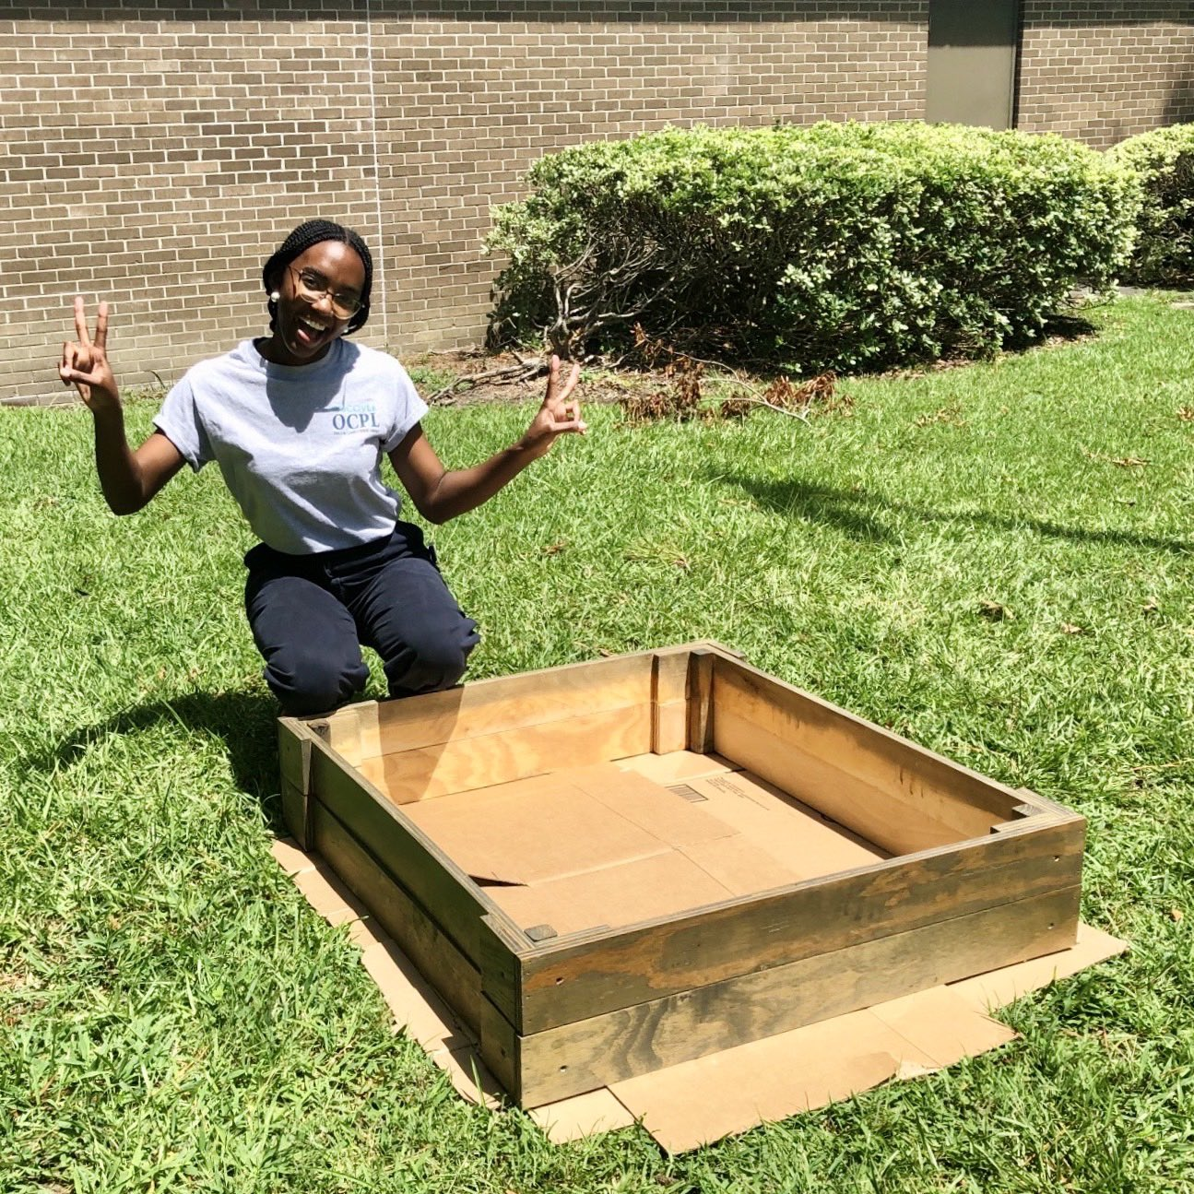
Step 1
LetsMoveInLibraries.org

Slide 24
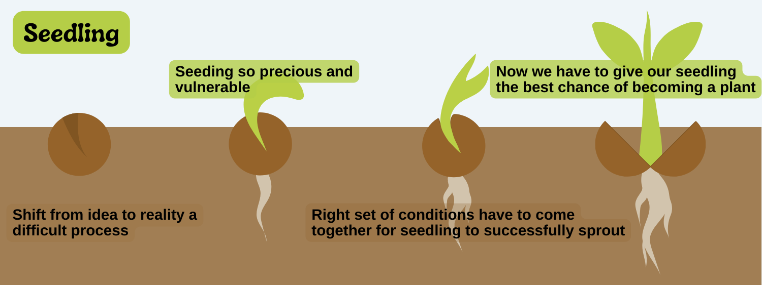
Step 2: Nourishing seedlings
LetsMoveInLibraries.org

Slide 25
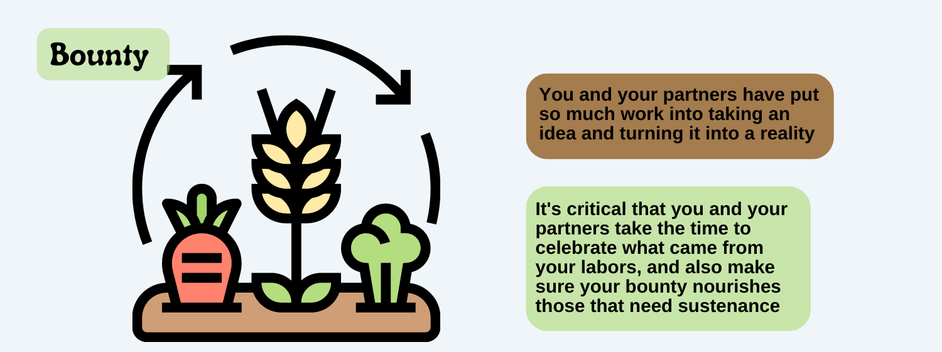
Step 3: Harvesting the bounty
LetsMoveInLibraries.org

Slide 26
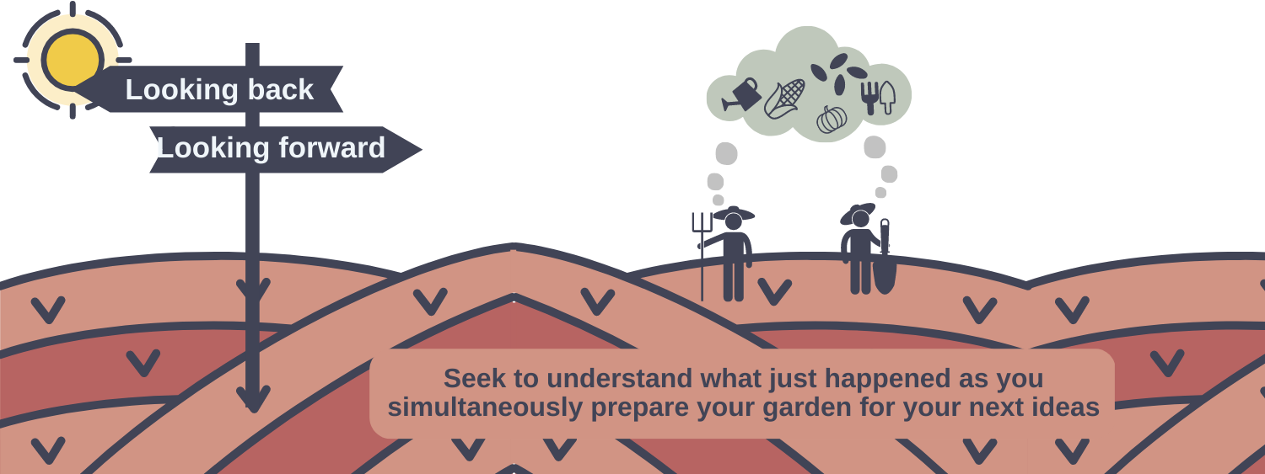
Step 4: Look back & forward
LetsMoveInLibraries.org

Slide 27
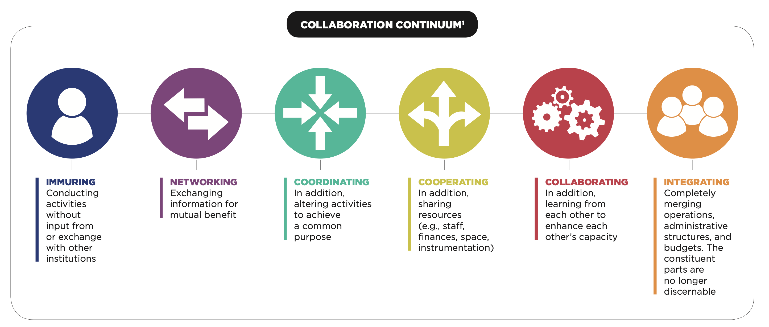
What does a debrief look like?
(or, deciding when to move up or move down the continuum)
Image via Teagle Foundation

Slide 28
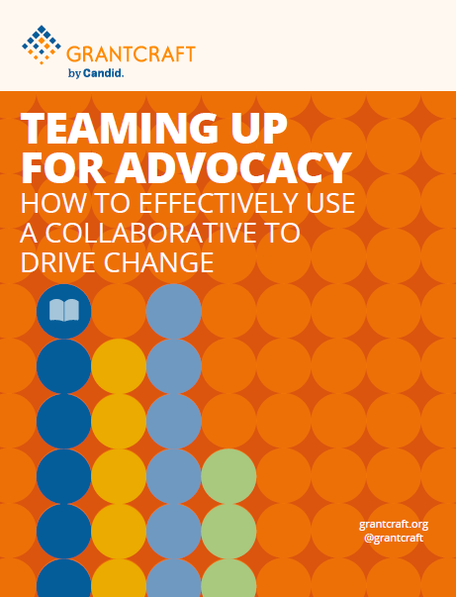
Final thoughts: Advocacy
Knowing (& communicating!) where a relationship may lead (garden, not recipe):
New library advocates and allies
New services, funding, and/or spaces
New ideas, inspiration, and energy
New ways to reach the underserved
New ways to make a difference
[Your ideas here!]
LetsMoveInLibraries.org

Slide 29
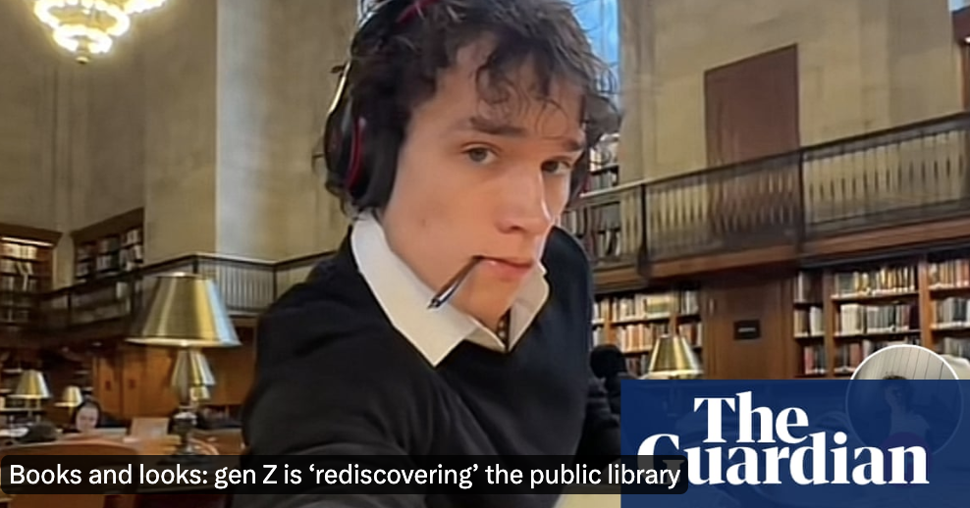
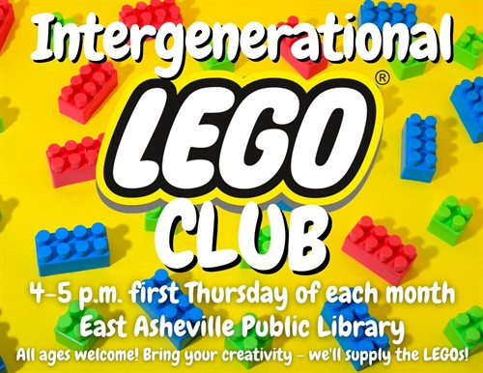
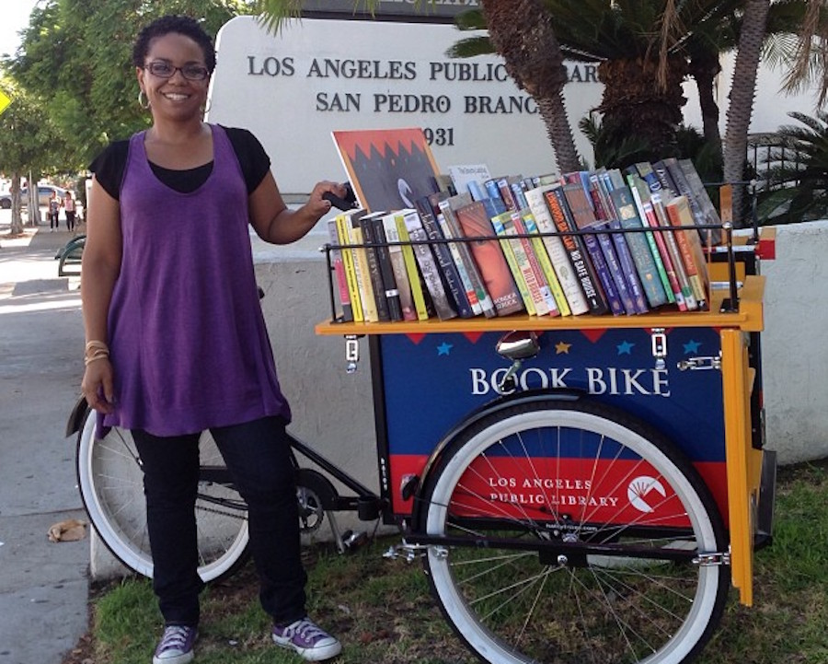
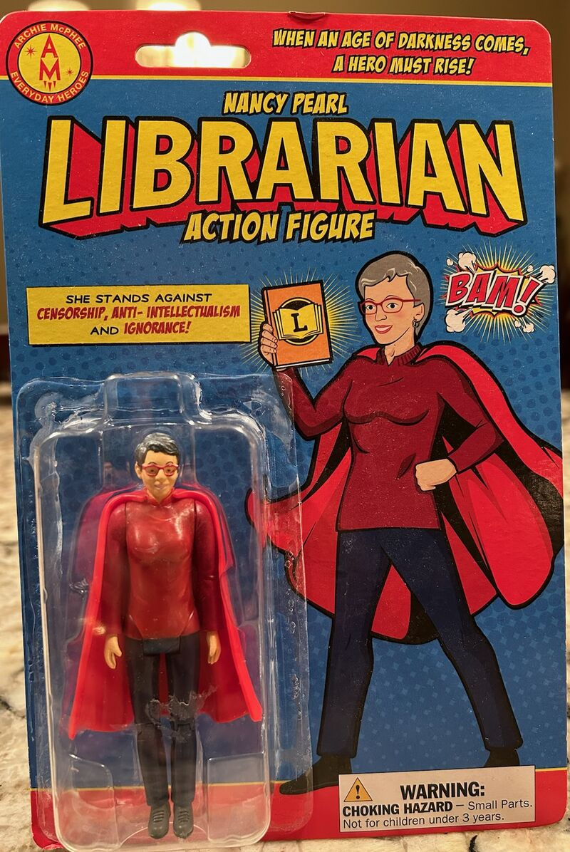
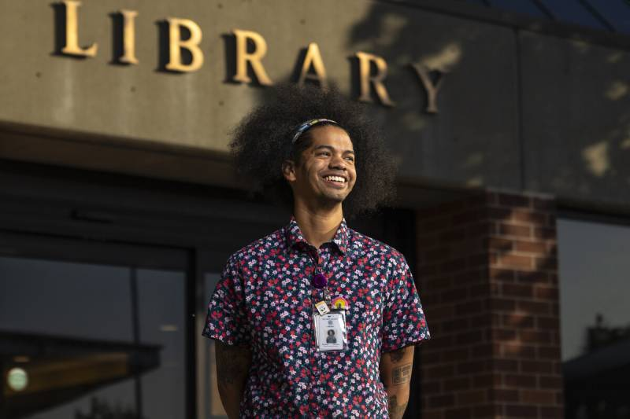
What’s in your talking points about why others should work with us?

Slide 30
And a plug
Call for applications opens June 1, 2024
See who won in 2023 at
LetsMoveInLibraries.org
Join us in building a national platform for the relationship-driven library!
LetsMoveInLibraries.org

Slide 31
Closing out
Who in your workplace or community needs to hear what you’ve heard today?
What additional information do you need to try something new – in terms of building the relationship-driven library?
Where do we go from here in building the relationship-driven library?
LetsMoveInLibraries.org

Slide 32
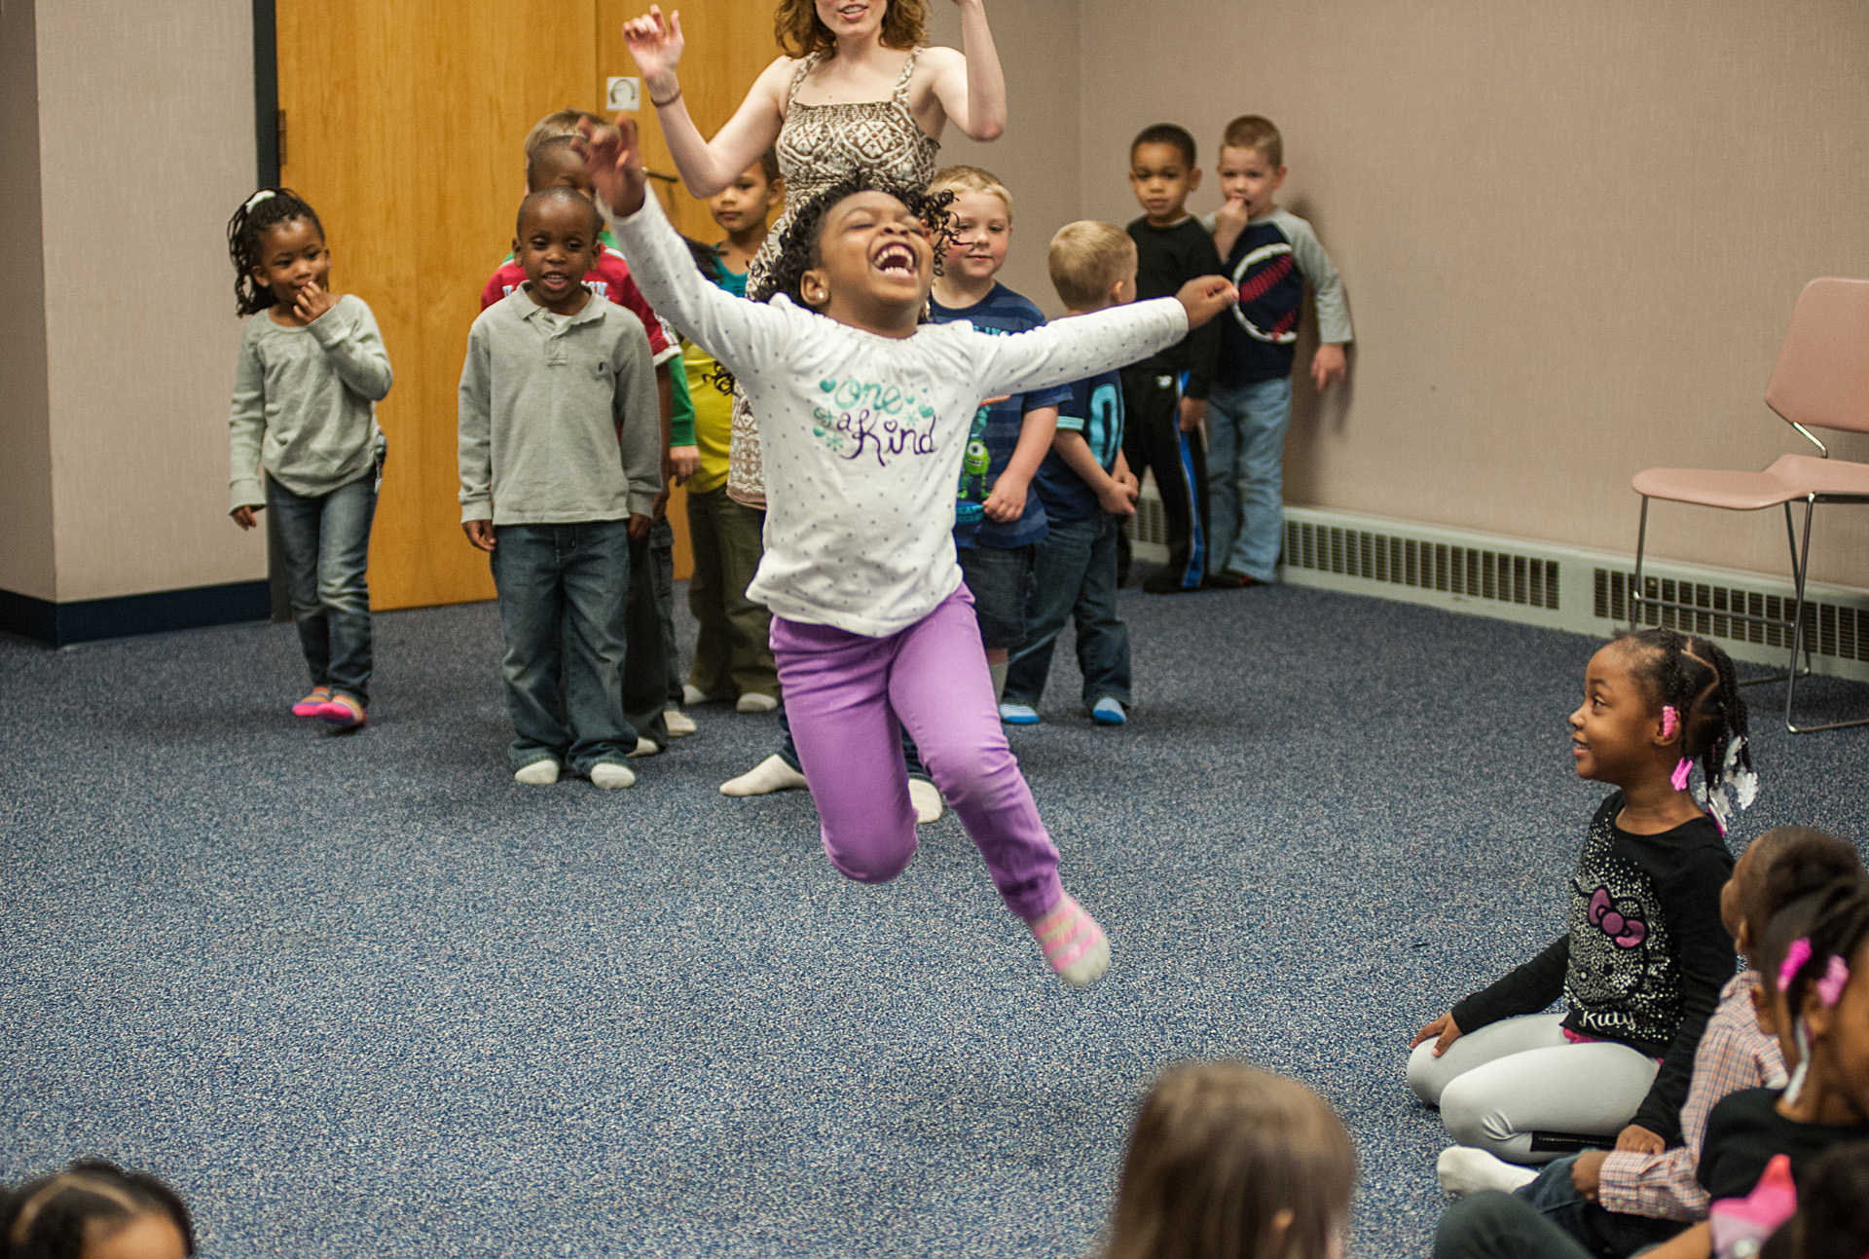
Let’s go!
Start with passion
Start small
Dream big
Don’t do anything new alone. EVER.
Beanstalk Ballet program made possible by partnership w/ St. Louis Ballet at St. Louis County Public Library, May 1, 2014
LetsMoveInLibraries.org

Slide 33
Thank you!
Noah Lenstra
Associate Professor of Library and Information Science at University of North Carolina at Greensboro
lenstra@uncg.edu
@NoahLenstra
@LetsMoveLibrary
Sign up for monthly newsletter
LetsMoveInLibraries.org/ about-us/newsletters/
LetsMoveInLibraries.org

