Slide 1
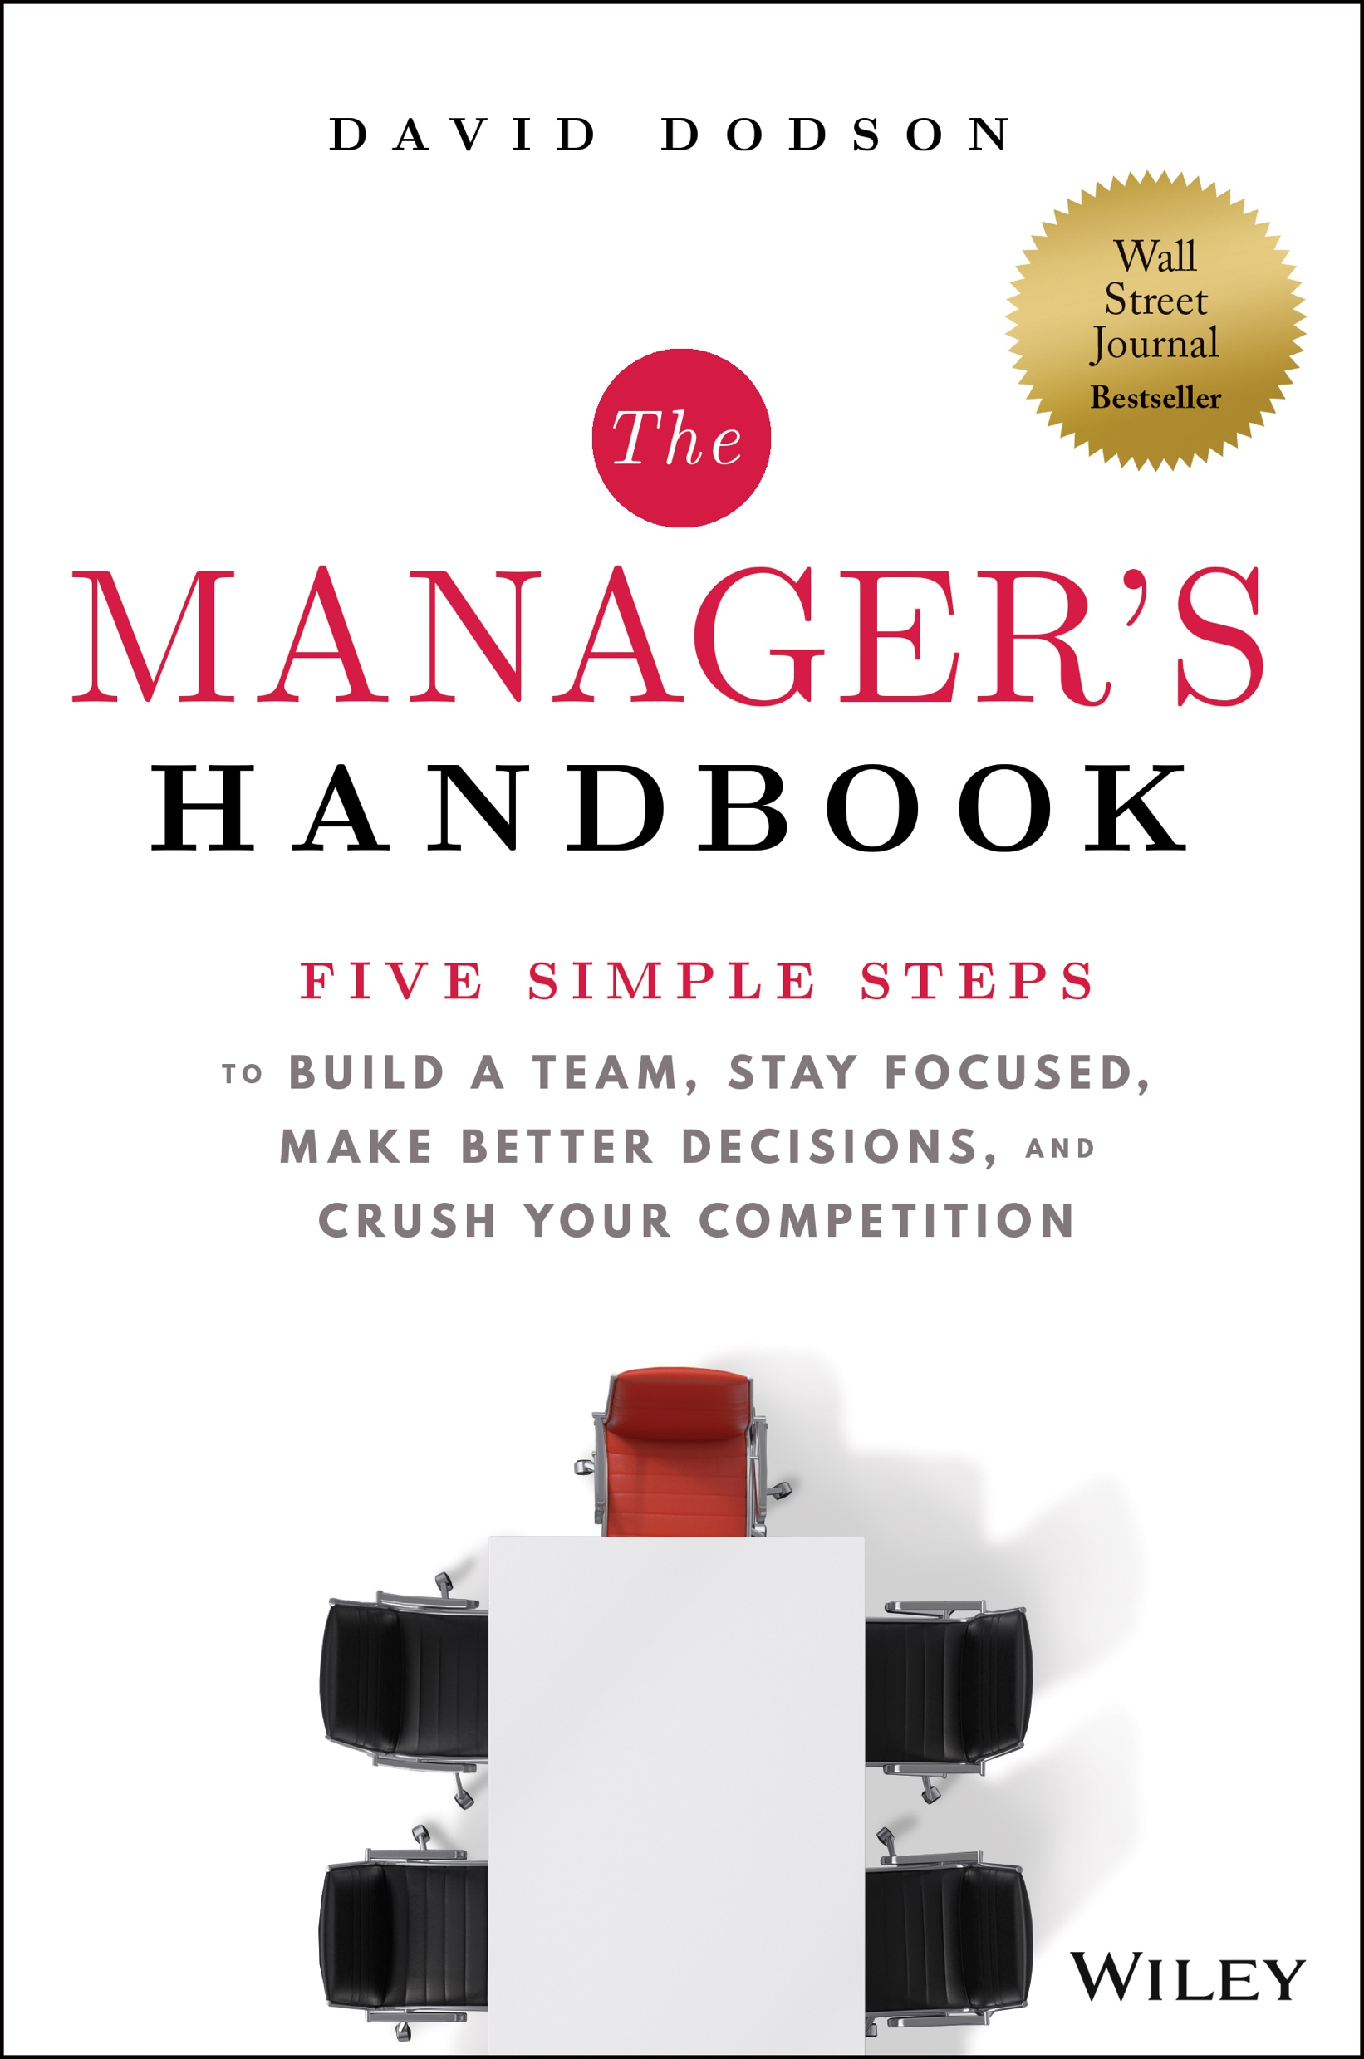
Getting Stuff Done
David Dodson

Slide 2
Distribution of FTF Exits by MOIC
% of
FTF Exits
MOIC

Slide 3
Market Correlation
MOIC
Industry Growth
This

Slide 4
Market Correlation
MOIC
Industry Growth
This

Slide 5
Market Correlation
MOIC
Industry Growth

Slide 6
Fund Winners and Losers
>2.5x MOIC
Forbes 400 Self-Made
Billionaires
Stable
Growth
High
Growth
Stable
Growth
High
Growth

Slide 7
Largest US Airlines Ranked by Passenger-Miles
1950 | 1970 | 1990 | 2010 | Today

Slide 8
History of US Department Stores
Number of Stores
1875-1900
1962
1980
2000
2020

Slide 9
History of US Department Stores
Number of Stores
1875-1900
1962
1980
2000
2020

Slide 10
History of US Department Stores
Number of Stores
1875-1900
1962
1980
2000
2020

Slide 11
History of the
Personal Computer
1981
1987
Today

Slide 12
History of the
Smart Phone
1992
1996
1997
1999
2002
2005
2007
2010

Slide 14
Market Correlation
MOIC
Industry Growth
This

Slide 15
Commitment to
Building a Team
Setting and Adhering to Priorities
Willingness to Seek
and Take Advice
Obsession with
Quality
Fanatical Custodian of Time

Slide 16
Commitment to Building a Team
Setting and Adhering to Priorities
Willingness to Seek
and Take Advice
Obsession with
Quality
Fanatical Custodian of Time

Slide 17
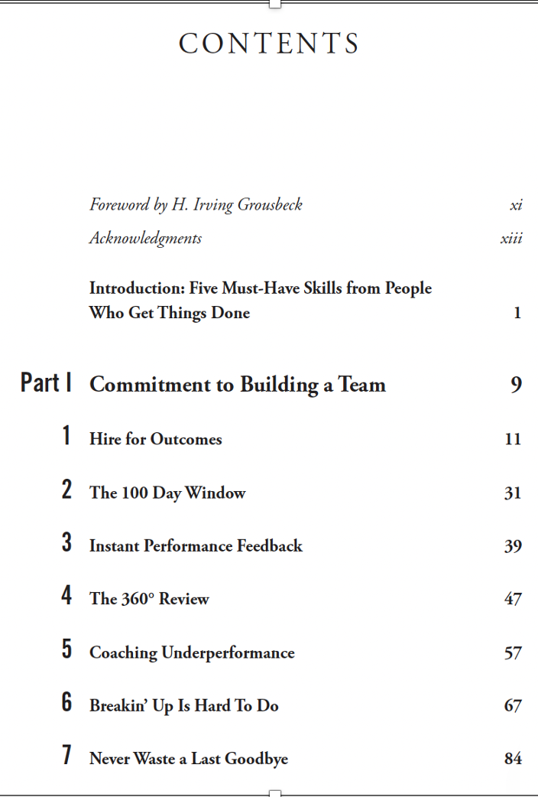

Slide 18
Commitment to Building a Team
Setting and Adhering to Priorities
Willingness to Seek
and Take Advice
Obsession with
Quality
Fanatical Custodian of Time

Slide 19
Five Questions
What is going well?
What are we working on that is a waste of time?
What do our customers care the most about?
What are we better at than all our competitors?
If you were me, what would you be working on?

Slide 20
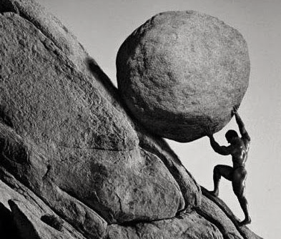
Gerald Risk Matrix
Low Impact
High Impact
Easy
Hard

Slide 21
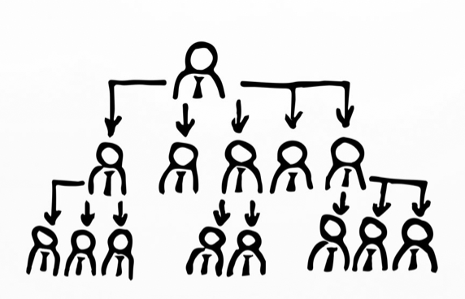
Eisenhower Matrix
Important
Not Important
Urgent
Not Urgent

Slide 22
Ansoff Matrix
Existing Product
New Product
Existing
Customer
New
Customer

Slide 23
Focus

Slide 24
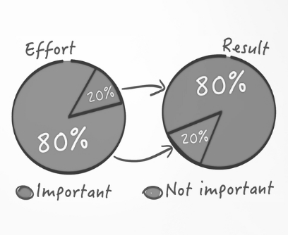

Slide 25
100 / 100

Slide 27
Priority #1
Priority #2
Priority #3
“What have you said ‘no’ to today?”

Slide 28
60,000 doors in 2024
90 Day Takeovers
120 Day Retrofits
“What have you said ‘no’ to today?”

Slide 29
Getting Stuff Done
David Dodson

