Slide 1
The fight against book bans: How do we move forward?
Dr. Shannon M. Oltmann
University of Kentucky
June 2023
Niche Academy

Slide 2
A bit about me:
Associate professor in library science at the University of Kentucky
10+ years of teaching about and research intellectual freedom and censorship
Dozens of talks about these issues
Listening to and helping librarians

Slide 3
Book bans and challenges on the rise
2020: 273 books challenged or banned
2021: 1,597 books challenged or banned
2022: 1,651 books challenged or banned (only the first 8 months of 2022)
PEN America reported 1,586 bans in school libraries from 2021-2022
Occurs in all 50 states (rural, urban, and suburban areas)

Slide 4
More than book challenges
Challenges to programming, displays, and other resources
Some librarians have quit or lost their jobs
Some libraries have been forced to close

Slide 5
Similarities across challenges
Same books challenged, using same language, across multiple geographical areas
Same objections repeated (with images/phrases often taken out of context)

Slide 6
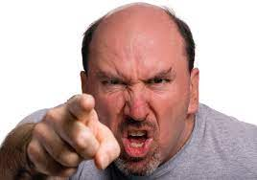
New groups, new tactics
Board meetings and city council meetings
Social media campaigns
“Ambush” approach
Misusing terminology and legal phrases
Passages taken out of context
Props, posters, and signs
Angry yelling

Slide 7
Grassroots activists and astroturfing
Grassroots
Political activity that is organic
Originating from citizens (bottom up)
Independent of influence from political elites

Slide 8
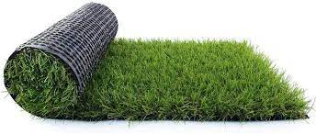
Grassroots activists and astroturfing
Grassroots
Political activity that is organic
Originating from citizens (bottom up)
Independent of influence from political elites
Astroturfing
The use of grassroots aesthetics in political organizing
Illusion of organic populist support
Moms for Liberty
No Left Turn in Education
Parents Defending Education
Parents Involved in Education

Slide 9
What we need to remember…

Slide 10
The principle of intellectual freedom
Intellectual freedom is the right of every individual to both seek and receive information from all points of view without restriction. It provides for free access to all expressions of ideas through which any and all sides of a question, cause or movement may be explored.

Slide 11
Foundation of librarianship
Intellectual freedom is really the basis for most of what librarians do

Slide 12
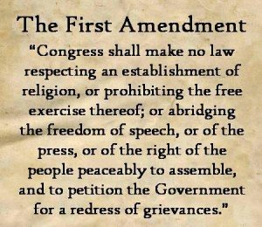
Breaking it down
First Amendment:
Expressing & seeking/receiving
What information is protected?
Nearly everything
A few key exceptions:
Fighting words (out of date)
Slander & libel
Incitement to break law
Child pornography
Obscenity

Slide 13
Other philosophical foundations
John Stuart Mill, On Liberty (1859)
Can only restrict liberty to prevent harm to others
Justice Oliver Wendell Holmes (1919)
Marketplace of ideas will determine the best ideas

Slide 14
Back to the definition of intellectual freedom
“Intellectual freedom is the right of every individual to both seek and receive information from all points of view without restriction. It provides for free access to all expressions of ideas through which any and all sides of a question, cause or movement may be explored.”
What does this mean to you?
All points of view?

Slide 15
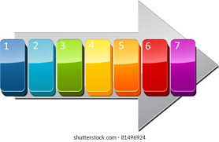
Defending intellectual freedom
Before a challenge
Demeanor and initial response
Reporting
Finding support
Preparing a response
Communicating with community
Post-challenge

Slide 16
How to respond—additional suggestions
Avoid arguments about semantics and definitions
Remain calm and professional
Use empathy and kindness
Avoid social media if possible
Call on friends, advocates, and library fans
Follow your process (make it as transparent as you can)

Slide 17
The fight against book bans: Perspectives from the field
The rise in book challenges across the nation
How challenges and bans affect librarians
External support for librarians
How to face challenges and bans
Advice from librarians

Slide 18
Some key points from the book
Stay aware of national and local trends
Reach out to national, regional, and state associations for help and support
Avoid getting drawn into personal arguments and name-calling
Find external support and hobbies/ routines
Take care of the entire library staff

Slide 19
Doing the right thing
Defending intellectual freedom = defending freedom of speech
We are standing up for core values of librarianship—and America

Slide 20
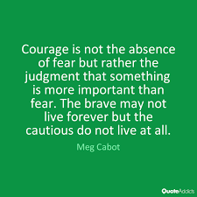
Being brave
Joy of bringing new things to your community
Joy of helping someone (even if you don’t know about it)
Building better community, more opportunities, and more freedom

Slide 21
Final thoughts
We’ll see continued book challenges
We’ll also see pushback against challenges
71% of voters oppose efforts to remove books from public libraries
67% oppose removal from school libraries
(Data from Unite Against Book Bans)

Slide 22
Thank you!
shannon.oltmann@uky.edu

