Slide 1
VALCHOICE AND NICHE ACADEMY
HELP PATRONS NAVIGATE THE RAPID INSURANCE PRICE INCREASES OF INFLATION
Insurance Industry Watchdog, ValChoice, produced exclusive content for libraries.
March 15, 2023

Slide 3
RELEVANT BACKGROUND
Pre-accident
Background in physics & math
High tech career
Engineering -> marketing -> sales -> CEO ->
Post-accident
Legal battles with insurance companies for years
Founded ValChoice in 2013

Slide 4
OVERVIEW
April = Financial Literacy
Problem: insurance is confusing and expensive
Inflation: creating stress and anxiety
Solution: financial literacy / insurance education
Demonstration: accessing the content and tools

Slide 5
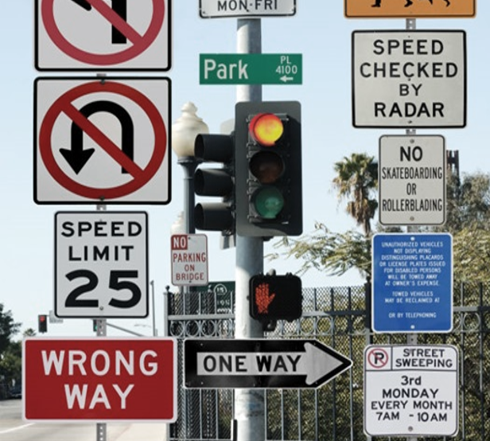
PROBLEMS CONSUMERS FACE
Rising prices due to inflation
Prices range widely (8x difference)
No transparency when legitimate claims not paid
Advertising spend misleading to consumers
Online purchases result in poorly insured shoppers
Choosing the wrong insurance can be financially catastrophic
WWW.DESIGNERSPARADISE.COM

Slide 6
INFLATION → STRESS & ANXIETY
Beat Stress. Get Informed.

Slide 7
THE SOLUTION IS FINANCIAL LITERACY
Unique, Easy to Understand
Great Benefit to Patrons 16+
What’s Provided
Ratings
Calculators
Educational videos
Worksheets
Virtual programming
Etc.
Vital information for responsible adults
Training Options
Deliver via
Web
Virtual programming
Staff led programming
No Support Required
Content automatically customized by location.

Slide 8
VALCHOICE
#1 Independent Insurance Company Ratings and Analytics
The Carfax for Insurance according to Forbes Magazine

Slide 9
Sales and Marketing Tools for Agents
COMMERCIAL BUSINESS MODEL
Help agents compete against billion $ advertising budgets by differentiating
Enable agents to deliver transparency to consumers

Slide 10
Free Analysis & Tools for Patrons
LIBRARY BUSINESS MODEL
Full access to the info needed to make the best decisions for themselves and their families
No ValChoice monetization model via library patrons

Slide 11
ESSENTIAL FINANCIAL LITERACY TOOLS
1 Book – Injured Money
2 Calculators – Price info tailored to your location
3 Educational videos – By stage of life
4 Worksheets – For individualizing info
5 Agent referrals – For assistance and advice
6 Company ratings – On value, quality and service
WWW.DESIGNERSPARADISE.COM

Slide 12
INJURED MONEY BOOK
“This book is the complete guide for dealing with insurance companies, and the people who work for them. I had read a few "file your own claim" type books, but this is the only one that accurately prepares you for what is going to happen at each step in the process. It also provides a clear explanation of how to handle the situation. This is like a Bible and a Dummies guide rolled into one book. As icing on the cake, it is actually interesting to read.
“Statistically speaking, most of us will never be in a serious car accident in our lives. However, we buy insurance anyway. Injured Money should be part of your insurance purchase, so order a copy now. If you or a loved one are in a serious accident, car or otherwise, you will need to have this book at hand.”
“A very informative book that everyone who has insurance should read.”

Slide 13
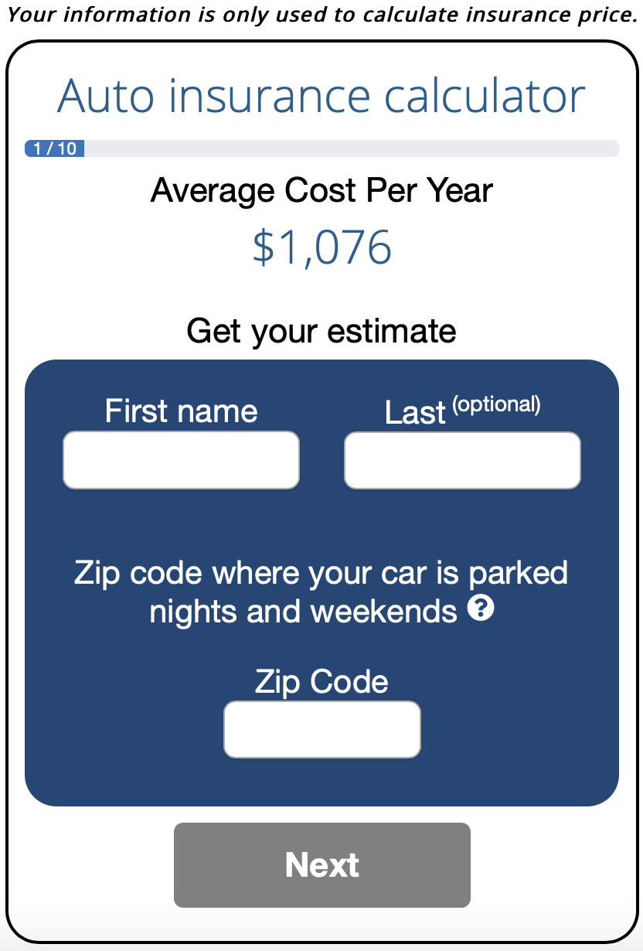
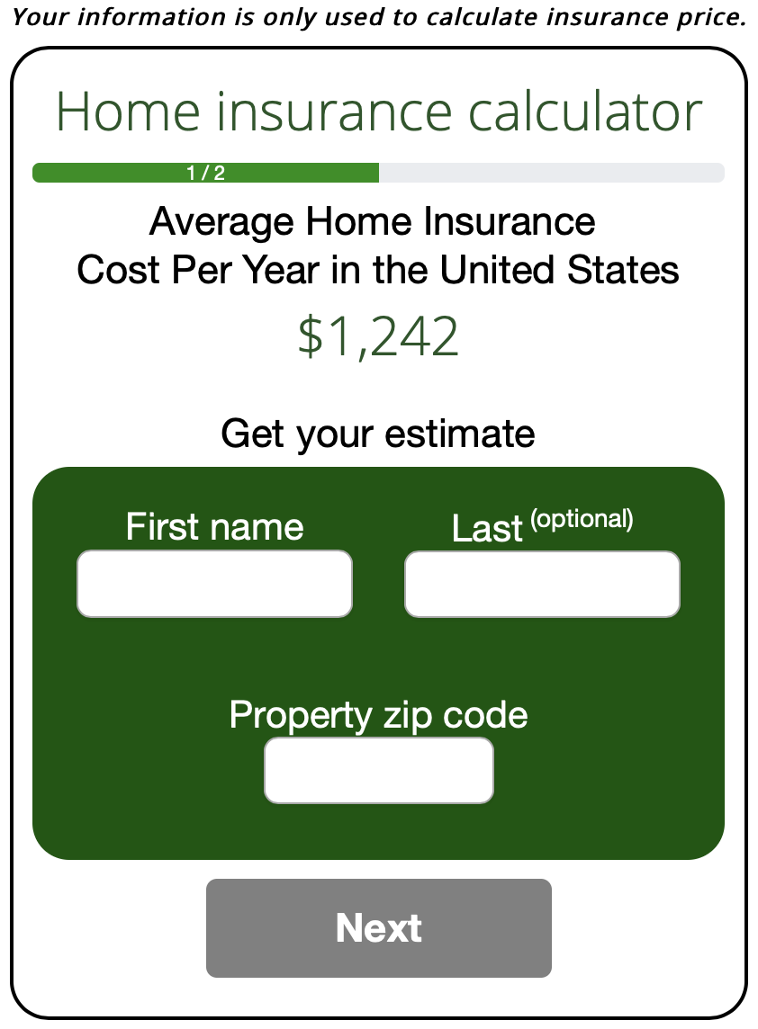
INSURANCE COST CALCULATORS
Am I Getting Ripped Off?
Empowering and informing consumers
Insurance shopping websites don’t provide a complete picture. ValChoice empowers by educating.
Automatic localization
Based on thousands of publicly available documents

Slide 14
CAR & HOME INSURANCE CHECK-UPS
Free ratings
How good is your insurance company?
Does your insurer delay & deny claims?
Who are the best companies?

Slide 15
EDUCATIONAL VIDEOS
Hands-on Learning with No Train the Trainer Required
16 - 24 Years Old
25 - 54 Years Old
55 and Older
21 frequently asked questions
Seven top tips
Series of six videos
25-minute total run time
25 frequently asked questions
11 top tips
Series of seven videos
30-minute total run time
28 frequently asked questions
12 top tips
Series of seven videos
30-minute total run time

Slide 16
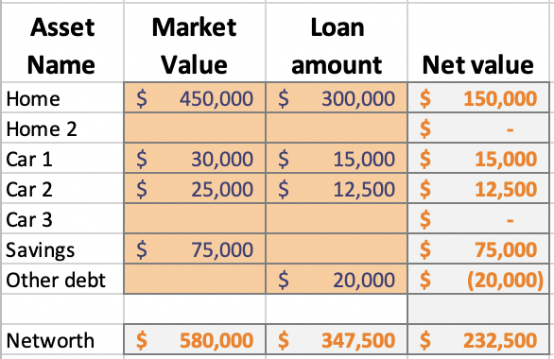
WORKSHEETS
Individualized, hands-on learning
Figure out exactly what you need
Liability insurance coverage
Deductible amount
Coordinated with calculators
Pages (screens) in the web app
Guides individualized decisions

Slide 17
INSURANCE COMPANY RATINGS
An Unbiased Measure of Quality and Value
Insurance that doesn’t pay claims is not insurance!
ValChoice is the only company rating insurers on value, quality and service.
Single company reports are free for library patrons

Slide 18
VALCHOICE INSURANCE COMPANY REPORTS
Bringing price and claims transparency to the insurance industry
ValChoice is the only company to
Use data collected by state insurance departments
Use data vetted by state insurance departments
Mathematical model of industry by insurance type
No user surveys or web reviews
UNDER EMBARGO UNTIL JAN. 26, 2016

Slide 19
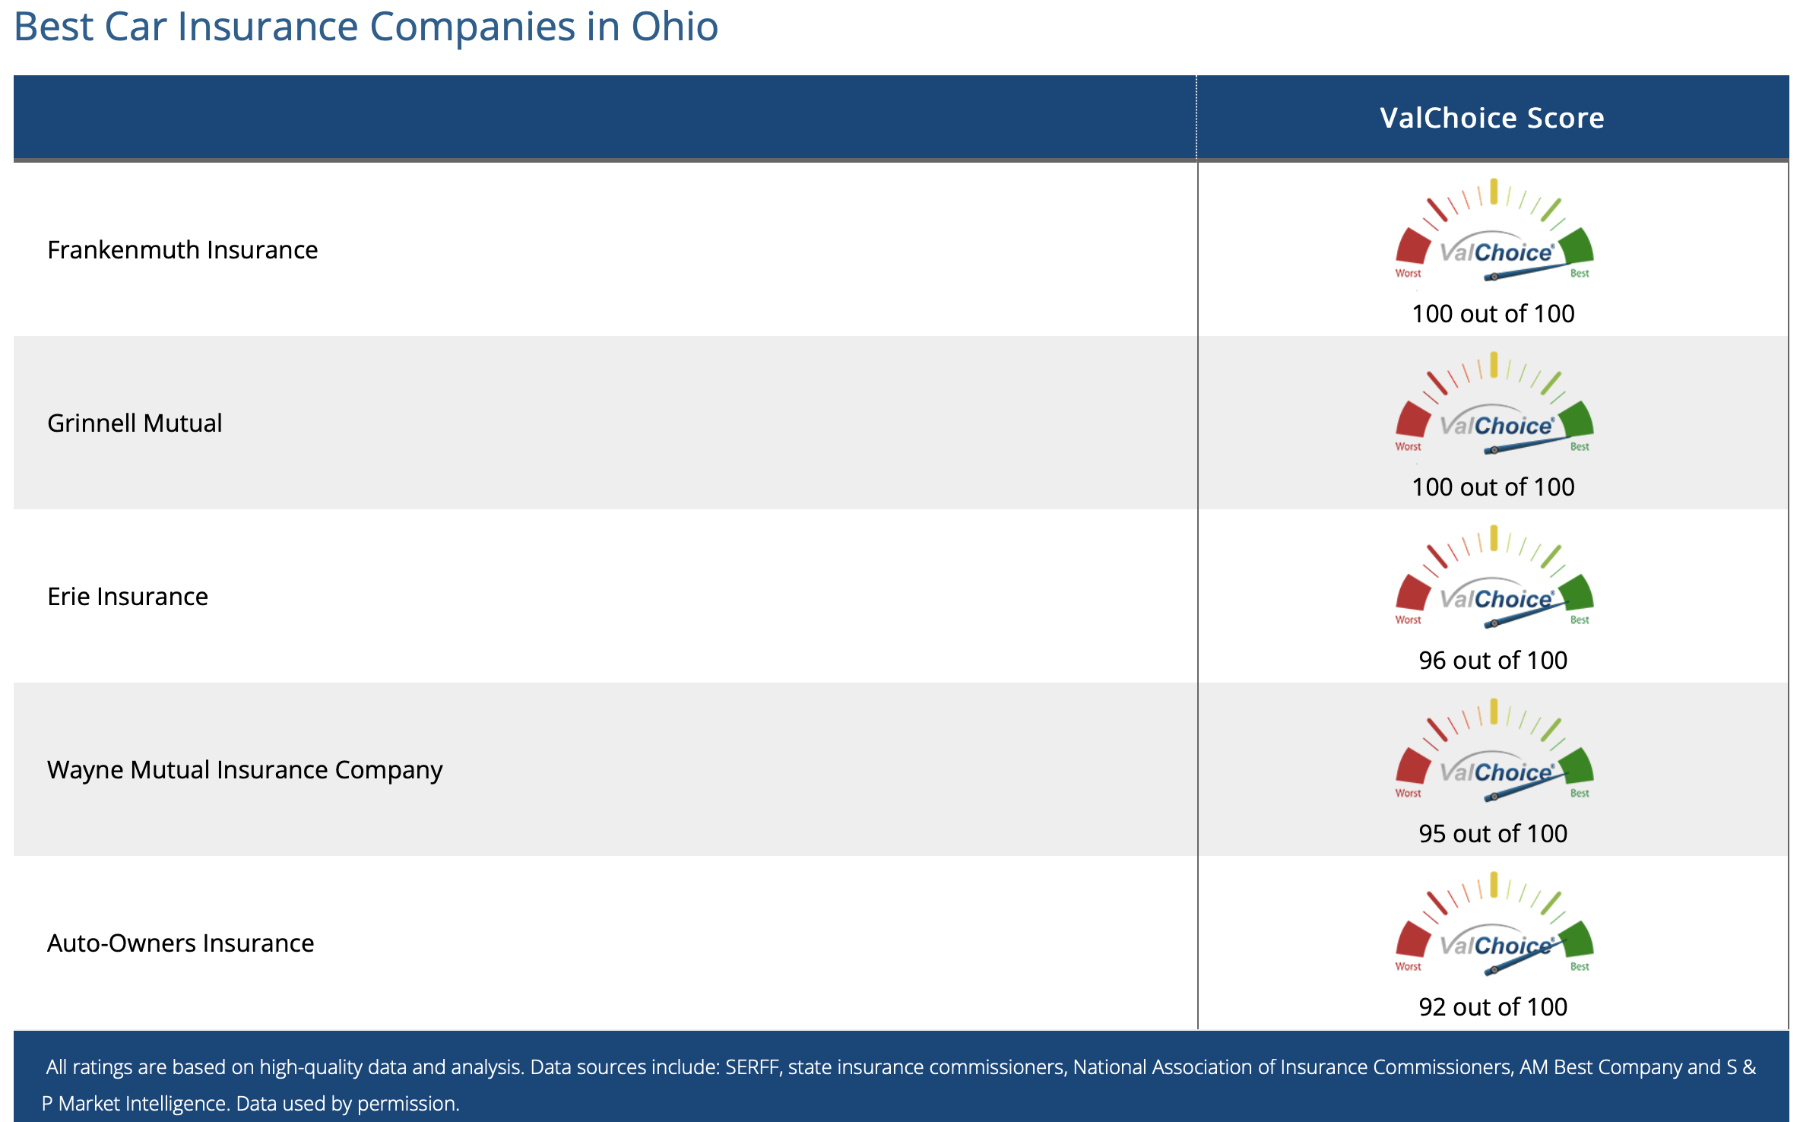
BEST CARRIERS BY STATE
ValChoice grades ~25,000 companies
~12,000 auto insurance
~13,000 home insurance
Listings for every state

Slide 20
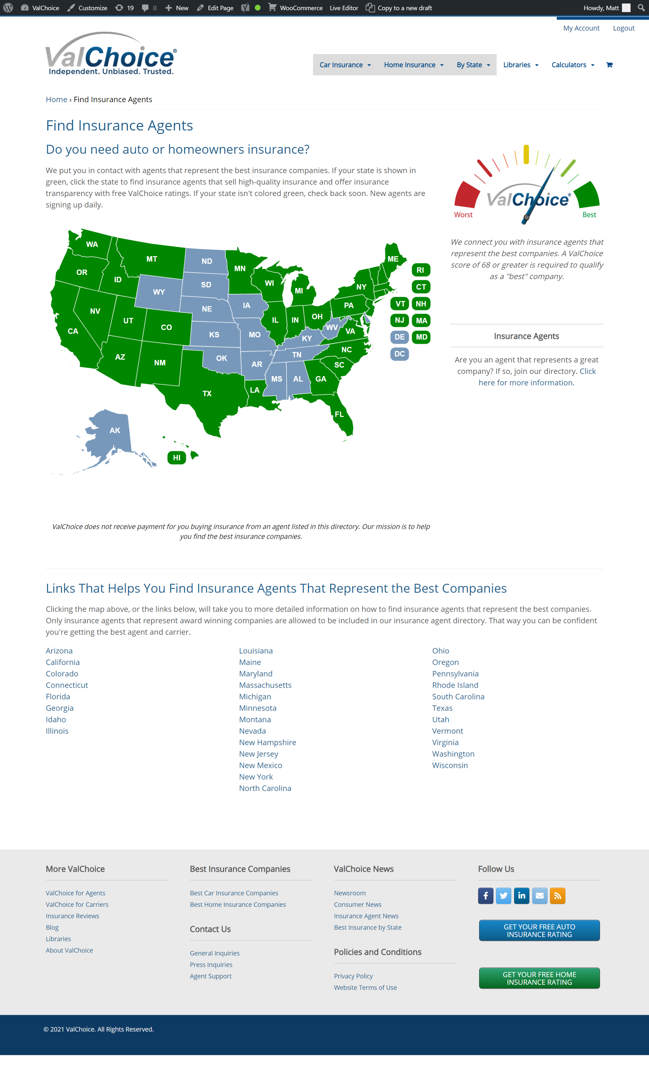
AGENT REFERRALS
Making it easy to get the help patrons need
ValChoice can match patrons with agents in their states
These agents represent the top performing carriers

Slide 21
VIRTUAL PROGRAMMING
Helping Patrons Help Themselves
Available during Financial Literacy Month
Sign-up available after registering
Promote through email, newsletters, websites and social media

Slide 22
PRICING = FREE
Calculators – Register to get links for your location
Educational Videos – Hosted by Niche Academy
Worksheets – Included with educational videos
Ratings – Premium reports free to library patrons
Agent referrals – Available to all web site users
Virtual programming – Free during financial literacy month

Slide 23
ValChoice will
OUR COMMITMENT
Keep data current
Limit email contact
Financial literacy month
National safety month
National preparedness month
Continue to offer this free service

Slide 24
Let Your Network Know
OUR REQUEST – HELP US HELP OTHERS
“Much needed service”
“Unique”
“Free”
“We’re using it”
valchoice.com/fin-lit/

Slide 25
www.valchoice.com/fin-lit

Slide 28
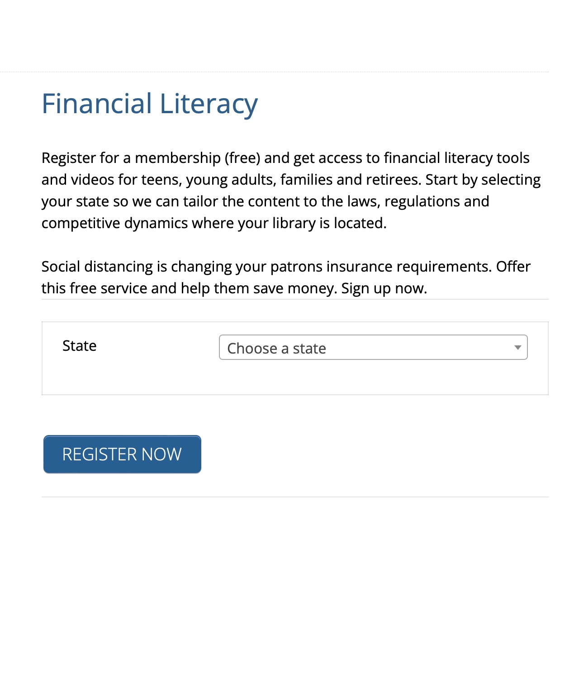
Ordering
STEP #1: ORDERING
Select your state
Click “REGISTER NOW”

Slide 29
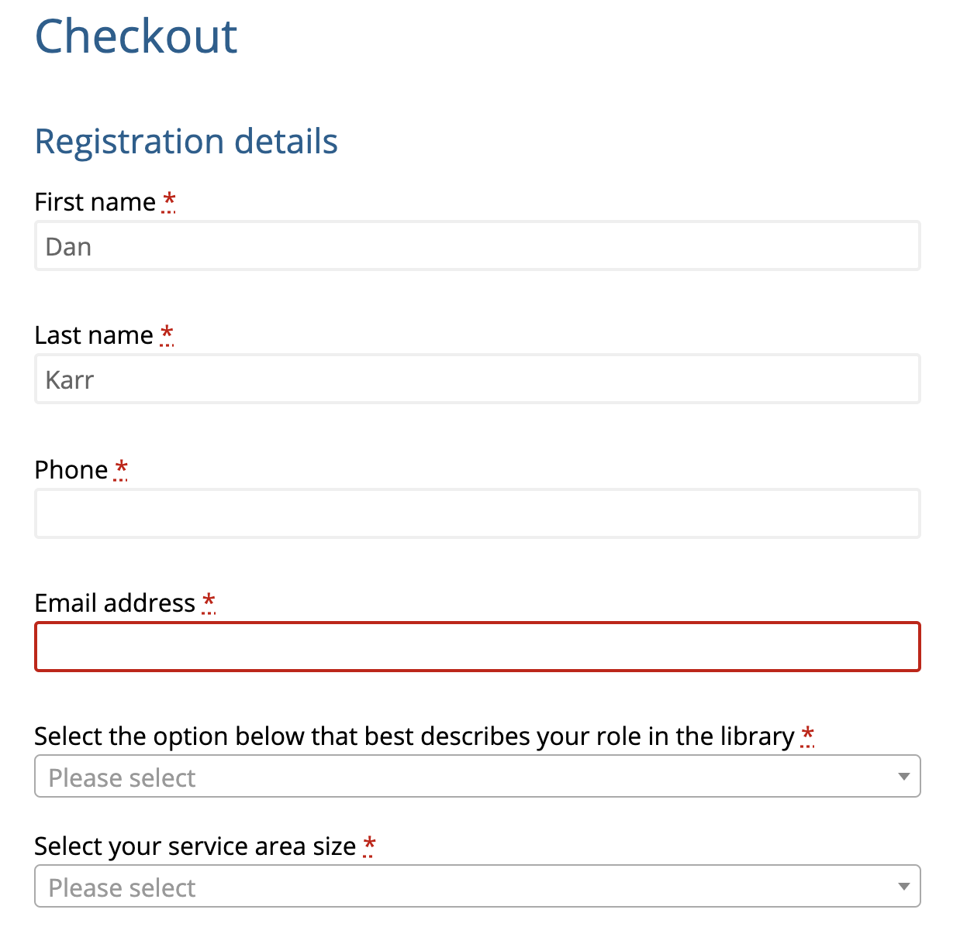
STEP #2: ORDERING
Fill in name
Email
Title
Service area size

Slide 30
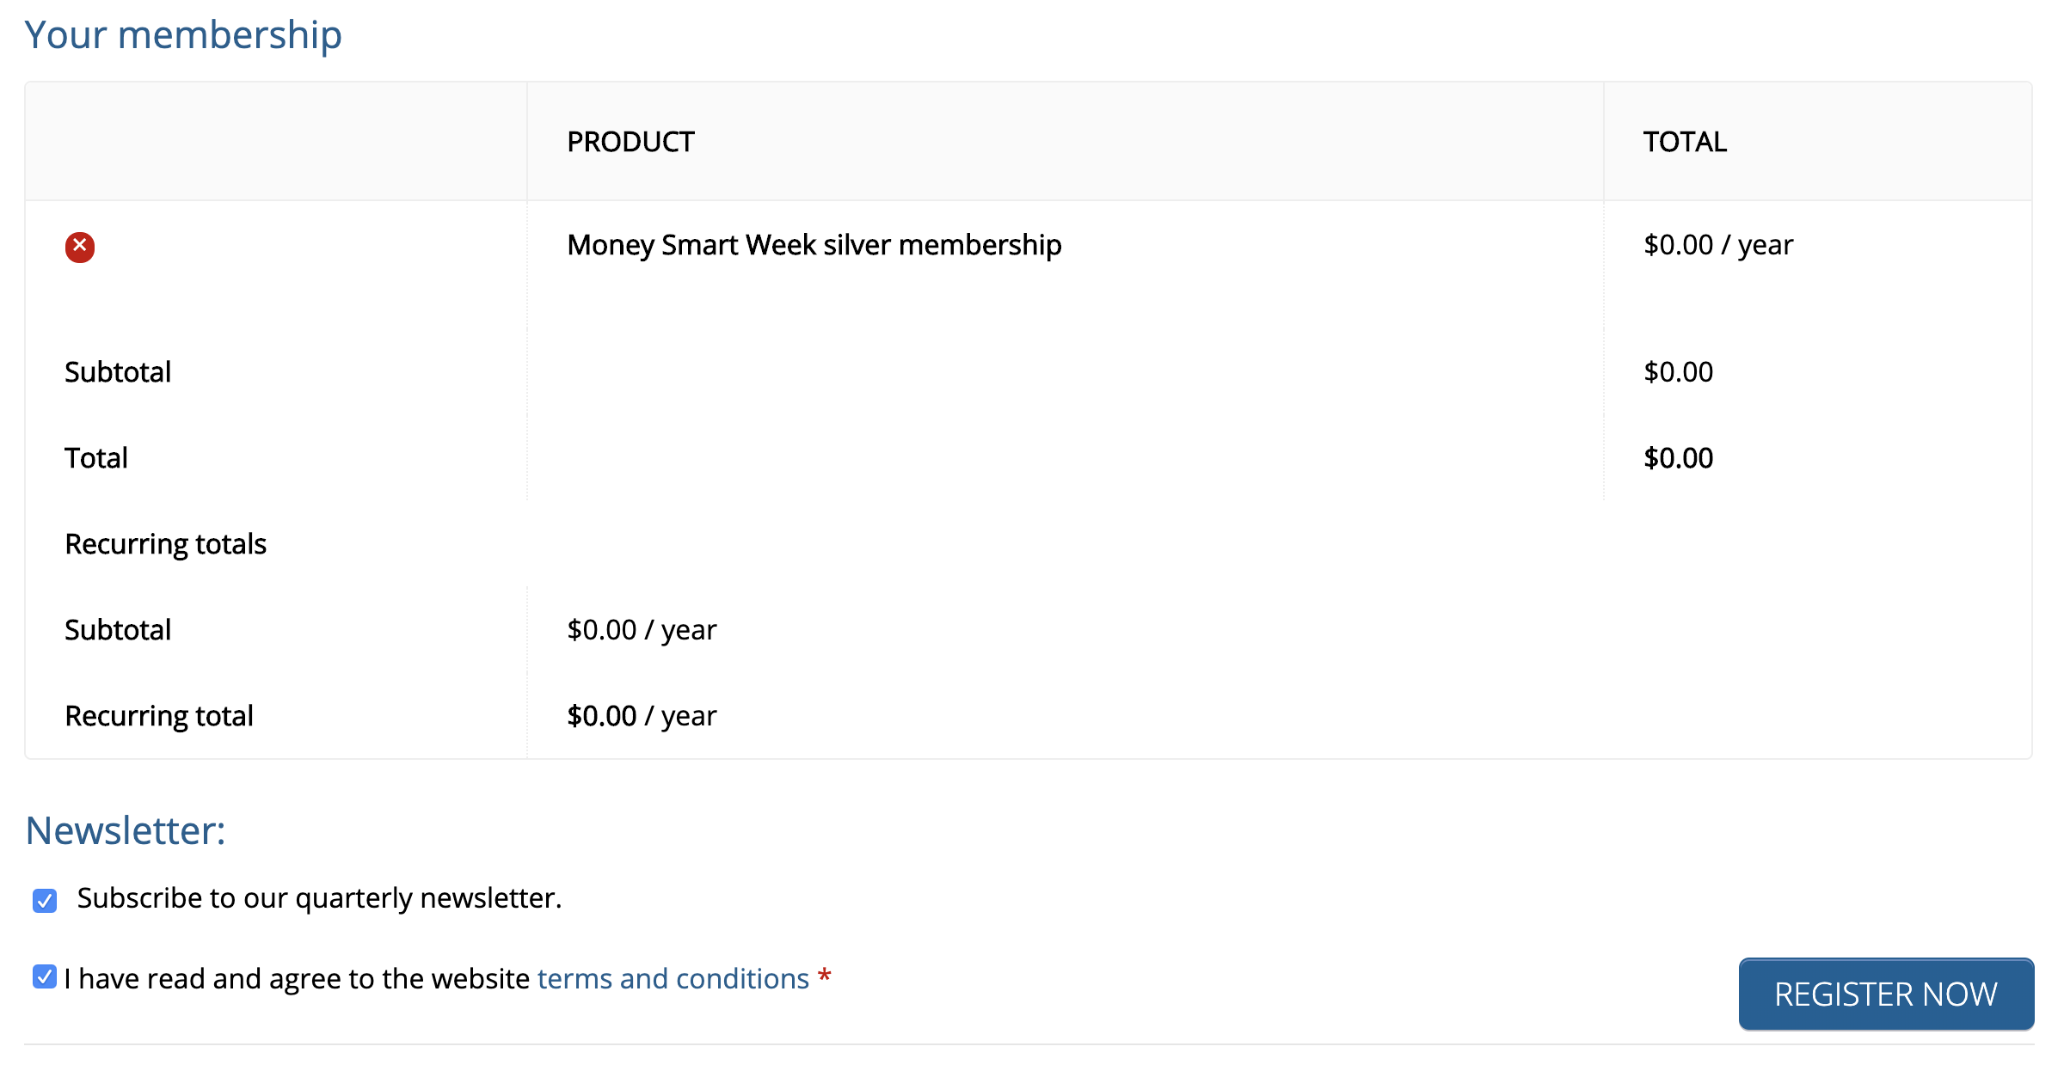
STEP #3: ORDERING
No charge order
No recurring charge
Accept terms
Click ”REGISTER NOW”

Slide 31
STEP #4: ORDERING
Click ”GET CONTENT”

Slide 32
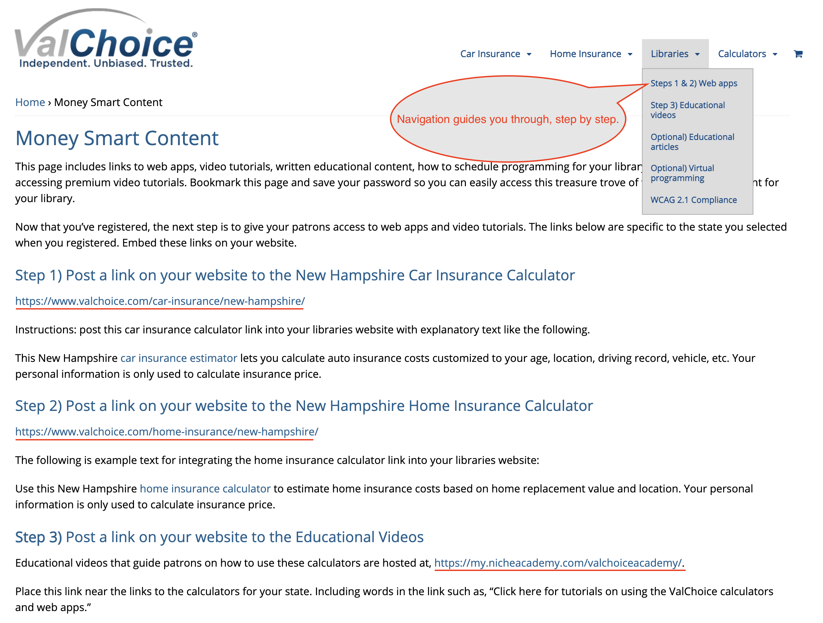
STEP #5: POST ON WEBSITE
Copy your links for pasting into your library’s website

Slide 33
VIDEO LIBRARY
https://my.nicheacademy.com/valchoiceacademy

Slide 34
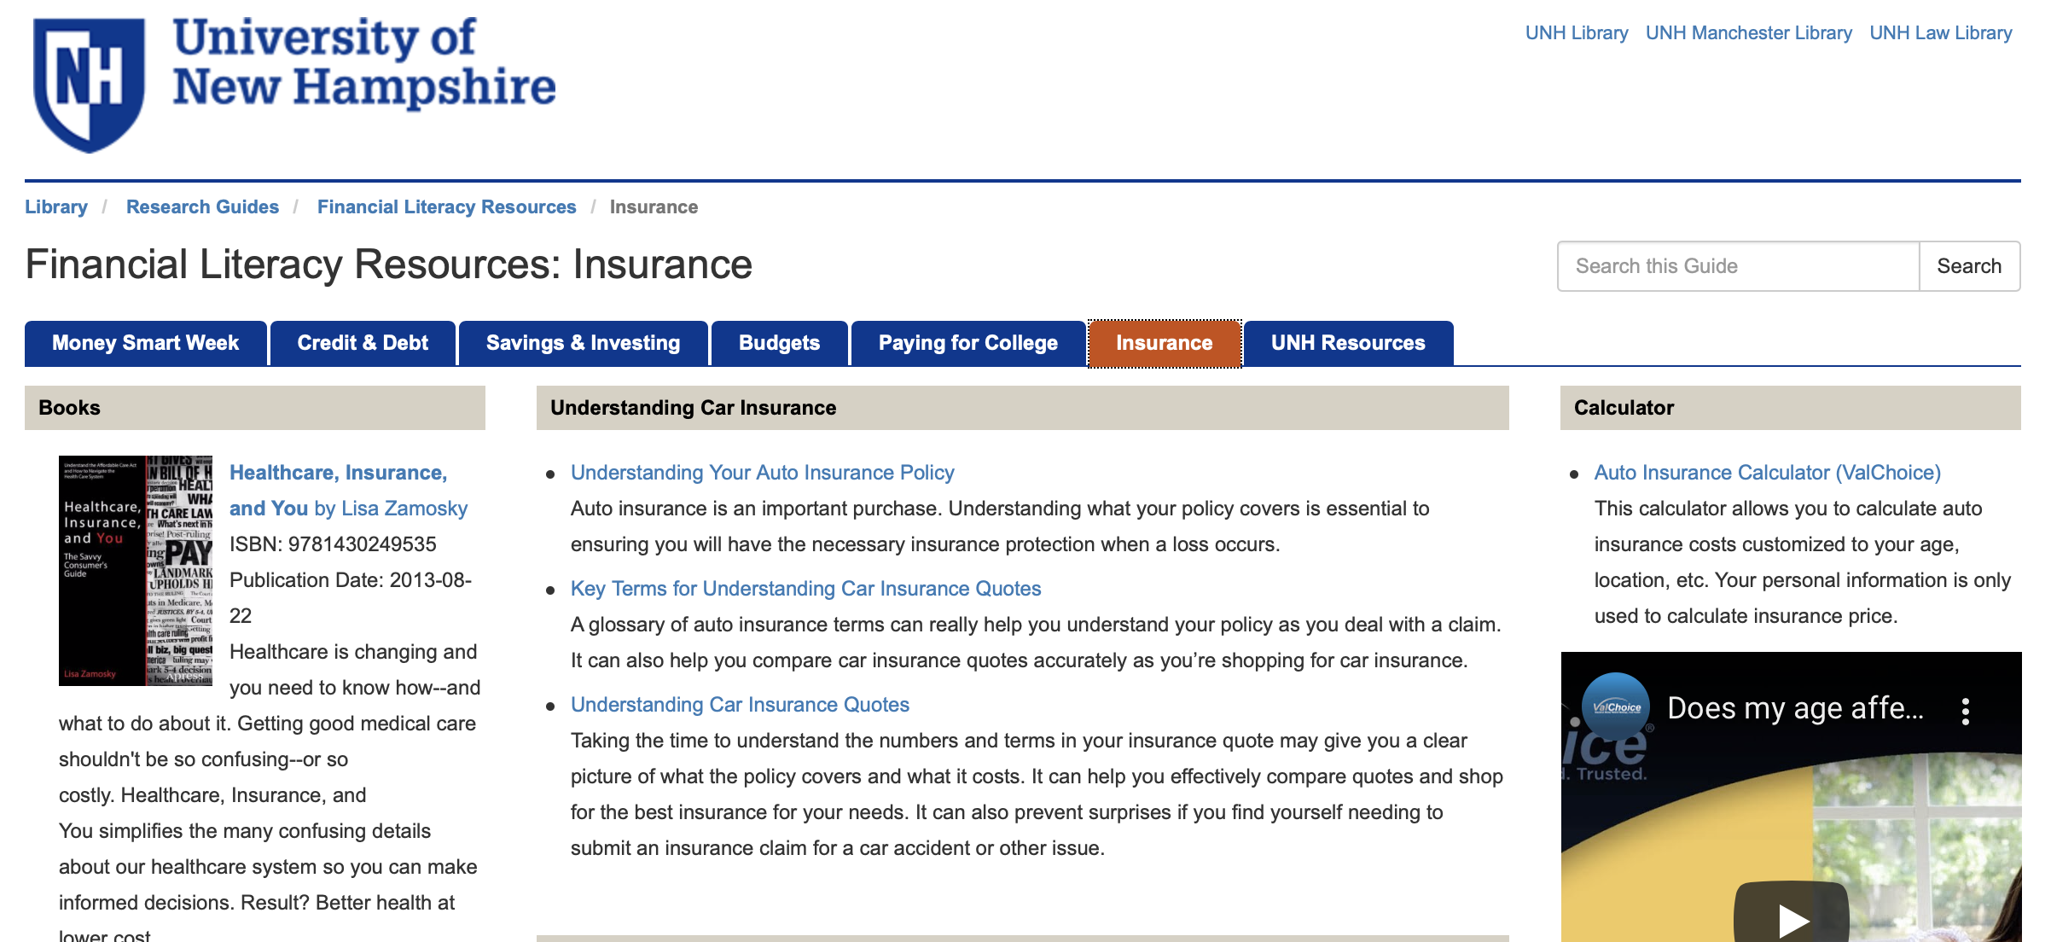
PLACING THE CONTENT

Slide 35
VIRTUAL PROGRAMMING

Slide 36
VIRTUAL PROGRAMMING
Free during Financial Literacy Month
First come, first served
Register
Send link to ValChoice content on your library web site

Slide 37
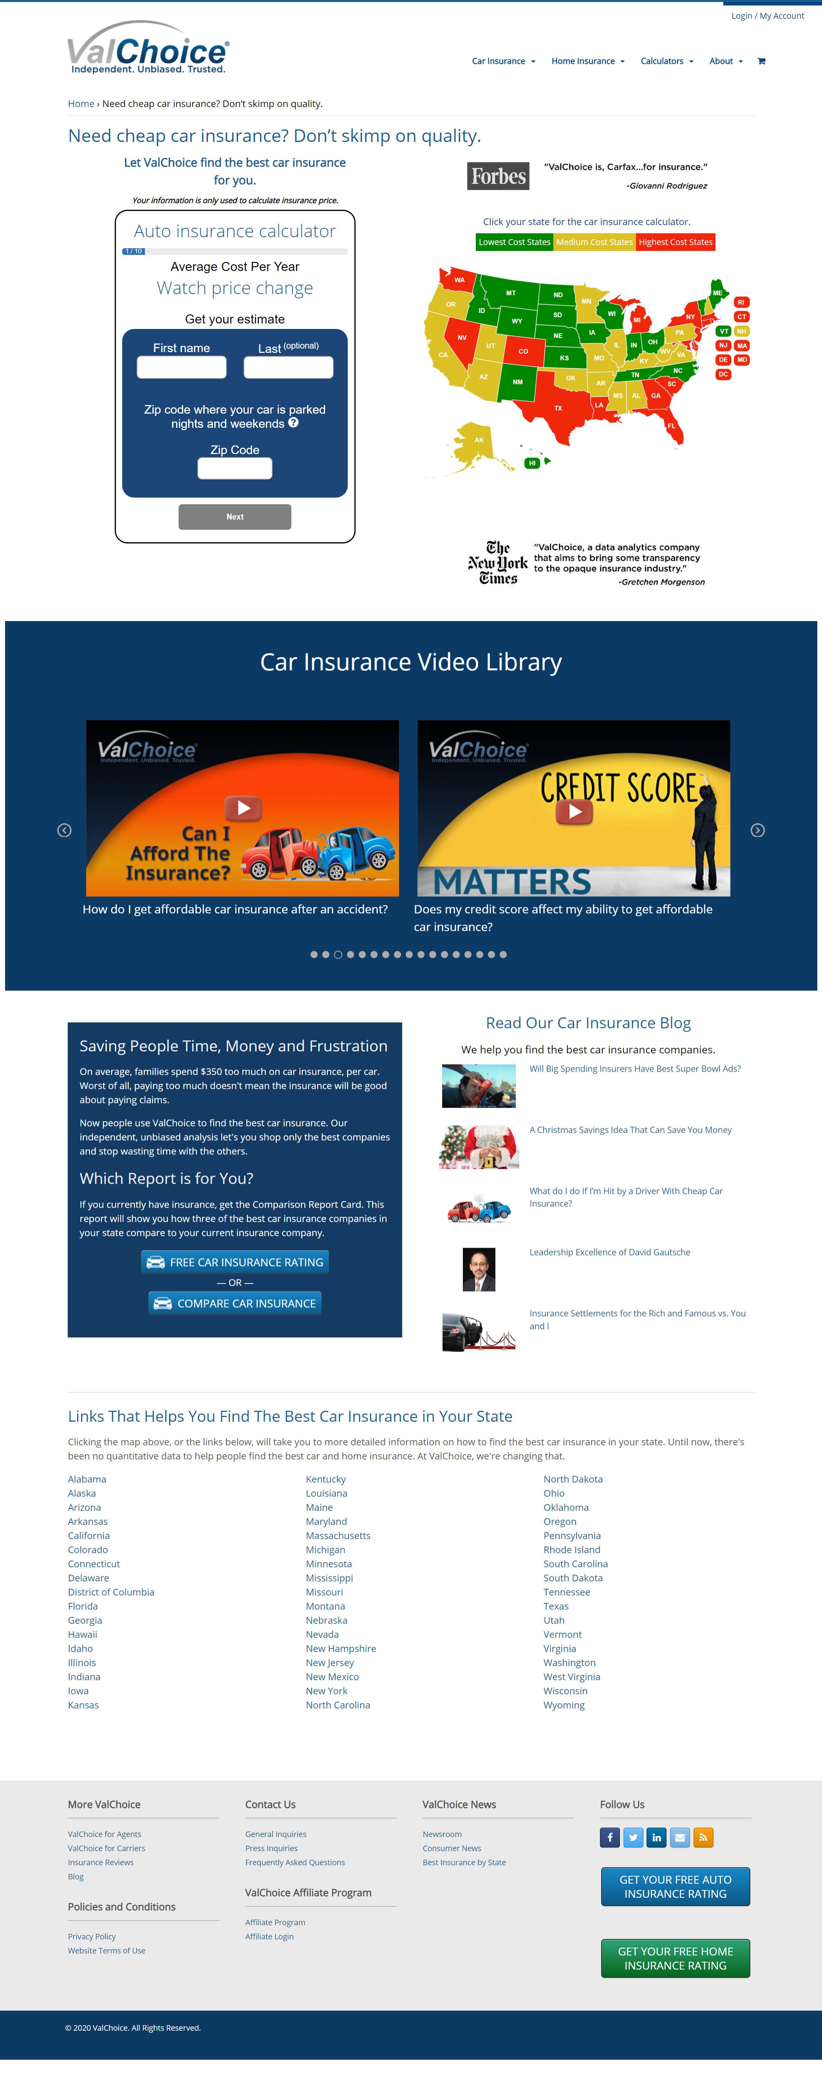
THE VALCHOICE CAR INSURANCE CALCULATOR
Bringing price and claims transparency to buying coverage for automobiles
Find a fair price without pressure to buy
Take control of the coverage and cost through literacy
Select insurance companies based on quality and value
UNDER EMBARGO UNTIL JAN. 26, 2016

Slide 38
THE VALCHOICE CAR INSURANCE CALCULATOR
Bringing price and claims transparency to buying coverage for automobiles
State versions updated as laws and regulations change
Pricing changes with the market
Updates require no support from your organization
No software required on your systems
UNDER EMBARGO UNTIL JAN. 26, 2016

Slide 39
THE VALCHOICE CAR INSURANCE CALCULATOR
Bringing price and claims transparency to buying coverage for automobiles
Customized by location
Educate users on what:
They need
They can influence
Fair
Debunk myths
Much additional info on web page
UNDER EMBARGO UNTIL JAN. 26, 2016

Slide 40
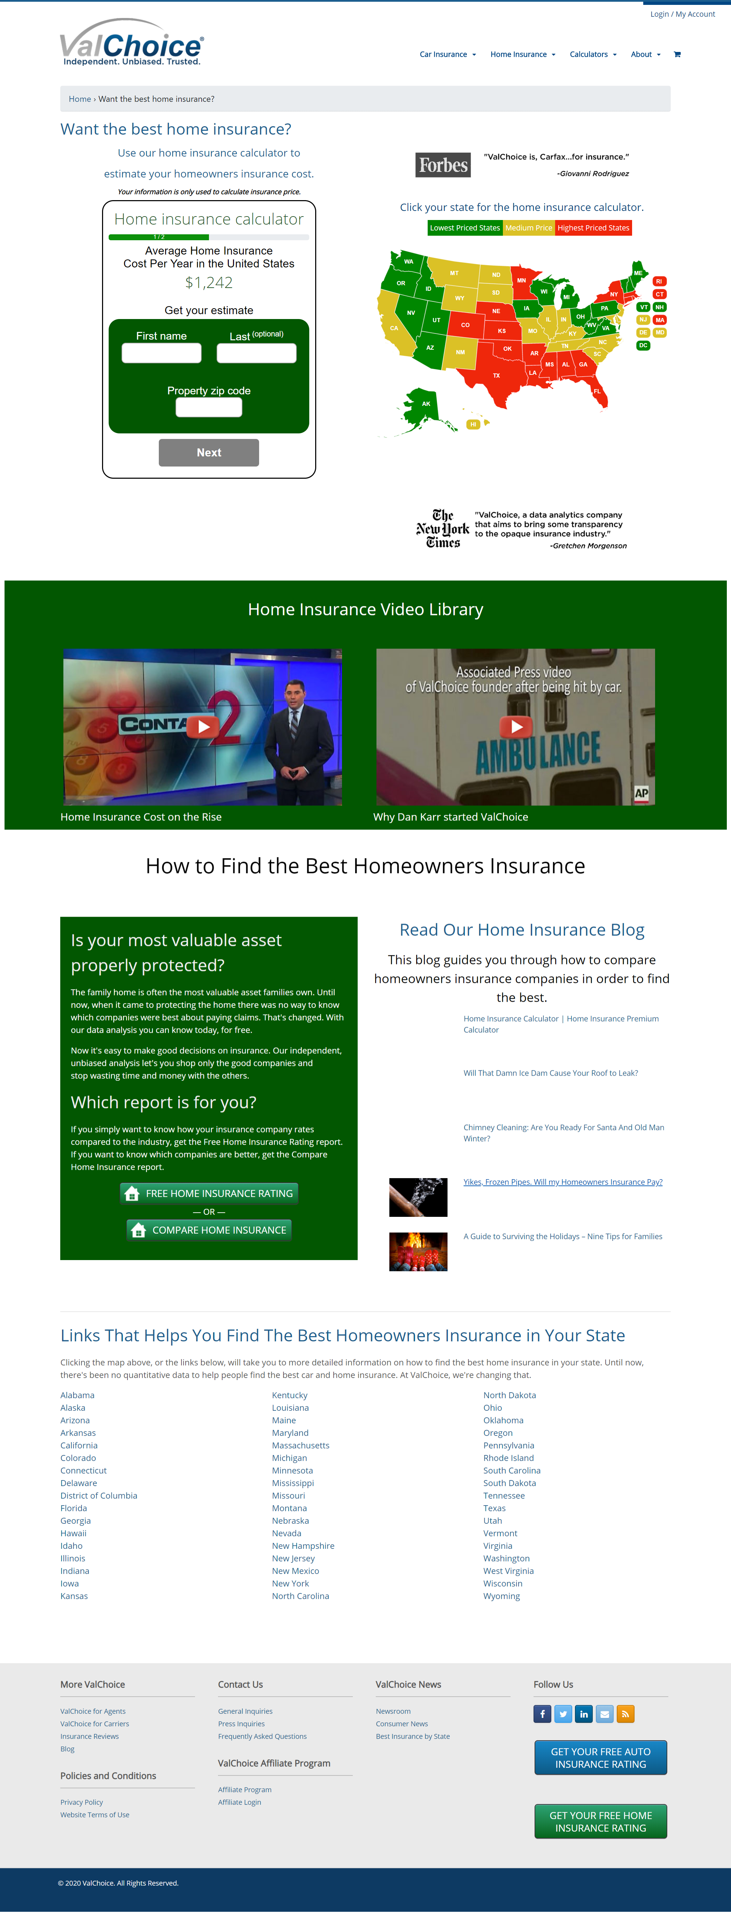
THE VALCHOICE HOME INSURANCE CALCULATOR
Bringing price and claims transparency to buying coverage for consumers most valuable asset
Find a fair price without pressure to buy
Take control of the coverage and cost through literacy
Select insurance companies based on quality and value
UNDER EMBARGO UNTIL JAN. 26, 2016

Slide 41
THE VALCHOICE HOME INSURANCE CALCULATOR
Bringing price and claims transparency to buying coverage for consumers most valuable asset
Updated as prices increase in each state
Updates require no support from your organization
No software required on your systems
UNDER EMBARGO UNTIL JAN. 26, 2016

Slide 42
THE VALCHOICE HOME INSURANCE CALCULATOR
Bringing price and claims transparency to buying coverage for consumers most valuable asset
All info custom, by location
Understand inputs
Debunk myths
Educate users on what’s
They need
They can influence
Fair
Much additional information on page
UNDER EMBARGO UNTIL JAN. 26, 2016

