Slide 1
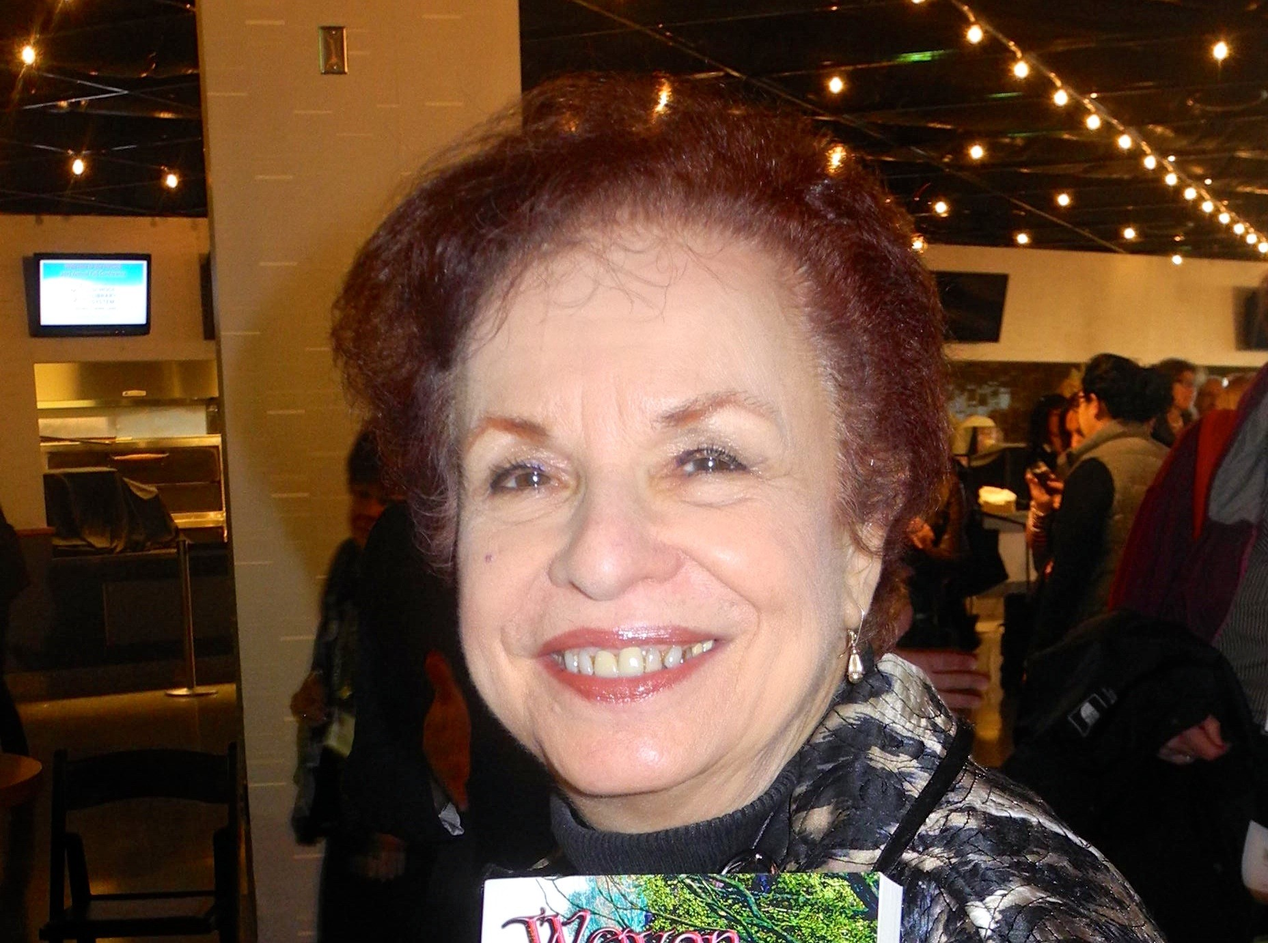
Managing difficult conversations
Hilda Weisburg 7/12/23

Slide 2
You Can’t avoid them
https://tinyurl.com/5dwx3nnm

Slide 3
Sometimes it Erupts
https://tinyurl.com/3zwsdcz9

Slide 4
If you are in it to win it ….
https://tinyurl.com/58y8mjmj

Slide 5
Power struggle
https://tinyurl.com/2u6m5epw

Slide 6
Four types of Power
Power Over
Power With
Power To
Power Within
https://tinyurl.com/yc7shf2y

Slide 7
You and ….
Students/ Young Patrons
Colleagues/Co-Workers
Supervisors / Administrators
Parents / Community Members

Slide 8
Students/ Young Patrons
Minor
Guidelines
Humor
Calm/Suggestion
Confrontational
ACE
Support /Expectations
Avoid Questions
Safety
https://tinyurl.com/bdjmxcbh

Slide 9
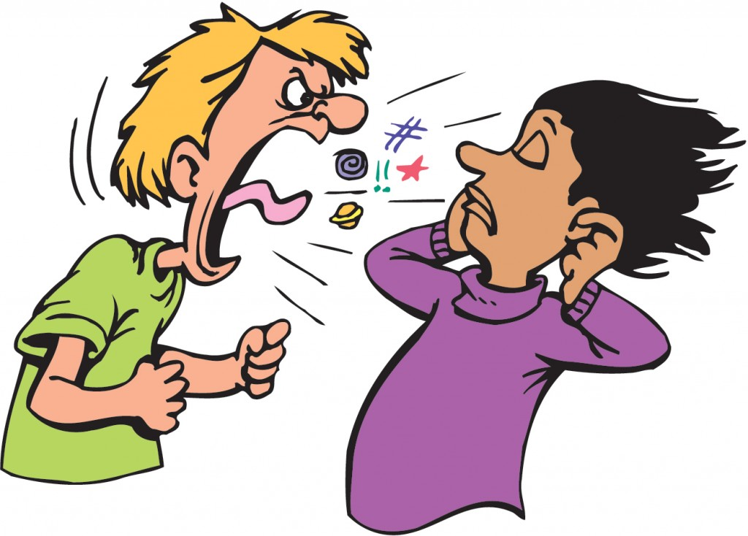
Colleagues/Co-Workers
Manage your emotions
Respond to the message
Cognitive dissonance
https://tinyurl.com/ye26wxwy
Notes:
Cognitive dissonance -https://www.verywellmind.com/what-is-cognitive-dissonance-2795012 Wikipedia Cognitive dissonance is typically experienced as psychological stress when persons participate in an action that goes against one or more of those things.^{[1]} According to this theory, when two actions or ideas are not psychologically consistent with each other, people do all in their power to change them until they become consistent. https://en.wikipedia.org/wiki/Cognitive_dissonance

Slide 10
Supervisors / Administrators
Don’t Defend
Ask for Suggestions
Build the Relationship
Toxic Culture
https://tinyurl.com/3y2zexrk

Slide 11
Parents / Community Members
Challenges
Be Prepared
ALA Selection Reconsideration Toolkit
Stay Calm
Listen/Explain
Inform
State Library Association
ALA- www.ala.org/oif
https://tinyurl.com/5xmx24vz

Slide 12
Your turn
Starting the conversation
Wish to avoid
Recognition of need
Don’t procrastinate
https://tinyurl.com/4x5pmka2

Slide 13
you Don’t have a Choice
Scenarios
Colleague
Interrupting a lesson
Using your things
Administrator
Not informing you of schedule changes
Parent
Allowing their child to act up
https://tinyurl.com/ms23m827
Notes:
We teach people how to treat us.

Slide 14
Managing the Conversation
Your Emotions
Know Your Why
Goal
When
The Opening
https://tinyurl.com/53n257yz

Slide 15
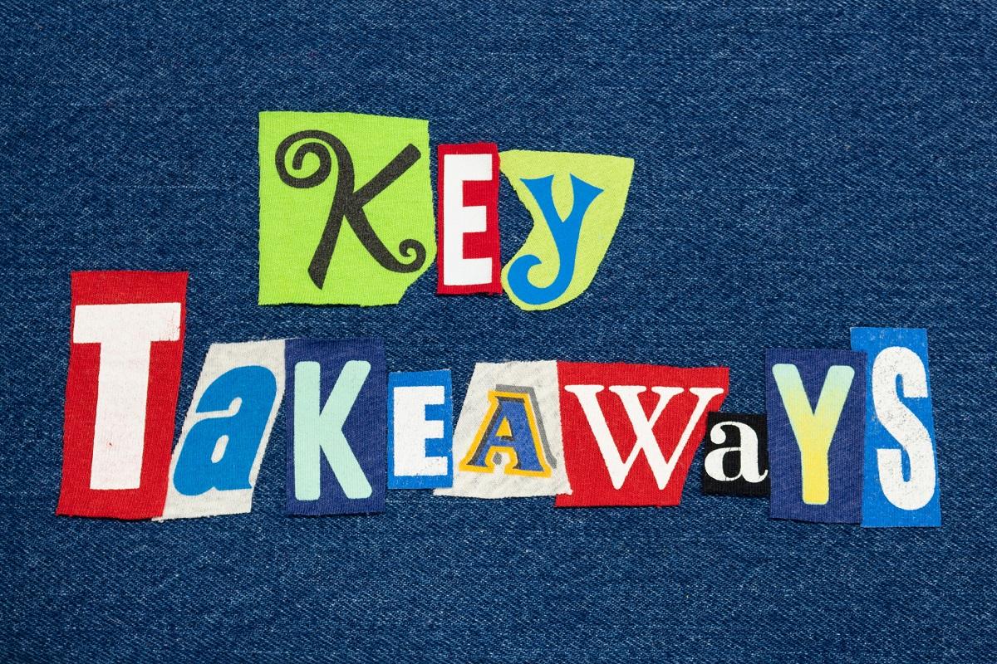
https://rb.gy/tdhtkz

Slide 16
$45
20% Discount
Total $36

Slide 17
Questions? Follow-up?
Hilda Weisburg
hilda@slworkshop.net
Facebook – School Librarian’s Workshop
https://hildakweisburg.com/blog/

