Slide 1
Building Belonging: The Key to Creating Connection in DEI

Slide 2
Agenda
The State of DEI
Let’s Talk About the “B” - Belonging
Making it Real
What Can You Do Today?
Q&A
The Belonging Guy.

Slide 3
The State of DEI

Slide 4
The Current State of DEI
DIVERSITY
EQUITY
INCLUSION
INTERSECTIONALITY
BELONGING
UNCONSCIOUS BIAS
We hear so much about DEI these days but what does it really mean?

Slide 5
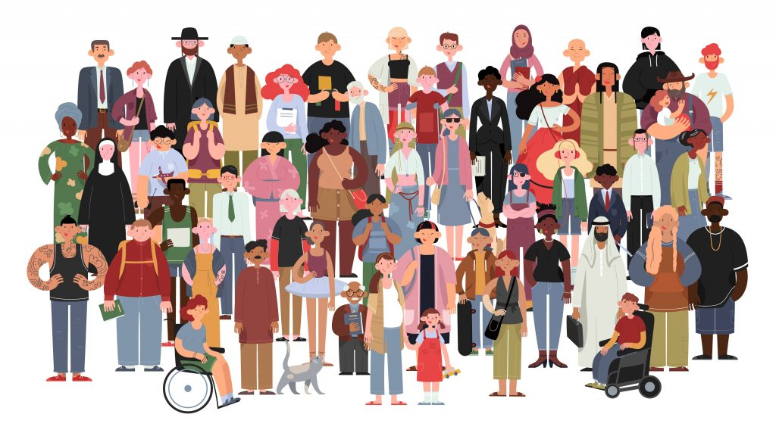
Diversity
Race
Gender
Sexual Orientation
Age
Socioeconomic Status
Education
Disability

Slide 6
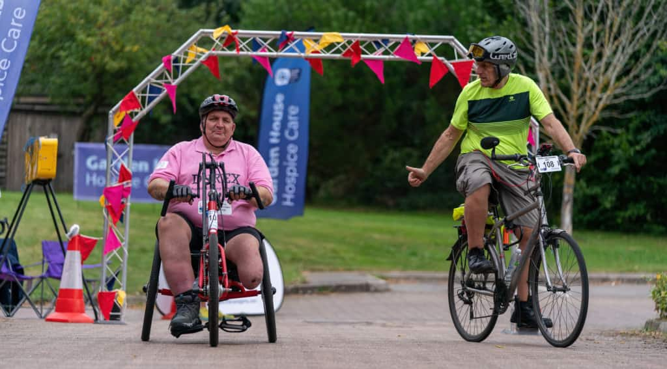
Equity
Tailoring what is provided to unique needs

Slide 7
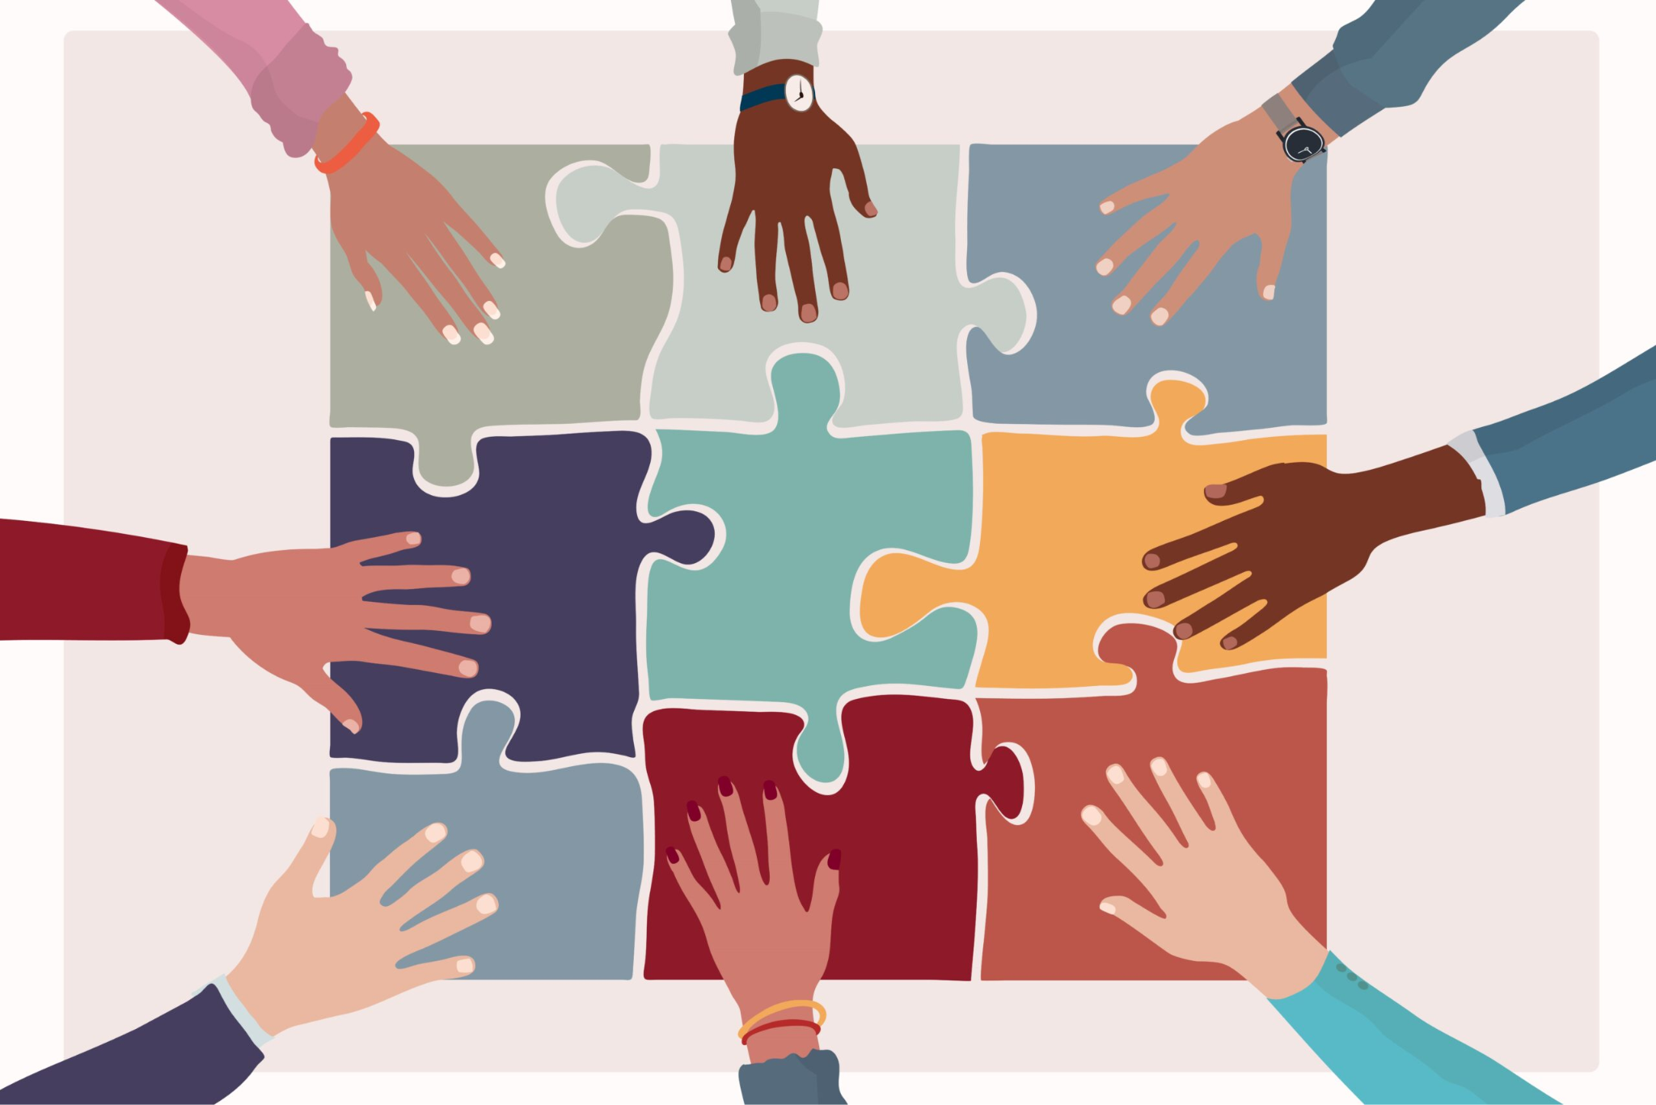
Inclusion
Going beyond diversity, allowing full engagement

Slide 8
Unconscious Bias
There are many different forms of bias
Halo / Horns Effect
Confirmation Bias
Affinity Bias
Conformity Bias
Anchor Bias
Authority Bias
Recency Bias
Attribution Bias
Appearance Bias
Contrast Bias

Slide 9
Unconscious Bias
There are many different forms of bias
Halo / Horns Effect
Confirmation Bias
Affinity Bias
Conformity Bias
Anchor Bias
Authority Bias
Recency Bias
Attribution Bias
Appearance Bias
Contrast Bias

Slide 10
Let’s Talk About the “B”

Slide 11
What is Belonging?
A 2019 study by the Think Tank Coqual has broken down Belonging into 4 elements:
Feeling Seen - you are recognized, rewarded and respected
Feeling Connected - you have positive, authentic social connections with peers, managers and leaders
Feeling Supported - those around you give you what you need to get your work done / live a fuller life
Feeling Proud - you feel aligned with purpose, vision and values
The Belonging Guy.
11

Slide 12
Why Belonging?
1
One Metric
2
Performance Increase
3
Out at Work
A sense of belonging in the workplace is the ONE single metric that is consistently tied to workplace commitment, motivation and pride.
(Paradigm, 2018)
High belonging is linked to a 56% increase in job performance, a 50% drop in turnover risk and a 75% reduction in sick days.
(HBR, 2019)
LGBTQ+ employees who are able to be “out” at work are 30% more productive than employees who have to hide their sexual orientation.
(Frost, 2014)
The Belonging Guy.

Slide 13
A Belonging Exercise
Instructions
Take a few moments to write in the chat briefly about someone who created Belonging for you.
What were their actions? How did it make you feel? Why was it important?

Slide 14
A Little Truth About Belonging

Slide 15
Making it Real

Slide 16
Slowing the Train Down

Slide 17
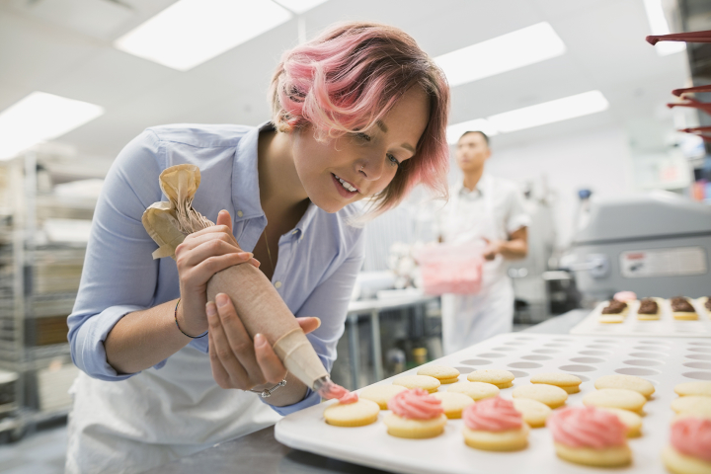
It’s Gotta be “Baked In”
Too often we treat DEIB like the icing on the cake.

Slide 18
The Importance of Language
Language plays such a critical role in DEIB
Foundation of Respect
Ability to Create Belonging
… and it’s so difficult to change

Slide 19
Don’t Outkick Your Coverage
Can you truly support the passion and good intentions that are behind your DEI efforts?

Slide 20
What Can You Do Today?

Slide 21
What Can We Do Today?
Just a few ideas you can use
Consider how you can create Belonging for someone else
Identify one area where you can make DEIB part of the batter
Identify an area around inclusive language that you can be more mindful of
Respect Pronouns and include them in your email signature
Give grace
Let Google and AI be your friend

Slide 22
Q&A
The Belonging Guy.

