Slide 1
Lateral Reading Mindset: Contextualizing Information Resources
Anders Tobiason, Assistant Professor / Multimedia Development and User Experience Librarian,
Boise State University
anderstobiason@boisestate.edu
@anders_Tobiason

Slide 2
Unceded land of the Shoshone, Northern Payute, and Bannock. http://www.sbtribes.com/. https://www.indigenousidalliance.org/ https://nativegov.org/news/beyond-land-acknowledgment-guide/

Slide 3
context

Slide 4
Stanford History Education Group. (Jan. 6, 2020) “Sort fact from fiction online with lateral reading” retrieved from https://youtu.be/SHNprb2hgzU

Slide 5
Lateral Reading as Proactive Evaluation

Slide 6
“Students don’t merely lack the skills they need to thrive in a digital environment. It’s worse. They’ve been taught ineffective ones.” (16)
Wineburg, S., Breakstone, J., Ziv, N., & Smith, M. (2020)

Slide 7
The CRAAP test is crappy….

Slide 8
How do you buy stuff online?

Slide 9
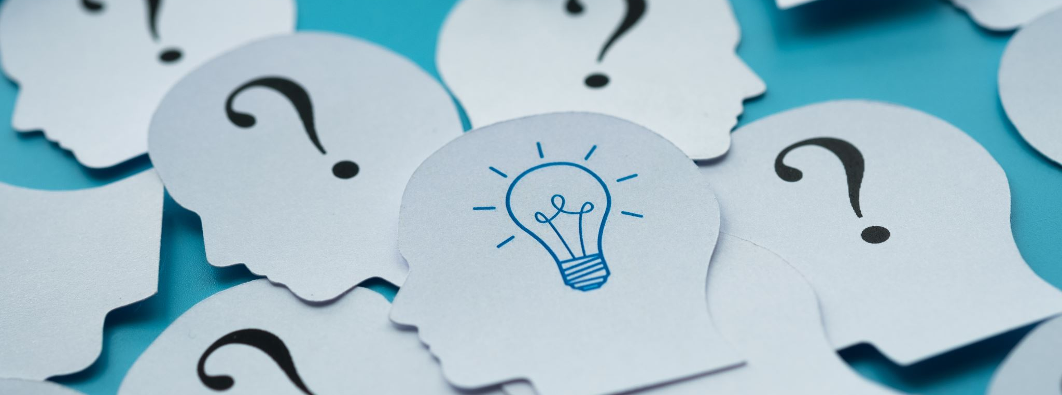
Read Around the Resource

Slide 10
Curiosity
“A strong desire to know about something.”
Oxford Learners Dictionary

Slide 11
“Wandering is not wondering.” (Inan, 11)

Slide 12
“What can we do as educators to encourage the ethical practice of curiosity, not just for times of uncertainty but as an everyday habit? What are we doing that inhibits curiosity? How can we pair curiosity with robust ethical practices that lead to creating, evaluating, and sharing information with integrity?” Fister, 2022

Slide 13
SIFT Created by Mike Caulfield https://hapgood.us/2019/06/19/sift-the-four-moves/
Trace Claims, Quotes, and Media
Investigate the Source
Find Better Coverage
Stop

Slide 14
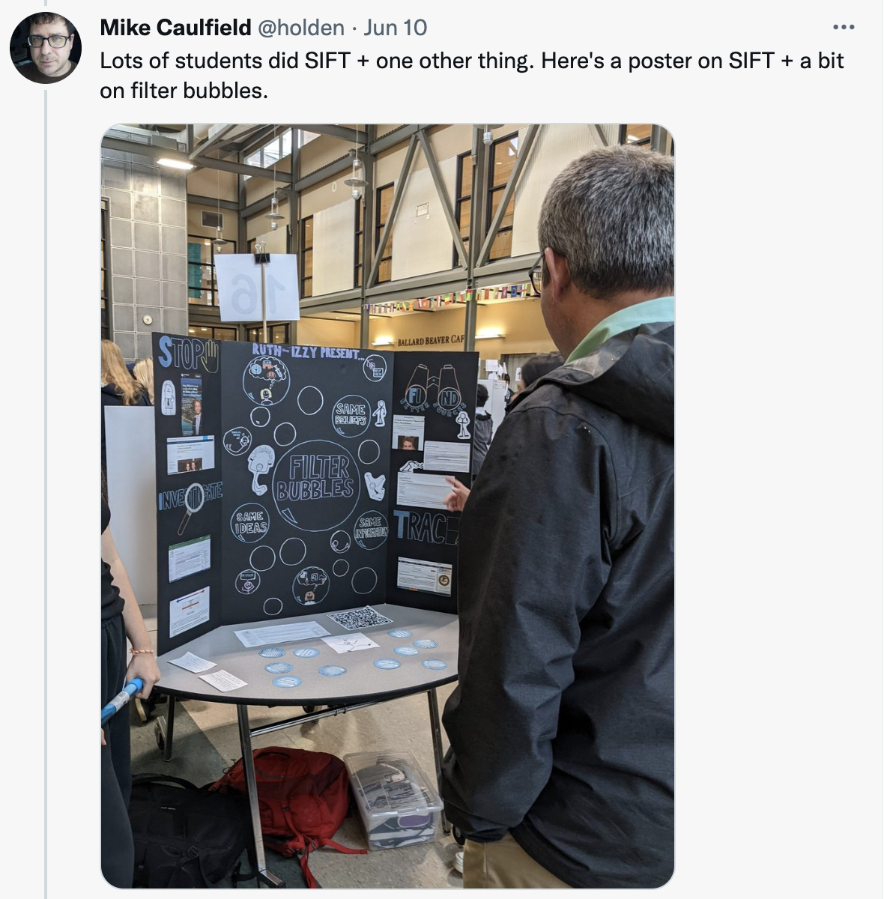
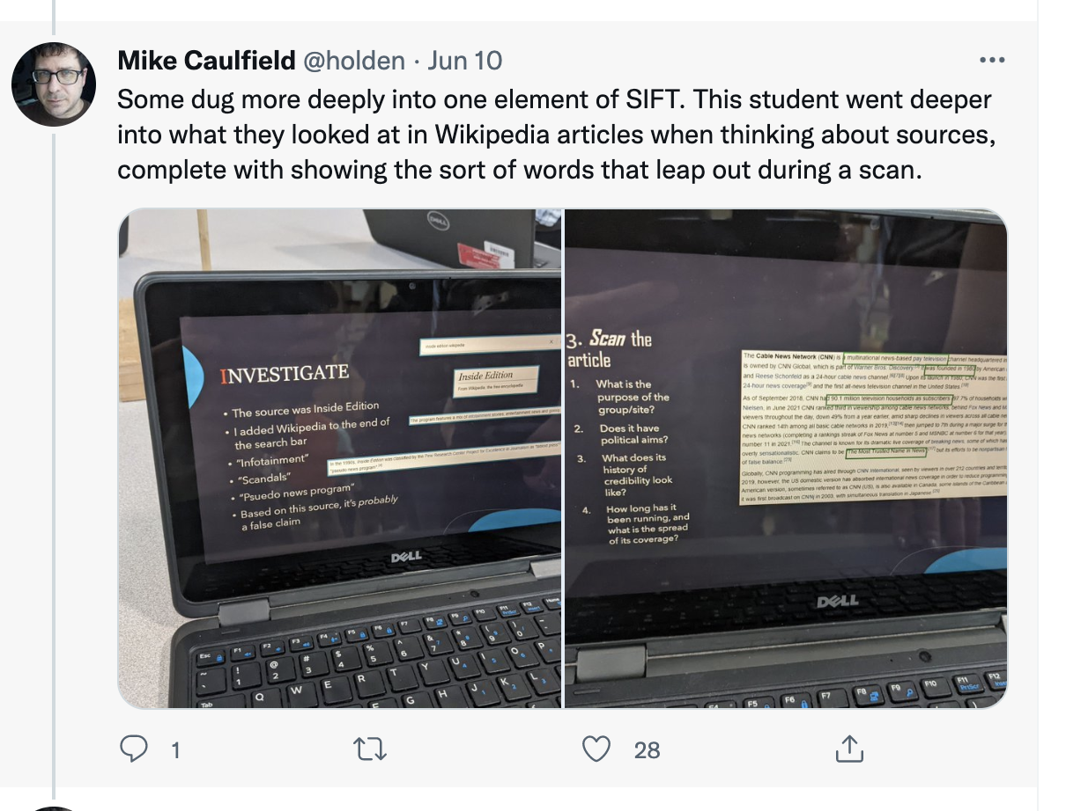
Caulfield, M. (June 10, 2022) 8:44 am. Twitter. Retrieved from https://bit.ly/3pnli38

Slide 15
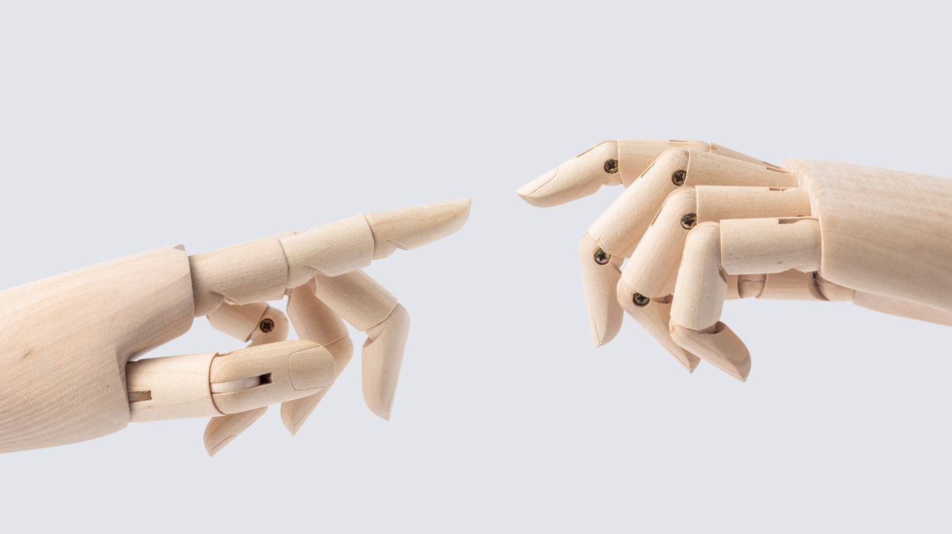
Real Vs Fake is a False Dichotomy

Slide 16
“The question I suggest asking instead of ‘what is the credibility of this information?’ is ‘what sort of public memory does this information invoke?’” (Johnson, 9)

Slide 17
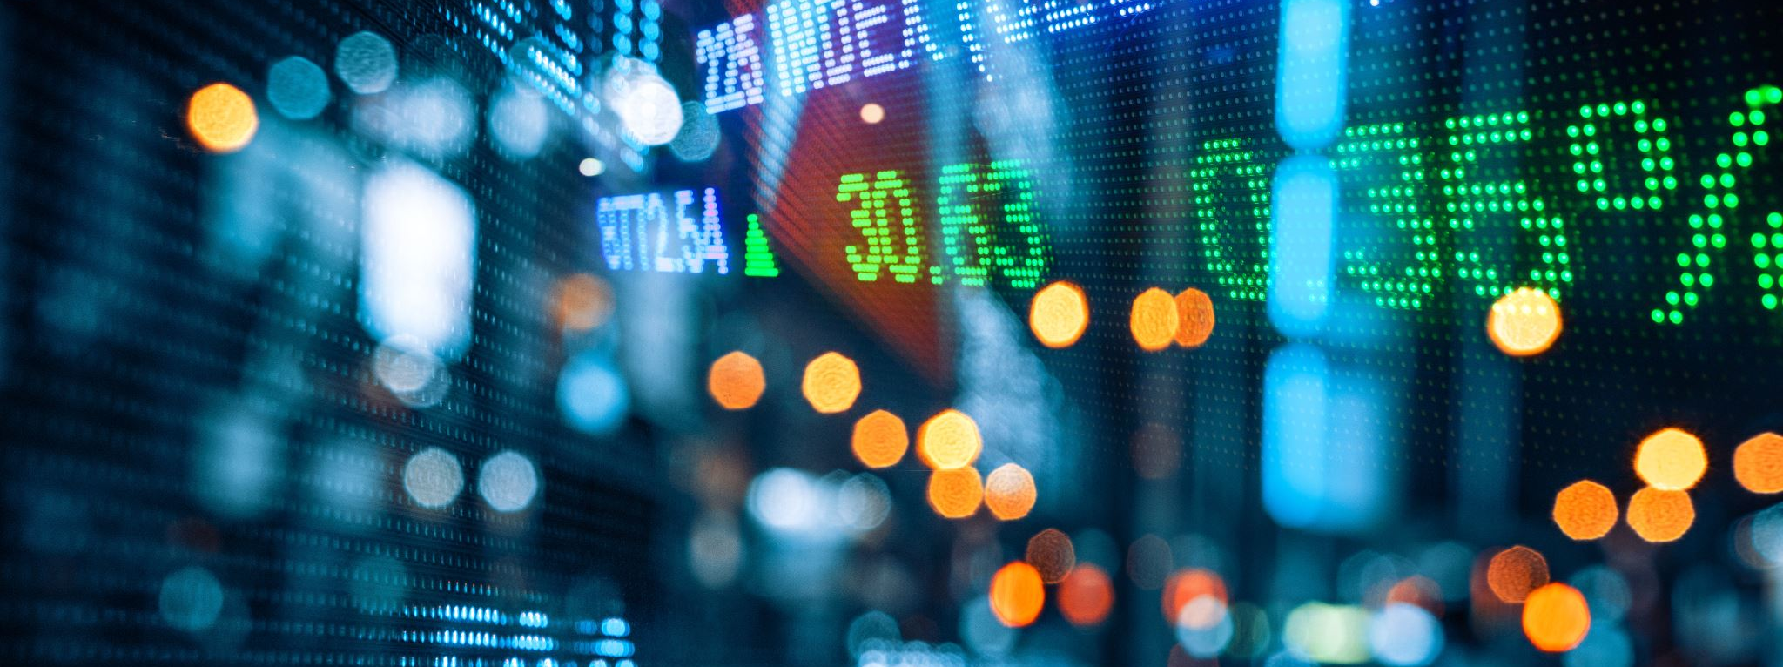
It’s All About Context

Slide 18
The Economic Policies Institute
Question:
Who is the Managing Director? Do a Web Search for him…..
“But something fundamental goes unsaid in the institute’s reports: The nonprofit group is run by a public relations firm that also represents the restaurant industry, as part of a tightly coordinated effort to defeat the minimum wage increase that the White House and Democrats in Congress have pushed for.”
Lipton, E (Feb. 9, 2014).

Slide 19
Who Are You?
A Simple Question…..

Slide 20
Let’s do some Lateral Reading
The 100 Percent Renewable Energy Myth
Select the link above, go to the website and look around. Record your observations about the website design, the formatting, etc. Look for any markers that can help you understand and evaluate the website for credibility.
Who is the Institute for Energy Research? Do a quick web search and take down any information about them that seems out of step with how they present themselves in this policy brief and on their website. This policy brief cites a number of articles in its footnotes. One of these is by the American Action Forum. Who are they? Do a quick web search and take down any information about them
After doing this short bit of Lateral Reading, how would you describe the credibility of this resource?

Slide 21
The Practice of Lateral Reading

Slide 22
“Disinformation is not a bug in the code, it’s a feature wielded for political gain, and a great risk to American Democracy.” (Tripoldi, xvi)

Slide 23
It all begins with a Question

Slide 24
Thank You

Slide 25
List of Resources
Bull, A. C., MacMillan, M., & Head, A. J. (2021). Dismantling the evaluation framework. In the Library with the Lead Pipe.
Caulfield, M. (2019). SIFT (The Four Moves). Hapgood.com. https://hapgood.us/2019/06/19/sift-the-four-moves/
Caulfield, M. (June 10, 2022) 8:44 am. Twitter.com. https://bit.ly/3pnli38
Fister, B. (2022) Principled Uncertainty: Why Learning to Ask Good Questions Matters More than Finding Answers. Provocation Series, Project Information Literacy. https://projectinfolit.org/pubs/provocation-series/essays/principled-uncertainty.html
Inan, I. (2018) Curiosity, Truth, and Knowledge. In I. Inan, L. Watson, D. Whitcomb, and S. Yigit (eds) The Moral Psychology of Curiosity (pp. 11-35). Rowman & Littlefield.
Johnson, N. (2020) Architects of Memory: Information and Rhetoric in a Networked Archival Age. Tuscaloosa: University of Alabama Press.
Lipton, E (Feb. 9, 2014). Fight Over Minimum Wage Illustrates Web of Industry Ties. New York Times.. https://www.nytimes.com/2014/02/10/us/politics/fight-over-minimum-wage-illustrates-web-of-industry-ties.html
Kozyreva, A., Wineburg, S., Lewandowsky, S., & Hertwig, R. (2022). Critical ignoring as a core competence for digital citizens. Current Directions in Psychological Science, https://doi.org/10.1177/09637214221121570
Mery, Y. (2020) How Do I Evaluate Online Information by Reading Laterally? University of Arizona Libraries. https://new.library.arizona.edu/tutorials/evaluating-online-info/#/
Stanford History Education Group. (Jan. 6, 2020) “Sort fact from fiction online with lateral reading” retrieved from https://youtu.be/SHNprb2hgzU
Tripoldi, F. (2022). The Propagandists' Playbook: How Conservative Elites Manipulate Search and Threaten Democracy. Yale University Press
Wineburg, S., & McGrew, S. (2017) Lateral Reading: Reading Less and Learning More When Evaluating Digital Information. Stanford History Education Group Working Paper No. 2017-A1. https://papers.ssrn.com/sol3/papers.cfm?abstract_id=3048994
Wineburg, S., Breakstone, J., Ziv, N., & Smith, M. (2020) Educating for Misunderstanding: How Approaches to Teaching Digital Literacy Make Students Susceptible to Scammers, Rogues, Bad Actors, and Hate Mongers. Working Paper A-21322, Stanford History Education Group, Stanford University, https://purl.stanford.edu/mf412bt5333.
Wineburg, S., & Ziv, N. (Aug. 1, 2022) Op-Ed: What happens when TikTok is your main source of news and information. Los Angeles Times. https://www.latimes.com/opinion/story/2022-08-01/gen-z-misinformation-tik-tok-instagram-social-media

