Slide 1
Partnerships for Student Success
Collaborating with Student Success Administrators
Amy Vecchione, MLIS
Assistant Director of Research and Innovation | eCampus Center Extended Studies | Boise State University
Cathlene McGraw, MS
Remote Academic Advisor | Lundquist College of Business | University of Oregon

Slide 2
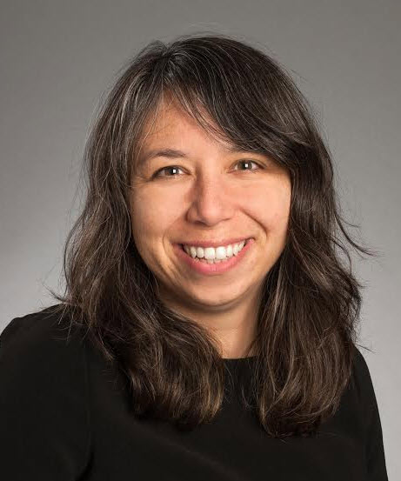
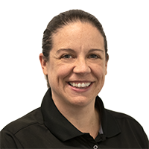
Introductions
Amy Vecchione, MLIS
Amy is an educational leader with a several decades long career in libraries. Leading a team to conduct research and innovation in online learning, Amy’s ultimate goal is to increase student success. Amy earned an MLIS at the University of Washington and is currently pursuing an EdD in higher education leadership.
Cat McGraw, M.S.
Cat is returning to advising in the Lundquist College of Business after serving in advising leadership positions at Boise State University and the New Jersey Institute of Technology. She earned a BA in Journalism from the University of Oregon and an MS in College Student Services from Oregon State with a focus on working with at-risk/at-promise students. She supported students and faculty as the Director of Queer Student Services at Portland State where she found her passion for academic advising. Cat currently lives in New Jersey with her partner and 2 rad kids.

Slide 3
Overview
This workshop will transform your approach to student success
Here’s what we will do together:
Introductions
Design thinking
Create action plan

Slide 4
Context
At-Risk to At-Promise
Shifting campus populations
Working alongside those we serve
Co-create an environment in which students thrive
Library as Interdisciplinary Student Success Hub
Networked hubs that provide access to faculty and peers
Open educational resources
Innovative services
“If we teach young people to run from the darkness rather than open up to the light in the darkness, to be the candles, the signposts, then we are doing great harm to them and to the communities they come out of” (Vincent Harding 2011)

Slide 5
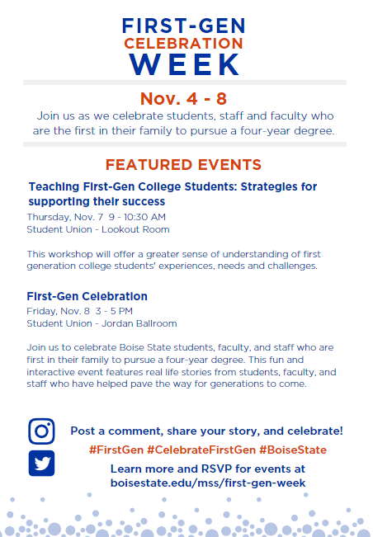
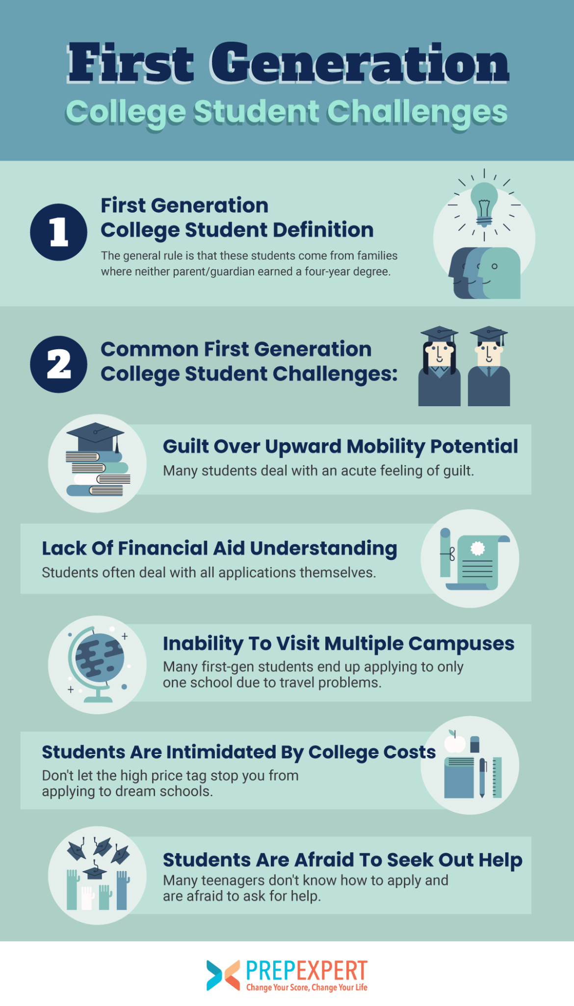
Audience
Some possible characteristics of First Generation Students
Encounter challenges
Single parents
LGBTQIA+
Low income
Underrepresented minorities
Rural students

Slide 6
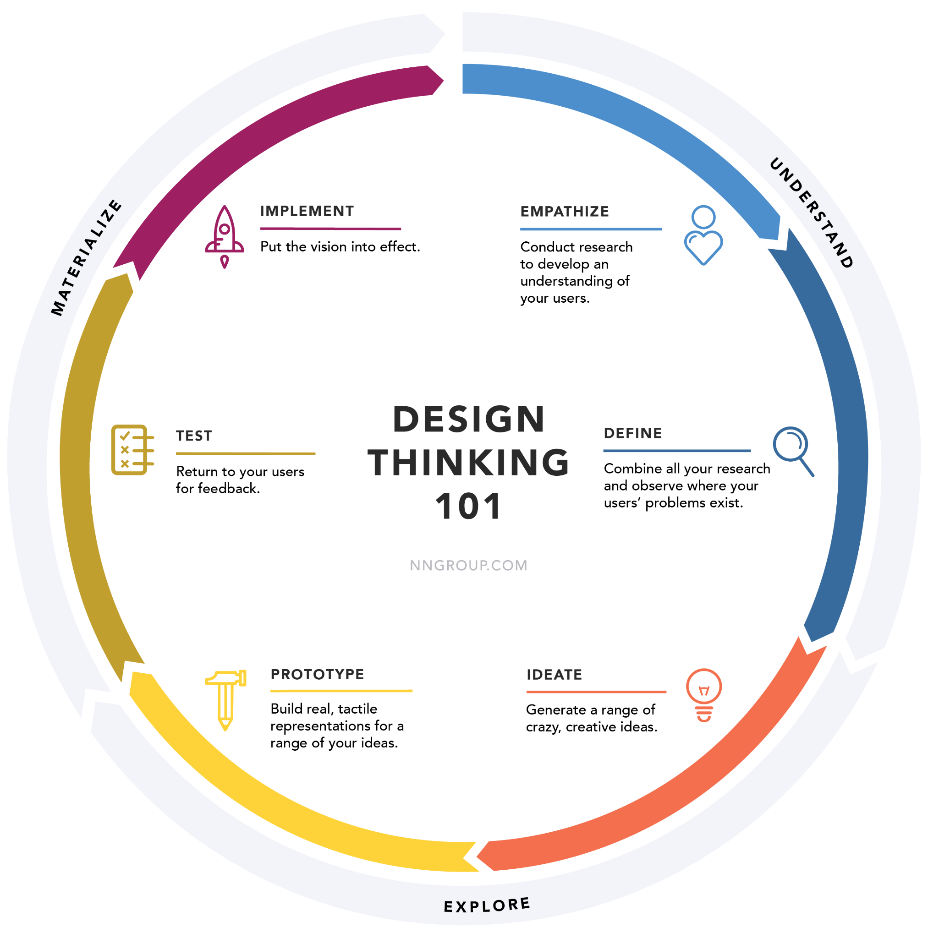
Design Thinking

Slide 7
Identifying Collaborators
Who May Help Them
First generation students interested in supporting their peers
Nontraditional student union
TRIO Office
McNair
LGBTQIA+ Support Services
Advisors
Brainstorm: On your campus who are examples of
people/departments who could help?

Slide 8
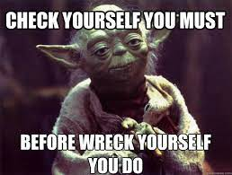
Gaining Empathy
Interview
Collecting Data
Needs Assessment
Search literature

Slide 9
Create a Problem Statement
____________ need ______________ in order to ________________________.
“First Generation College Students need food security in order to have their basic needs met and attend class.”

Slide 10
Collect Evidence: Evidence Based Practice
Ideas, Brainstorm, Ideation Time
Eportfolio
Career education
Basic needs
https://firstgen.naspa.org/blog/first-gen-stories

Slide 11
Managing Partnerships
Establish shared goals Find functional area boundaries Find shared value Share work from your fields Ideate solutions Identify needs Prototype and test | Consensus Building relationships Cogenerating services Collaboration Setting expectations Communication

Slide 12
Understanding Roles: RACI and Gantt Chart
Responsible The person who performs the work. There must be one “R” on every row, no more and no less.
Accountable The person ultimately accountable for the work or decision being made.
Consulted Anyone who must be consulted with prior to a decision being made and/or the task being completed.
Informed Anyone who must be informed when a decision is made or work is completed.

Slide 13
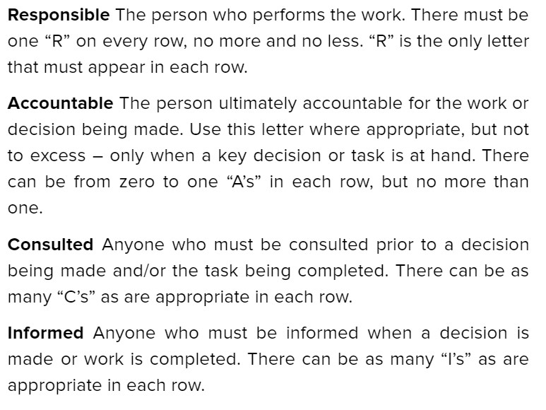
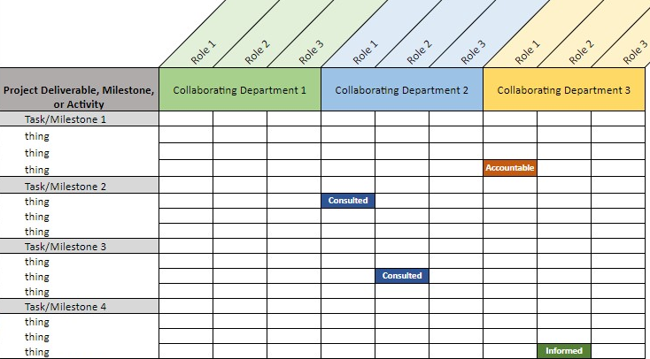
Understanding Roles

Slide 14
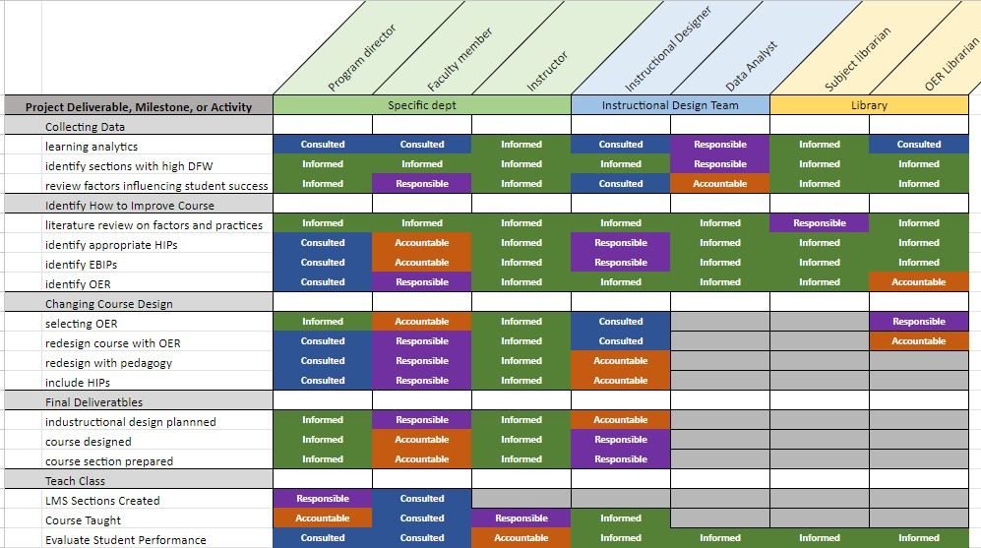
Understanding Roles

Slide 15
Understanding Roles: Gantt Long Term

Slide 16
Action Plan: Next Steps
Complete your action plan
Discuss your action plan with colleagues
Reach out to Cathlene and Amy with consultation requests of any kind
Amy Vecchione
amyvecchione@boisestate.edu
Cathlene McGraw
cathlene@uoregon.edu

