Slide 1
Accessibility in Your Library
JJ Pionke
Applied Health Sciences Librarian
pionke@Illinois.edu

Slide 2
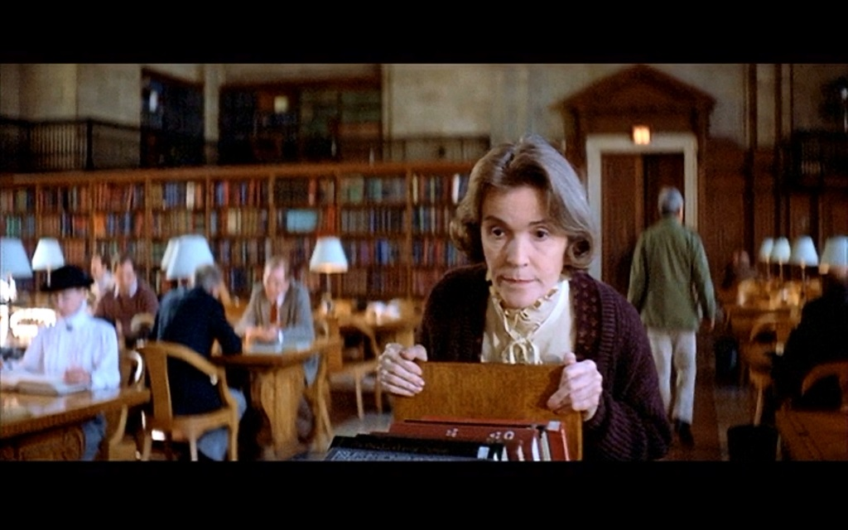
Notes:
Audience participation! Who are these people? (Giles from Buffy, Librarian from Ghostbusters, Librarian from Indiana Jones and the Last Crusade)
What do they all have in common? They fulfill the stereotype of what it means to be a librarian.
What is the stereotype of the library?
How do the stereotypes effect our patrons? Especially vulnerable populations, like those with disabilities?

Slide 3
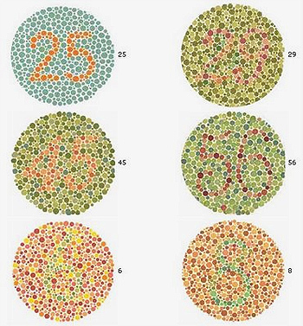
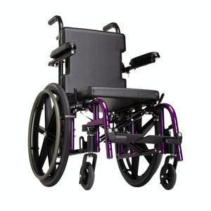
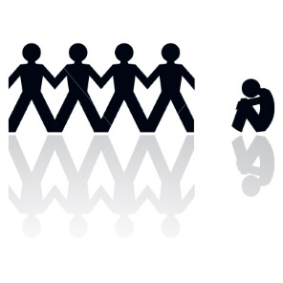
What is disability?
Lenn, K. (1996). Library services to disabled students: Outreach and education. The Reference Librarian, 25(53), 13-25.
Notes:
Perceptions of disability used to focus on the physical.
Greater awareness of mental health concerns as a disability
Especially true for the library which has focused on physical accessibility

Slide 4
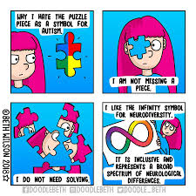
Notes:
Beth Wilson - Artist

Slide 5
Why might we need laws about disability rights?
“Deviant” and disabled people were forcefully sterilized in an eugenics program in North Carolina until 1978.
Ben-Moshe and Magana (2014), “An Introduction to Race, Gender and Disability: Intersectionality, Disability Studies, and Families of Color”. Women, Gender, and Families of Color.
Notes:
Have we come much further than that?

Slide 6
American Disabilities Act of 1990
“Physical, sensory, mental, and emotional disabilities are all covered by the ADA. A mental impairment is defined by the ADA as: ‘any mental or psychological disorder, such as mental retardation, organic brain syndrome, emotional or mental illness, and specific learning disabilities.’ Thus, mental illness is recognized by the law as a disability, with the same protections as other disabilities such as paraplegia, blindness, or hearing impairment.”
Hecker, T.E. (1996). Patrons with disabilities or problem patrons. The Reference Librarian, 25(53). 5-12.
Notes:
ADA turned 25 in July 2015. Can we say that our libraries or archives accommodate all of these concerns?

Slide 7
Some Numbers
1 in 5 adults have experienced a mental illness in 2020, about 21% of the US Population
1 in 20 experienced a serious mental illness, about 5.6% of the US Population
Annual prevalence among U.S. adults, by condition:
Major Depressive Episode: 8.4% (21 million people)
Schizophrenia: <1% (estimated 1.5 million people)
Bipolar Disorder: 2.8% (estimated 7 million people)
Anxiety Disorders: 19.1% (estimated 48 million people)
Posttraumatic Stress Disorder: 3.6% (estimated 9 million people)
Obsessive Compulsive Disorder: 1.2% (estimated 3 million people)
Borderline Personality Disorder: 1.4% (estimated 3.5 million people)
Notes:
Mental health issues is a more serious issue than people realize.
It’s an issue that is more prevalent than people understand.
https://www.nami.org/mhstats

Slide 8
Prevalence of mental illness among US Adults, by demographic group
Non-Hispanic Asian: 13.9%
Non-Hispanic white: 22.6%
Non-Hispanic black or African-American: 17.3%
Non-Hispanic American Indian or Alaska Native: 18.7%
Non-Hispanic mixed/multiracial: 35.8%
Non-Hispanic Native Hawaiian or Other Pacific Islander: 16.6%
Hispanic or Latino: 18.4%
Lesbian, Gay or Bisexual: 47.4%
Notes:
https://www.nami.org/mhstats

Slide 9
What is the average time between onset of a mental disorder and seeking assistance?
About 10 YEARS
Notes:
Any guesses about the length of time?
Why do you think this is the case?
The effect on libraries is substantial because we often see the severely mentally ill in our libraries.
We more often than not don’t have training to work with this population.
So what does a mental disability look like?
https://www.nami.org/mhstats

Slide 10
Why do people wait so long?

Slide 11
A few words on language
People first
Handicap vs. Disabled vs. Functionally Diverse vs. Diversability
Notes:
A person with a disability not a disabled person.
Handicapped – older term that centers the point of view on how the person is deficient
Disabled – A more politically correct word but still centers the point of view on how the person is different from others
Functionally Diverse – more inclusive and centers the point of view as a part of a population and not separate from it

Slide 12
Ask Your Patrons
Heat Mapping/Behavior Mapping
Surveys
Focus Groups
Interviews
Other Usability Studies

Slide 13
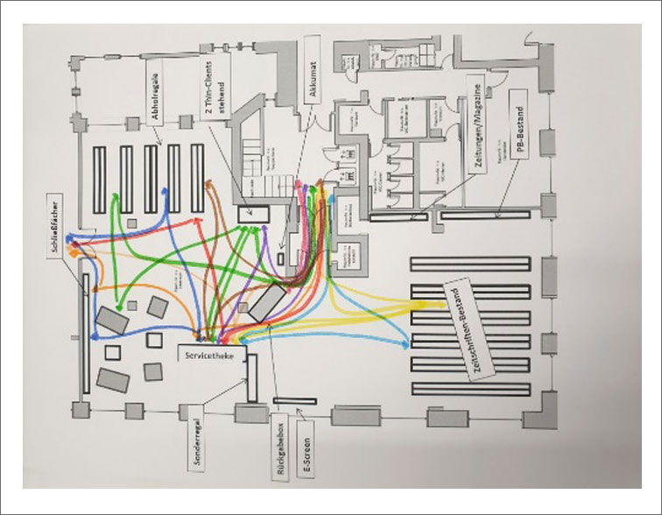
Heat Map/Behavior Map
Notes:
https://www.zbw-mediatalk.eu/2020/08/user-experience-for-libraries-the-best-tools-and-methods-for-beginners/

Slide 14
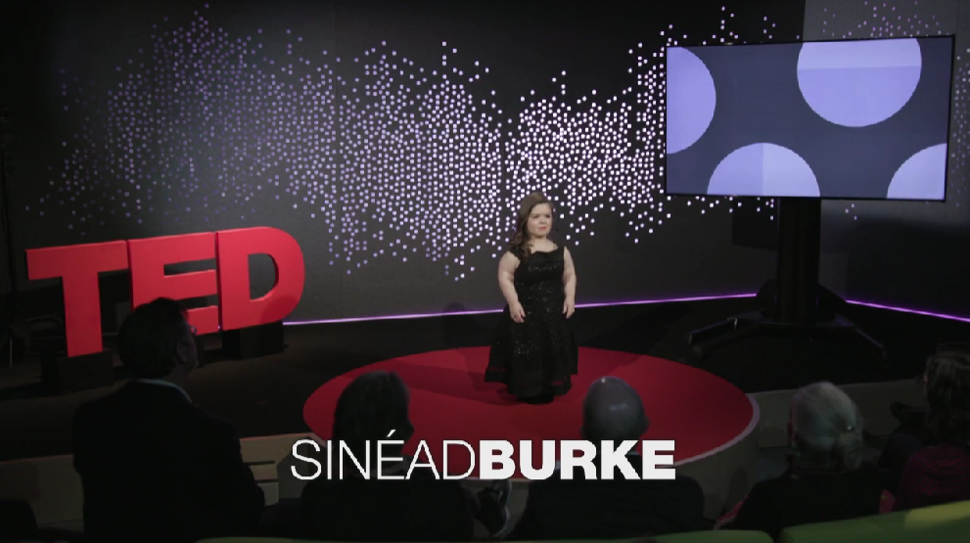
Take Perspective
TED Talk: Why Design Should Include Everyone
https://www.ted.com/talks/sinead_burke_why_design_should_include_everyone?utm_campaign=tedspread&utm_medium=referral&utm_source=tedcomshare

Slide 15
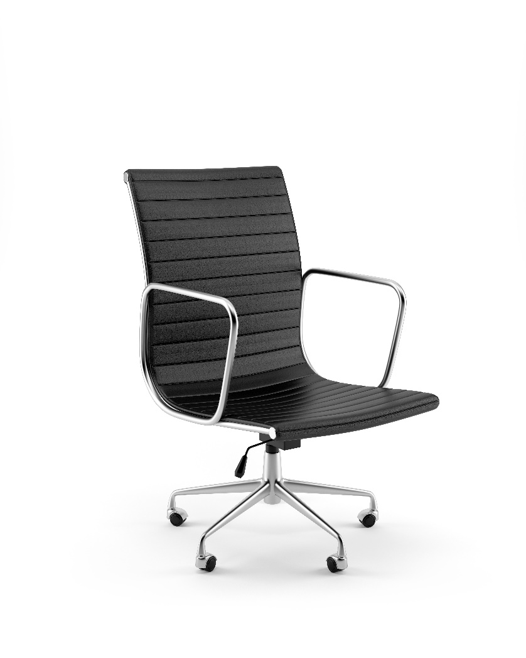
Perspective Exercise

Slide 16
Works Cited - Statistics
Mental Health Association of Maryland, Missouri Department of Mental Health, and National Council for Behavioral Health. (2013). Mental Health First Aid USA, Revised First Edition.
https://www.nami.org/mhstats
National Alliance on Mental Illness. “Press Release – Veteran Resources” http://www.nami.org/Press-Media/Press-Releases/2007/NAMI-Launches-Veterans-Resource-Center-on-Mental-H

Slide 17
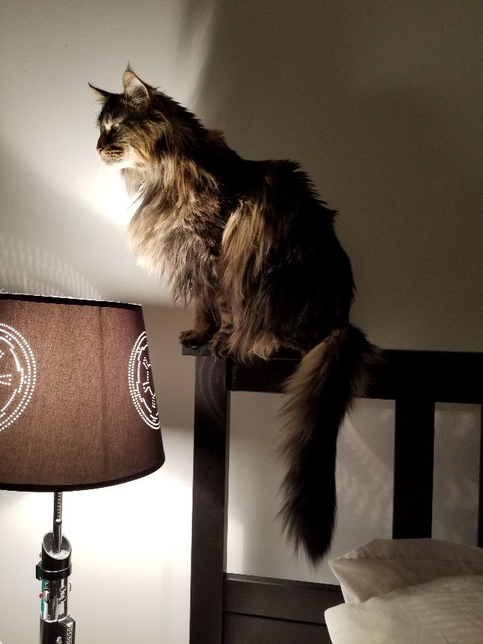
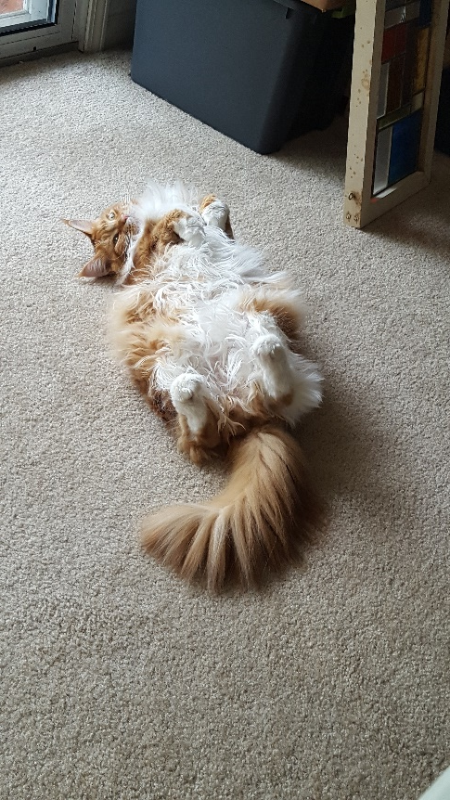
Thank you! (Gratuitous Cat Pictures) Questions? Pionke@Illinois.edu
Aiden (Wookie)
Savil (FluffMuffin)

